Slide 1
Analysis Results from Folder - Battery_6

Slide 2
Analysis Results:
Metric | Value
Date and Time | 19/03/2024 17:08:27 to 19/03/2024 18:53:29
Byte Beam ID | 3
Total time taken for the ride | 0 days 01:45:02.271000
Actual Ampere-hours (Ah) | 30.756723333333337
Actual Watt-hours (Wh)- Calculated_UsingFormala | 1580.484200687778
Starting SoC (Ah) | 8.507
Ending SoC (Ah) | 39.446
Starting SoC (%) | 99.0
Ending SoC (%) | 21.0
Total distance covered (km) | 47.1116906664707
Total energy consumption(WH/KM) | 33.54760099519429
Total SOC consumed(%) | 78.0
Mode | Sports mode 85.76% Eco mode 9.38%

Slide 3
Analysis Results:
Metric | Value
Peak Power(kW) | 5580.273014
Average Power(kW) | 907.5997962156645
Total Energy Regenerated(kWh) | 135.43471635444445
Regenerative Effectiveness(%) | 7.892838933665764
Highest Cell Voltage(V) | 3.449
Lowest Cell Voltage(V) | 3.067
Difference in Cell Voltage(V) | 0.3819999999999997
Minimum Temperature(C) | 37.0
Maximum Temperature(C) | 47.0
Difference in Temperature(C) | 10.0
Maximum Fet Temperature-BMS(C) | 72.0
Maximum Afe Temperature-BMS(C) | 68.0
Maximum PCB Temperature-BMS(C) | 67.0

Slide 4
Analysis Results:
Metric | Value
Maximum MCU Temperature(C) | 50.0
Maximum Motor Temperature(C) | 0.0
Abnormal Motor Temperature Detected(C) | False
highest cell temp(C) | 47.0
lowest cell temp(C) | 37.0
Difference between Highest and Lowest Cell Temperature at 100% SOC(C) | 10.0
Battery Voltage(V) | 56.0
Total energy charged(kWh)- Calculated_BatteryData | 1.722376506666667
Electricity consumption units(kW) | 7.591842566145963e-08
Cycle Count of battery | 146.0
Idling time percentage | 17.82876559523605
Time spent in 0-10 km/h | 12.807399907329547
Time spent in 10-20 km/h | 9.196684457105594

Slide 5
Analysis Results:
Metric | Value
Time spent in 20-30 km/h | 10.696572909337407
Time spent in 30-40 km/h | 18.245782636302792
Time spent in 40-50 km/h | 16.24821952600779
Time spent in 50-60 km/h | 11.163357416210465
Time spent in 60-70 km/h | 3.5369223112697563
Time spent in 70-80 km/h | 0.0
Time spent in 80-90 km/h | 0.0

Slide 6
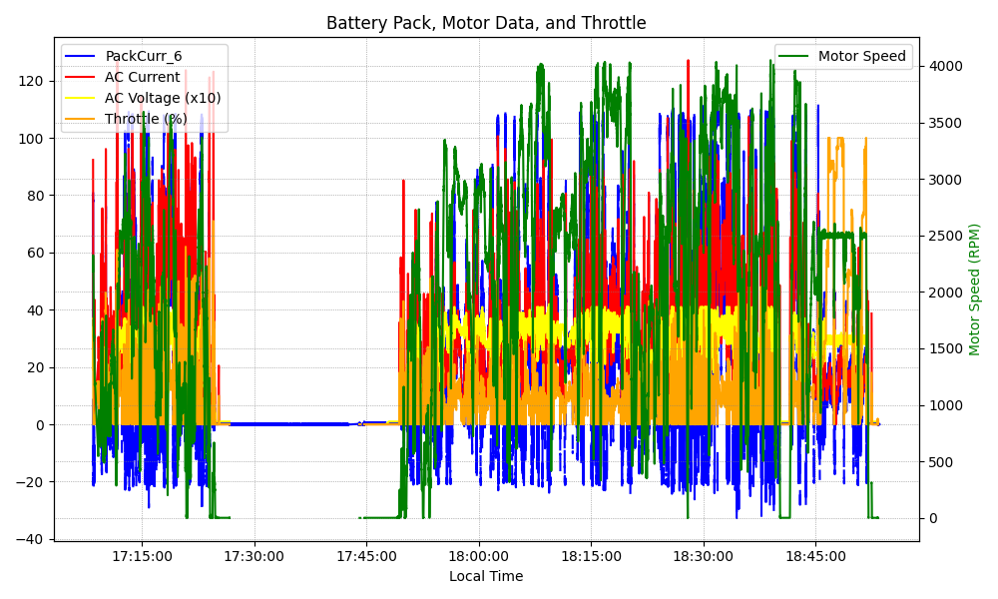
Graph Analysis

