Slide 1
Analysis Results from Folder - Battery_7

Slide 2
Analysis Results:
Metric | Value
Date and Time | 19/03/2024 18:55:06 to 19/03/2024 20:05:19
Byte Beam ID | 3
Total time taken for the ride | 0 days 01:10:12.170000
Actual Ampere-hours (Ah) | 28.61986111111111
Actual Watt-hours (Wh)- Calculated_UsingFormala | 1473.1746271547222
Starting SoC (Ah) | 7.749
Ending SoC (Ah) | 36.403
Starting SoC (%) | 91.0
Ending SoC (%) | 19.0
Total distance covered (km) | 42.19573410620048
Total energy consumption(WH/KM) | 34.91288061127121
Total SOC consumed(%) | 72.0
Mode | Sports mode 81.61% Eco mode 18.27% Custom mode 0.05%

Slide 3
Analysis Results:
Metric | Value
Peak Power(kW) | 5645.07254
Average Power(kW) | 1264.8291575857381
Total Energy Regenerated(kWh) | 115.77358486666668
Regenerative Effectiveness(%) | 7.286177358756374
Highest Cell Voltage(V) | 3.429
Lowest Cell Voltage(V) | 3.096
Difference in Cell Voltage(V) | 0.33299999999999974
Minimum Temperature(C) | 34.0
Maximum Temperature(C) | 44.0
Difference in Temperature(C) | 10.0
Maximum Fet Temperature-BMS(C) | 63.0
Maximum Afe Temperature-BMS(C) | 60.0
Maximum PCB Temperature-BMS(C) | 57.0

Slide 4
Analysis Results:
Metric | Value
Maximum MCU Temperature(C) | 47.0
Maximum Motor Temperature(C) | 0.0
Abnormal Motor Temperature Detected(C) | False
highest cell temp(C) | 44.0
lowest cell temp(C) | 34.0
Difference between Highest and Lowest Cell Temperature at 100% SOC(C) | 10.0
Battery Voltage(V) | 74.0
Total energy charged(kWh)- Calculated_BatteryData | 2.1178697222222223
Electricity consumption units(kW) | 1.3967168686175886e-07
Cycle Count of battery | 147.0
Idling time percentage | 4.107087748174056
Time spent in 0-10 km/h | 5.5344100401193295
Time spent in 10-20 km/h | 9.538627713198231

Slide 5
Analysis Results:
Metric | Value
Time spent in 20-30 km/h | 14.78242979117375
Time spent in 30-40 km/h | 26.437609299454788
Time spent in 40-50 km/h | 18.24143606624833
Time spent in 50-60 km/h | 15.679971196378972
Time spent in 60-70 km/h | 5.480403250694374
Time spent in 70-80 km/h | 0.0
Time spent in 80-90 km/h | 0.0

Slide 6
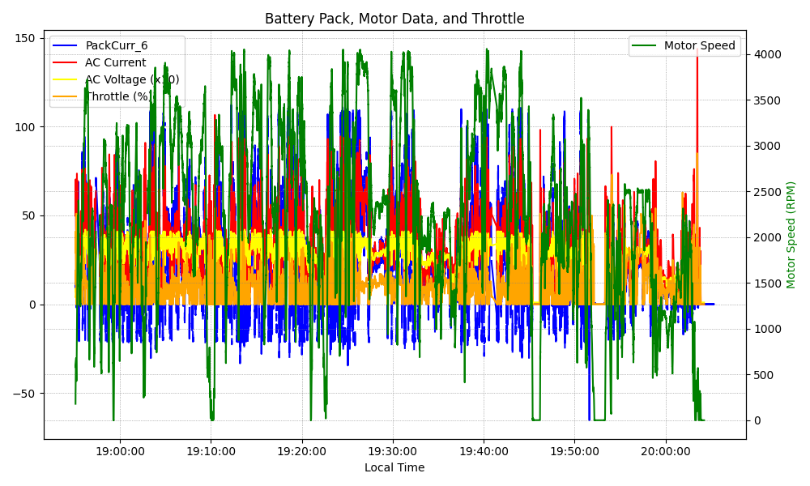
Graph Analysis

