Slide 1
Analysis Results from Folder - Battery_8

Slide 2
Analysis Results:
Metric | Value
Date and Time | 19/03/2024 20:06:30 to 19/03/2024 21:20:38
Byte Beam ID | 3
Total time taken for the ride | 0 days 01:14:07.913000
Actual Ampere-hours (Ah) | 32.1451475
Actual Watt-hours (Wh)- Calculated_UsingFormala | 1648.0503417441669
Starting SoC (Ah) | 7.955
Ending SoC (Ah) | 39.6
Starting SoC (%) | 100.0
Ending SoC (%) | 20.0
Total distance covered (km) | 44.36126884315222
Total energy consumption(WH/KM) | 37.150658327000635
Total SOC consumed(%) | 80.0
Mode | Sports mode 85.03% Eco mode 12.80%

Slide 3
Analysis Results:
Metric | Value
Peak Power(kW) | 5703.639740999999
Average Power(kW) | 1338.6690501532041
Total Energy Regenerated(kWh) | 123.05918225944446
Regenerative Effectiveness(%) | 6.948140732780201
Highest Cell Voltage(V) | 3.545
Lowest Cell Voltage(V) | 3.074
Difference in Cell Voltage(V) | 0.4710000000000001
Minimum Temperature(C) | 35.0
Maximum Temperature(C) | 48.0
Difference in Temperature(C) | 13.0
Maximum Fet Temperature-BMS(C) | 70.0
Maximum Afe Temperature-BMS(C) | 67.0
Maximum PCB Temperature-BMS(C) | 64.0

Slide 4
Analysis Results:
Metric | Value
Maximum MCU Temperature(C) | 48.0
Maximum Motor Temperature(C) | 0.0
Abnormal Motor Temperature Detected(C) | True
highest cell temp(C) | 48.0
lowest cell temp(C) | -54.0
Difference between Highest and Lowest Cell Temperature at 100% SOC(C) | 102.0
Battery Voltage(V) | 90.0
Total energy charged(kWh)- Calculated_BatteryData | 2.893063275
Electricity consumption units(kW) | 1.8071254497413985e-07
Cycle Count of battery | 55.0
Idling time percentage | 4.153846153846154
Time spent in 0-10 km/h | 9.235653235653235
Time spent in 10-20 km/h | 7.218559218559219

Slide 5
Analysis Results:
Metric | Value
Time spent in 20-30 km/h | 12.454212454212454
Time spent in 30-40 km/h | 22.639804639804638
Time spent in 40-50 km/h | 23.902319902319903
Time spent in 50-60 km/h | 13.206349206349207
Time spent in 60-70 km/h | 7.010989010989011
Time spent in 70-80 km/h | 0.0
Time spent in 80-90 km/h | 0.0

Slide 6
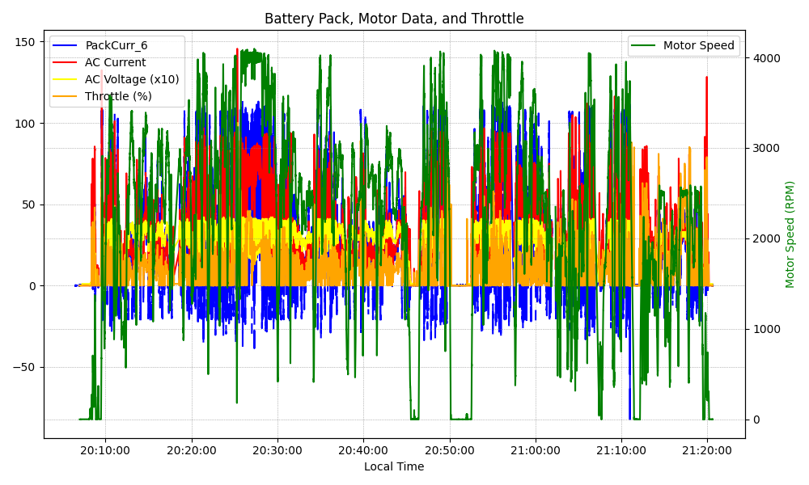
Graph Analysis

