Slide 1
Analysis Results from Folder - Battery_1

Slide 2
Analysis Results:
Metric | Value
Date and Time | 20/03/2024 08:27:30 to 20/03/2024 09:51:36
Byte Beam ID | 3
Total time taken for the ride | 0 days 01:24:05.527000
Actual Ampere-hours (Ah) | 30.04146527777778
Actual Watt-hours (Wh)- Calculated_UsingFormala | 1533.907527639722
Starting SoC (Ah) | 10.235
Ending SoC (Ah) | 39.379
Starting SoC (%) | 99.0
Ending SoC (%) | 25.0
Total distance covered (km) | 39.800457898464956
Total energy consumption(WH/KM) | 38.53994674013242
Total SOC consumed(%) | 74.0
Mode | Sports mode 97.47% Eco mode 1.03%

Slide 3
Analysis Results:
Metric | Value
Peak Power(kW) | 5615.1491399999995
Average Power(kW) | 1098.9188257717412
Total Energy Regenerated(kWh) | 83.77130618722224
Regenerative Effectiveness(%) | 5.178488117387577
Highest Cell Voltage(V) | 3.401
Lowest Cell Voltage(V) | 3.062
Difference in Cell Voltage(V) | 0.33899999999999997
Minimum Temperature(C) | 25.0
Maximum Temperature(C) | 37.0
Difference in Temperature(C) | 12.0
Maximum Fet Temperature-BMS(C) | 54.0
Maximum Afe Temperature-BMS(C) | 53.0
Maximum PCB Temperature-BMS(C) | 51.0

Slide 4
Analysis Results:
Metric | Value
Maximum MCU Temperature(C) | 44.0
Maximum Motor Temperature(C) | 0.0
Abnormal Motor Temperature Detected(C) | True
highest cell temp(C) | 37.0
lowest cell temp(C) | 25.0
Difference between Highest and Lowest Cell Temperature at 100% SOC(C) | 12.0
Battery Voltage(V) | 55.0
Total energy charged(kWh)- Calculated_BatteryData | 1.652280590277778
Electricity consumption units(kW) | 9.097459477358099e-08
Cycle Count of battery | 56.0
Idling time percentage | 20.855553775377082
Time spent in 0-10 km/h | 5.104026000778193
Time spent in 10-20 km/h | 4.813348286832529

Slide 5
Analysis Results:
Metric | Value
Time spent in 20-30 km/h | 11.219701998123183
Time spent in 30-40 km/h | 15.27545718797922
Time spent in 40-50 km/h | 15.653109336018858
Time spent in 50-60 km/h | 20.047607058661967
Time spent in 60-70 km/h | 6.919045112265684
Time spent in 70-80 km/h | 0.0
Time spent in 80-90 km/h | 0.0

Slide 6
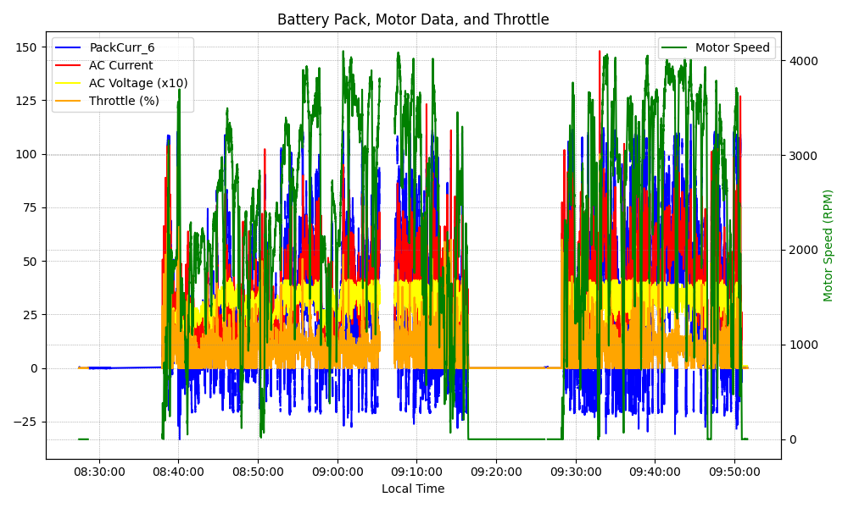
Graph Analysis

