Slide 1
Analysis Results from Folder - Battery_2

Slide 2
Analysis Results:
Metric | Value
Date and Time | 20/03/2024 09:53:09 to 20/03/2024 10:51:14
Byte Beam ID | 3
Total time taken for the ride | 0 days 00:58:04.402000
Actual Ampere-hours (Ah) | 25.375939166666665
Actual Watt-hours (Wh)- Calculated_UsingFormala | 1295.1145328502778
Starting SoC (Ah) | 10.474
Ending SoC (Ah) | 36.15
Starting SoC (%) | 91.0
Ending SoC (%) | 26.0
Total distance covered (km) | 32.95821071780162
Total energy consumption(WH/KM) | 39.29565667078982
Total SOC consumed(%) | 65.0
Mode | Sports mode 99.88%

Slide 3
Analysis Results:
Metric | Value
Peak Power(kW) | 5488.016468000001
Average Power(kW) | 1344.7973228327085
Total Energy Regenerated(kWh) | 67.29445844916667
Regenerative Effectiveness(%) | 4.939372749219915
Highest Cell Voltage(V) | 3.382
Lowest Cell Voltage(V) | 3.069
Difference in Cell Voltage(V) | 0.31300000000000017
Minimum Temperature(C) | 23.0
Maximum Temperature(C) | 38.0
Difference in Temperature(C) | 15.0
Maximum Fet Temperature-BMS(C) | 60.0
Maximum Afe Temperature-BMS(C) | 57.0
Maximum PCB Temperature-BMS(C) | 54.0

Slide 4
Analysis Results:
Metric | Value
Maximum MCU Temperature(C) | 49.0
Maximum Motor Temperature(C) | 0.0
Abnormal Motor Temperature Detected(C) | False
highest cell temp(C) | 38.0
lowest cell temp(C) | 6.0
Difference between Highest and Lowest Cell Temperature at 100% SOC(C) | 32.0
Battery Voltage(V) | 55.0
Total energy charged(kWh)- Calculated_BatteryData | 1.3956766541666665
Electricity consumption units(kW) | 1.1127668182857081e-07
Cycle Count of battery | 148.0
Idling time percentage | 25.343154752247138
Time spent in 0-10 km/h | 5.574845053055132
Time spent in 10-20 km/h | 3.653827432910407

Slide 5
Analysis Results:
Metric | Value
Time spent in 20-30 km/h | 6.976668721809391
Time spent in 30-40 km/h | 7.2330207353084335
Time spent in 40-50 km/h | 10.841418697472175
Time spent in 50-60 km/h | 31.27494564688321
Time spent in 60-70 km/h | 8.92689100171983
Time spent in 70-80 km/h | 0.0
Time spent in 80-90 km/h | 0.0

Slide 6
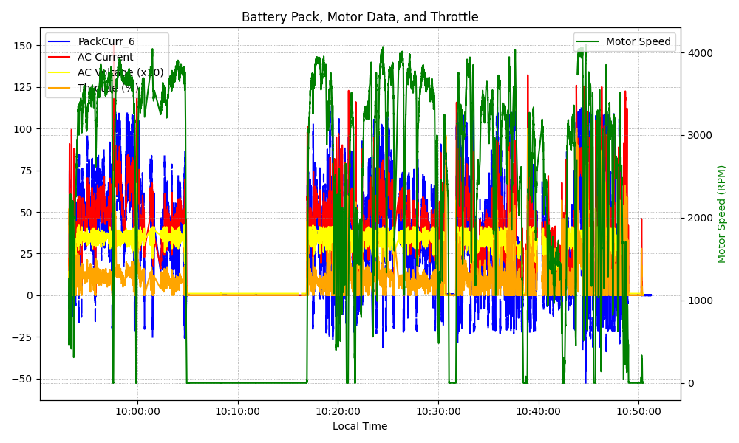
Graph Analysis

