Slide 1
Analysis Results from Folder - Battery_3

Slide 2
Analysis Results:
Metric | Value
Date and Time | 20/03/2024 11:06:08 to 20/03/2024 11:34:12
Byte Beam ID | 3
Total time taken for the ride | 0 days 00:28:04.062000
Actual Ampere-hours (Ah) | 15.776625833333334
Actual Watt-hours (Wh)- Calculated_UsingFormala | 803.8514303622221
Starting SoC (Ah) | 12.132
Ending SoC (Ah) | 39.514
Starting SoC (%) | 100.0
Ending SoC (%) | 30.0
Total distance covered (km) | 19.53816644162543
Total energy consumption(WH/KM) | 41.14262373411062
Total SOC consumed(%) | 70.0
Mode | Sports mode 90.04% Eco mode 0.49%

Slide 3
Analysis Results:
Metric | Value
Peak Power(kW) | 5580.949868000001
Average Power(kW) | 1724.5918649010725
Total Energy Regenerated(kWh) | 48.55470917638889
Regenerative Effectiveness(%) | 5.696194211209049
Highest Cell Voltage(V) | 3.436
Lowest Cell Voltage(V) | 3.089
Difference in Cell Voltage(V) | 0.347
Minimum Temperature(C) | 29.0
Maximum Temperature(C) | 40.0
Difference in Temperature(C) | 11.0
Maximum Fet Temperature-BMS(C) | 66.0
Maximum Afe Temperature-BMS(C) | 63.0
Maximum PCB Temperature-BMS(C) | 61.0

Slide 4
Analysis Results:
Metric | Value
Maximum MCU Temperature(C) | 52.0
Maximum Motor Temperature(C) | 0.0
Abnormal Motor Temperature Detected(C) | False
highest cell temp(C) | 40.0
lowest cell temp(C) | -18.0
Difference between Highest and Lowest Cell Temperature at 100% SOC(C) | 58.0
Battery Voltage(V) | 56.0
Total energy charged(kWh)- Calculated_BatteryData | 0.8834910466666668
Electricity consumption units(kW) | 1.4573288576581335e-07
Cycle Count of battery | 126.0
Idling time percentage | 12.903445458259565
Time spent in 0-10 km/h | 3.8540106223614328
Time spent in 10-20 km/h | 6.019338145172273

Slide 5
Analysis Results:
Metric | Value
Time spent in 20-30 km/h | 6.032956557265424
Time spent in 30-40 km/h | 8.845158654500885
Time spent in 40-50 km/h | 14.204003813155385
Time spent in 50-60 km/h | 18.201007762494893
Time spent in 60-70 km/h | 29.803894865858645
Time spent in 70-80 km/h | 0.0
Time spent in 80-90 km/h | 0.0

Slide 6
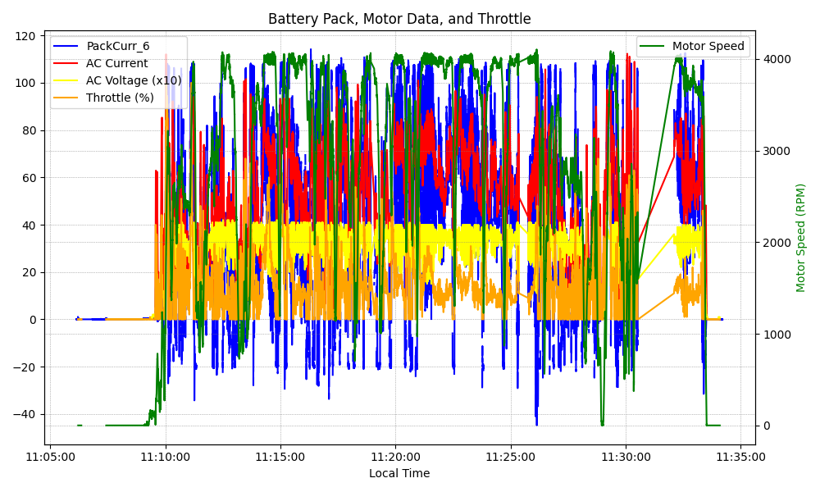
Graph Analysis

