Slide 1
Analysis Results from Folder - Battery_4

Slide 2
Analysis Results:
Metric | Value
Date and Time | 20/03/2024 11:35:46 to 20/03/2024 12:16:04
Byte Beam ID | 3
Total time taken for the ride | 0 days 00:40:18.098000
Actual Ampere-hours (Ah) | 25.423989722222224
Actual Watt-hours (Wh)- Calculated_UsingFormala | 1295.9266356316666
Starting SoC (Ah) | 13.084
Ending SoC (Ah) | 39.097
Starting SoC (%) | 98.0
Ending SoC (%) | 33.0
Total distance covered (km) | 32.53131099445334
Total energy consumption(WH/KM) | 39.83628682694727
Total SOC consumed(%) | 65.0
Mode | Sports mode 94.15% Eco mode 0.33% Custom mode 0.21%

Slide 3
Analysis Results:
Metric | Value
Peak Power(kW) | 5698.53834
Average Power(kW) | 1941.4631245418227
Total Energy Regenerated(kWh) | 66.62743962805555
Regenerative Effectiveness(%) | 4.889893240776915
Highest Cell Voltage(V) | 3.313
Lowest Cell Voltage(V) | 3.091
Difference in Cell Voltage(V) | 0.22199999999999998
Minimum Temperature(C) | 29.0
Maximum Temperature(C) | 42.0
Difference in Temperature(C) | 13.0
Maximum Fet Temperature-BMS(C) | 71.0
Maximum Afe Temperature-BMS(C) | 68.0
Maximum PCB Temperature-BMS(C) | 68.0

Slide 4
Analysis Results:
Metric | Value
Maximum MCU Temperature(C) | 57.0
Maximum Motor Temperature(C) | 0.0
Abnormal Motor Temperature Detected(C) | True
highest cell temp(C) | 42.0
lowest cell temp(C) | 29.0
Difference between Highest and Lowest Cell Temperature at 100% SOC(C) | 13.0
Battery Voltage(V) | 54.0
Total energy charged(kWh)- Calculated_BatteryData | 1.3728954450000002
Electricity consumption units(kW) | 1.5771705783016268e-07
Cycle Count of battery | 127.0
Idling time percentage | 2.6782862618059045
Time spent in 0-10 km/h | 5.041748414472784
Time spent in 10-20 km/h | 4.822740338549984

Slide 5
Analysis Results:
Metric | Value
Time spent in 20-30 km/h | 5.949719395902724
Time spent in 30-40 km/h | 8.568690970479537
Time spent in 40-50 km/h | 12.652279052790071
Time spent in 50-60 km/h | 29.100698088242005
Time spent in 60-70 km/h | 31.094584112789157
Time spent in 70-80 km/h | 0.0
Time spent in 80-90 km/h | 0.0

Slide 6
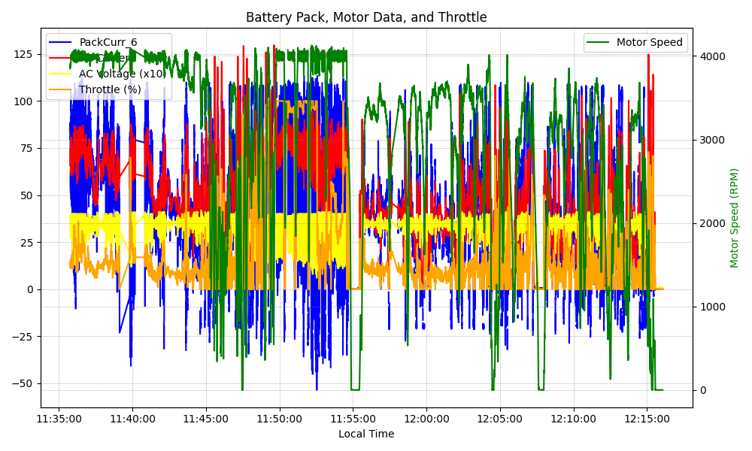
Graph Analysis

