Slide 1
Analysis Results from Folder - Battery_1

Slide 2
Analysis Results:
Metric | Value
Date and Time | 21/03/2024 05:56:58 to 21/03/2024 06:53:07
Byte Beam ID | 3
Total time taken for the ride | 0 days 00:56:09
Actual Ampere-hours (Ah) | 28.905608888888892
Actual Watt-hours (Wh)- Calculated_UsingFormala | 1483.2168524175
Starting SoC (Ah) | 10.229
Ending SoC (Ah) | 39.303
Starting SoC (%) | 99.0
Ending SoC (%) | 25.0
Total distance covered (km) | 43.608419551132016
Total energy consumption(WH/KM) | 34.01216709260443
Total SOC consumed(%) | 74.0
Mode | Sports mode 96.49% Eco mode 2.65%

Slide 3
Analysis Results:
Metric | Value
Peak Power(kW) | 5535.171768
Average Power(kW) | 1595.3333339417388
Total Energy Regenerated(kWh) | 27.415748898888893
Regenerative Effectiveness(%) | 1.8148521933790105
Highest Cell Voltage(V) | 3.385
Lowest Cell Voltage(V) | 3.093
Difference in Cell Voltage(V) | 0.2919999999999998
Minimum Temperature(C) | 27.0
Maximum Temperature(C) | 35.0
Difference in Temperature(C) | 8.0
Maximum Fet Temperature-BMS(C) | 46.0
Maximum Afe Temperature-BMS(C) | 46.0
Maximum PCB Temperature-BMS(C) | 44.0

Slide 4
Analysis Results:
Metric | Value
Maximum MCU Temperature(C) | 31.0
Maximum Motor Temperature(C) | 0.0
Abnormal Motor Temperature Detected(C) | False
highest cell temp(C) | 35.0
lowest cell temp(C) | 27.0
Difference between Highest and Lowest Cell Temperature at 100% SOC(C) | 8.0
Battery Voltage(V) | 76.0
Total energy charged(kWh)- Calculated_BatteryData | 2.1968262755555554
Electricity consumption units(kW) | 1.8113075719431711e-07
Cycle Count of battery | 57.0
Idling time percentage | 2.976281795587739
Time spent in 0-10 km/h | 3.203338344941855
Time spent in 10-20 km/h | 1.7366757693841859

Slide 5
Analysis Results:
Metric | Value
Time spent in 20-30 km/h | 2.221472185572704
Time spent in 30-40 km/h | 3.4580098800282286
Time spent in 40-50 km/h | 7.738332668528121
Time spent in 50-60 km/h | 77.89573808720199
Time spent in 60-70 km/h | 0.6934429750544628
Time spent in 70-80 km/h | 0.0
Time spent in 80-90 km/h | 0.0

Slide 6
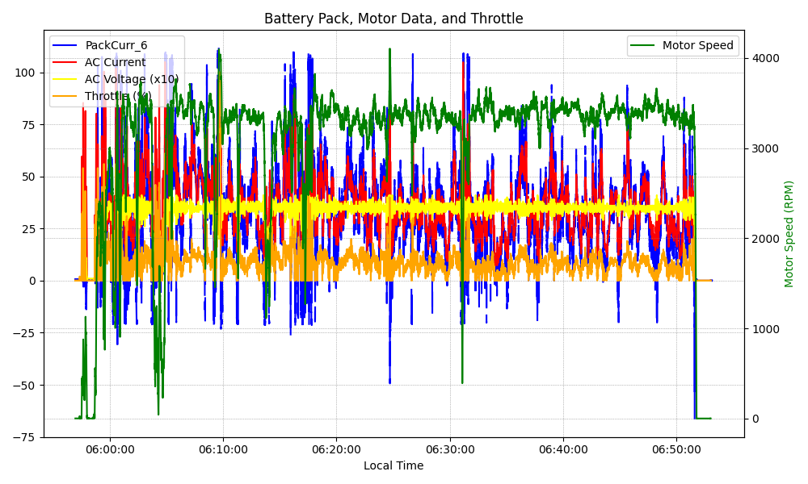
Graph Analysis

