Slide 1
Analysis Results from Folder - Battery_2

Slide 2
Analysis Results:
Metric | Value
Date and Time | 21/03/2024 06:54:46 to 21/03/2024 07:51:59
Byte Beam ID | 3
Total time taken for the ride | 0 days 00:57:13.651000
Actual Ampere-hours (Ah) | 29.34302111111111
Actual Watt-hours (Wh)- Calculated_UsingFormala | 1502.8085687505554
Starting SoC (Ah) | 10.474
Ending SoC (Ah) | 39.416
Starting SoC (%) | 99.0
Ending SoC (%) | 26.0
Total distance covered (km) | 42.90857223770504
Total energy consumption(WH/KM) | 35.023504404324896
Total SOC consumed(%) | 73.0
Mode | Sports mode 99.47% Eco mode 0.09%

Slide 3
Analysis Results:
Metric | Value
Peak Power(kW) | 5412.7966
Average Power(kW) | 1586.0776451193199
Total Energy Regenerated(kWh) | 8.844194883055556
Regenerative Effectiveness(%) | 0.5850678870057741
Highest Cell Voltage(V) | 3.404
Lowest Cell Voltage(V) | 3.069
Difference in Cell Voltage(V) | 0.33499999999999996
Minimum Temperature(C) | 25.0
Maximum Temperature(C) | 35.0
Difference in Temperature(C) | 10.0
Maximum Fet Temperature-BMS(C) | 51.0
Maximum Afe Temperature-BMS(C) | 52.0
Maximum PCB Temperature-BMS(C) | 50.0

Slide 4
Analysis Results:
Metric | Value
Maximum MCU Temperature(C) | 36.0
Maximum Motor Temperature(C) | 0.0
Abnormal Motor Temperature Detected(C) | False
highest cell temp(C) | 35.0
lowest cell temp(C) | 25.0
Difference between Highest and Lowest Cell Temperature at 100% SOC(C) | 10.0
Battery Voltage(V) | 55.0
Total energy charged(kWh)- Calculated_BatteryData | 1.6138661611111111
Electricity consumption units(kW) | 1.305843739773369e-07
Cycle Count of battery | 55.0
Idling time percentage | 16.241389347045697
Time spent in 0-10 km/h | 2.962388021085993
Time spent in 10-20 km/h | 1.076938003298729

Slide 5
Analysis Results:
Metric | Value
Time spent in 20-30 km/h | 0.527149833446525
Time spent in 30-40 km/h | 0.43336243976585487
Time spent in 40-50 km/h | 4.682901587917597
Time spent in 50-60 km/h | 73.91093431648395
Time spent in 60-70 km/h | 0.1261278742602115
Time spent in 70-80 km/h | 0.0
Time spent in 80-90 km/h | 0.0

Slide 6
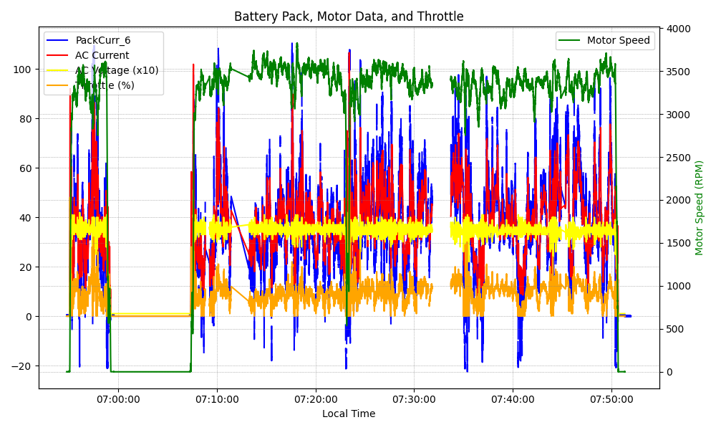
Graph Analysis

