Slide 1
Analysis Results from Folder - Battery_3

Slide 2
Analysis Results:
Metric | Value
Date and Time | 21/03/2024 08:01:25 to 21/03/2024 08:54:33
Byte Beam ID | 3
Total time taken for the ride | 0 days 00:53:08.510000
Actual Ampere-hours (Ah) | 27.822537500000003
Actual Watt-hours (Wh)- Calculated_UsingFormala | 1420.4536295816667
Starting SoC (Ah) | 12.246
Ending SoC (Ah) | 39.431
Starting SoC (%) | 99.0
Ending SoC (%) | 30.0
Total distance covered (km) | 38.95818584323218
Total energy consumption(WH/KM) | 36.460979864349305
Total SOC consumed(%) | 69.0
Mode | Sports mode 97.54% Eco mode 0.20%

Slide 3
Analysis Results:
Metric | Value
Peak Power(kW) | 5544.71676
Average Power(kW) | 1611.1005250453686
Total Energy Regenerated(kWh) | 72.72561036333332
Regenerative Effectiveness(%) | 4.87052112819437
Highest Cell Voltage(V) | 3.377
Lowest Cell Voltage(V) | 3.074
Difference in Cell Voltage(V) | 0.30299999999999994
Minimum Temperature(C) | 25.0
Maximum Temperature(C) | 37.0
Difference in Temperature(C) | 12.0
Maximum Fet Temperature-BMS(C) | 58.0
Maximum Afe Temperature-BMS(C) | 57.0
Maximum PCB Temperature-BMS(C) | 56.0

Slide 4
Analysis Results:
Metric | Value
Maximum MCU Temperature(C) | 42.0
Maximum Motor Temperature(C) | 0.0
Abnormal Motor Temperature Detected(C) | True
highest cell temp(C) | 37.0
lowest cell temp(C) | 25.0
Difference between Highest and Lowest Cell Temperature at 100% SOC(C) | 12.0
Battery Voltage(V) | 55.0
Total energy charged(kWh)- Calculated_BatteryData | 1.5302395625
Electricity consumption units(kW) | 1.3333329521295134e-07
Cycle Count of battery | 129.0
Idling time percentage | 12.168711191882478
Time spent in 0-10 km/h | 4.357867635923066
Time spent in 10-20 km/h | 4.721338785400576

Slide 5
Analysis Results:
Metric | Value
Time spent in 20-30 km/h | 5.00530062092988
Time spent in 30-40 km/h | 6.671210056035136
Time spent in 40-50 km/h | 6.852945630773891
Time spent in 50-60 km/h | 55.364985612600336
Time spent in 60-70 km/h | 4.728911101014691
Time spent in 70-80 km/h | 0.0
Time spent in 80-90 km/h | 0.0

Slide 6
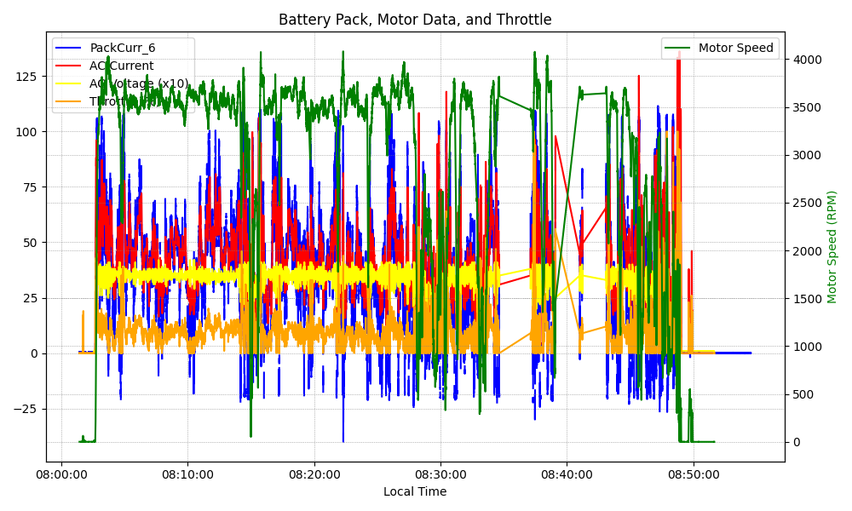
Graph Analysis

