Slide 1
Analysis Results from Folder - Battery_4

Slide 2
Analysis Results:
Metric | Value
Date and Time | 21/03/2024 11:08:01 to 21/03/2024 11:50:59
Byte Beam ID | 3
Total time taken for the ride | 0 days 00:42:58.943000
Actual Ampere-hours (Ah) | 21.429358055555554
Actual Watt-hours (Wh)- Calculated_UsingFormala | 1099.936830528889
Starting SoC (Ah) | 10.242
Ending SoC (Ah) | 27.904
Starting SoC (%) | 81.0
Ending SoC (%) | 25.0
Total distance covered (km) | 32.55718479301786
Total energy consumption(WH/KM) | 33.78476479221812
Total SOC consumed(%) | 56.0
Mode | Sports mode 90.72% Eco mode 0.63%

Slide 3
Analysis Results:
Metric | Value
Peak Power(kW) | 5580.2986200000005
Average Power(kW) | 1555.9027858168959
Total Energy Regenerated(kWh) | 22.56699629722222
Regenerative Effectiveness(%) | 2.010415978806112
Highest Cell Voltage(V) | 3.341
Lowest Cell Voltage(V) | 3.071
Difference in Cell Voltage(V) | 0.27
Minimum Temperature(C) | 34.0
Maximum Temperature(C) | 43.0
Difference in Temperature(C) | 9.0
Maximum Fet Temperature-BMS(C) | 62.0
Maximum Afe Temperature-BMS(C) | 61.0
Maximum PCB Temperature-BMS(C) | 60.0

Slide 4
Analysis Results:
Metric | Value
Maximum MCU Temperature(C) | 40.0
Maximum Motor Temperature(C) | 0.0
Abnormal Motor Temperature Detected(C) | False
highest cell temp(C) | 43.0
lowest cell temp(C) | 34.0
Difference between Highest and Lowest Cell Temperature at 100% SOC(C) | 9.0
Battery Voltage(V) | 55.0
Total energy charged(kWh)- Calculated_BatteryData | 1.1786146930555557
Electricity consumption units(kW) | 1.2699494580807212e-07
Cycle Count of battery | 130.0
Idling time percentage | 8.563375611373623
Time spent in 0-10 km/h | 2.2589737212965266
Time spent in 10-20 km/h | 2.926303572908895

Slide 5
Analysis Results:
Metric | Value
Time spent in 20-30 km/h | 6.358285666915362
Time spent in 30-40 km/h | 6.615269833374783
Time spent in 40-50 km/h | 9.052474508828649
Time spent in 50-60 km/h | 58.27323219762911
Time spent in 60-70 km/h | 5.869186769460334
Time spent in 70-80 km/h | 0.0
Time spent in 80-90 km/h | 0.0

Slide 6
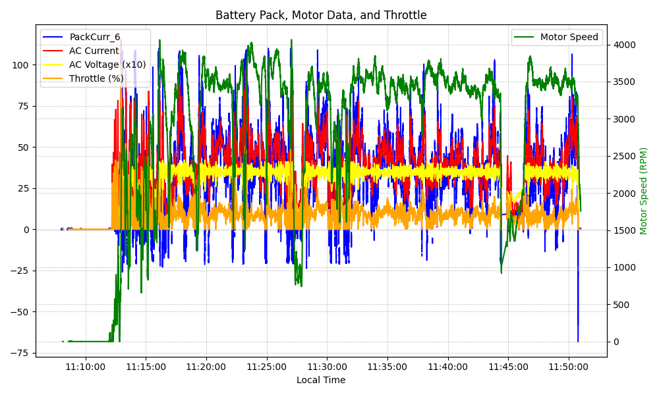
Graph Analysis

