Slide 1
Analysis Results from Folder - Battery_5

Slide 2
Analysis Results:
Metric | Value
Date and Time | 21/03/2024 11:53:32 to 21/03/2024 12:55:42
Byte Beam ID | 3
Total time taken for the ride | 0 days 01:02:10.240000
Actual Ampere-hours (Ah) | 25.111953055555553
Actual Watt-hours (Wh)- Calculated_UsingFormala | 1287.4219069266667
Starting SoC (Ah) | 11.259
Ending SoC (Ah) | 36.168
Starting SoC (%) | 91.0
Ending SoC (%) | 28.0
Total distance covered (km) | 35.1814499221004
Total energy consumption(WH/KM) | 36.59377057447339
Total SOC consumed(%) | 63.0
Mode | Sports mode 99.24% Custom mode 0.38% Eco mode 0.03%

Slide 3
Analysis Results:
Metric | Value
Peak Power(kW) | 5535.067203
Average Power(kW) | 1250.6109302928012
Total Energy Regenerated(kWh) | 56.62213962138889
Regenerative Effectiveness(%) | 4.21281875149948
Highest Cell Voltage(V) | 3.385
Lowest Cell Voltage(V) | 3.063
Difference in Cell Voltage(V) | 0.3219999999999996
Minimum Temperature(C) | -1.0
Maximum Temperature(C) | 38.0
Difference in Temperature(C) | 39.0
Maximum Fet Temperature-BMS(C) | 60.0
Maximum Afe Temperature-BMS(C) | 56.0
Maximum PCB Temperature-BMS(C) | 53.0

Slide 4
Analysis Results:
Metric | Value
Maximum MCU Temperature(C) | 50.0
Maximum Motor Temperature(C) | 0.0
Abnormal Motor Temperature Detected(C) | False
highest cell temp(C) | 38.0
lowest cell temp(C) | -7.0
Difference between Highest and Lowest Cell Temperature at 100% SOC(C) | 45.0
Battery Voltage(V) | 55.0
Total energy charged(kWh)- Calculated_BatteryData | 1.3811574180555553
Electricity consumption units(kW) | 1.0285652502647864e-07
Cycle Count of battery | 149.0
Idling time percentage | 22.766998776437685
Time spent in 0-10 km/h | 4.591271922158131
Time spent in 10-20 km/h | 5.048651168210686

Slide 5
Analysis Results:
Metric | Value
Time spent in 20-30 km/h | 7.961894773640972
Time spent in 30-40 km/h | 12.285148284099517
Time spent in 40-50 km/h | 11.973431218318476
Time spent in 50-60 km/h | 31.08430926994115
Time spent in 60-70 km/h | 4.212550253452194
Time spent in 70-80 km/h | 0.0
Time spent in 80-90 km/h | 0.0

Slide 6
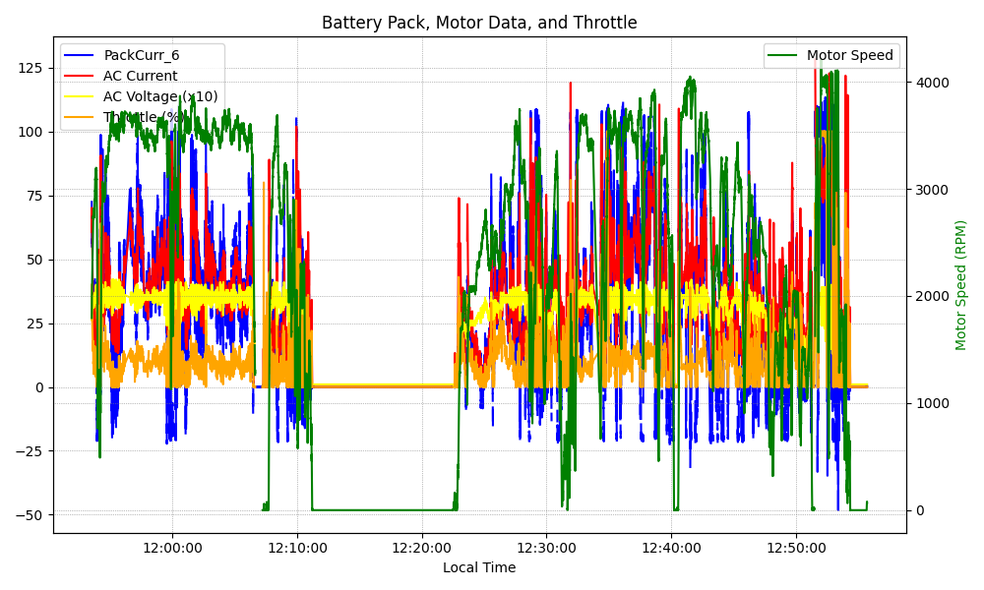
Graph Analysis

