Slide 1
Analysis Results from Folder - Battery_1

Slide 2
Analysis Results:
Metric | Value
Date and Time | 22/03/2024 05:50:56 to 22/03/2024 06:47:59
Byte Beam ID | 3
Total time taken for the ride | 0 days 00:57:02.987000
Actual Ampere-hours (Ah) | 28.975470555555553
Actual Watt-hours (Wh)- Calculated_UsingFormala | 1488.3386016430557
Starting SoC (Ah) | 10.48
Ending SoC (Ah) | 39.448
Starting SoC (%) | 99.0
Ending SoC (%) | 26.0
Total distance covered (km) | 44.271602712409475
Total energy consumption(WH/KM) | 33.61835828062013
Total SOC consumed(%) | 73.0
Mode | Sports mode 96.66% Eco mode 0.03%

Slide 3
Analysis Results:
Metric | Value
Peak Power(kW) | 5462.940862
Average Power(kW) | 1574.0361239468273
Total Energy Regenerated(kWh) | 25.471739334444443
Regenerative Effectiveness(%) | 1.6826242128850033
Highest Cell Voltage(V) | 3.385
Lowest Cell Voltage(V) | 3.085
Difference in Cell Voltage(V) | 0.2999999999999998
Minimum Temperature(C) | 28.0
Maximum Temperature(C) | 37.0
Difference in Temperature(C) | 9.0
Maximum Fet Temperature-BMS(C) | 52.0
Maximum Afe Temperature-BMS(C) | 51.0
Maximum PCB Temperature-BMS(C) | 50.0

Slide 4
Analysis Results:
Metric | Value
Maximum MCU Temperature(C) | 32.0
Maximum Motor Temperature(C) | 0.0
Abnormal Motor Temperature Detected(C) | False
highest cell temp(C) | 37.0
lowest cell temp(C) | 28.0
Difference between Highest and Lowest Cell Temperature at 100% SOC(C) | 9.0
Battery Voltage(V) | 55.0
Total energy charged(kWh)- Calculated_BatteryData | 1.5936508805555554
Electricity consumption units(kW) | 1.2936317947233226e-07
Cycle Count of battery | 132.0
Idling time percentage | 3.4992200165172975
Time spent in 0-10 km/h | 4.722723518796072
Time spent in 10-20 km/h | 1.1531520508977458

Slide 5
Analysis Results:
Metric | Value
Time spent in 20-30 km/h | 2.2390114091701587
Time spent in 30-40 km/h | 3.6399229192793565
Time spent in 40-50 km/h | 6.297984277979996
Time spent in 50-60 km/h | 77.56400452696296
Time spent in 60-70 km/h | 0.8044535527482948
Time spent in 70-80 km/h | 0.0
Time spent in 80-90 km/h | 0.0

Slide 6
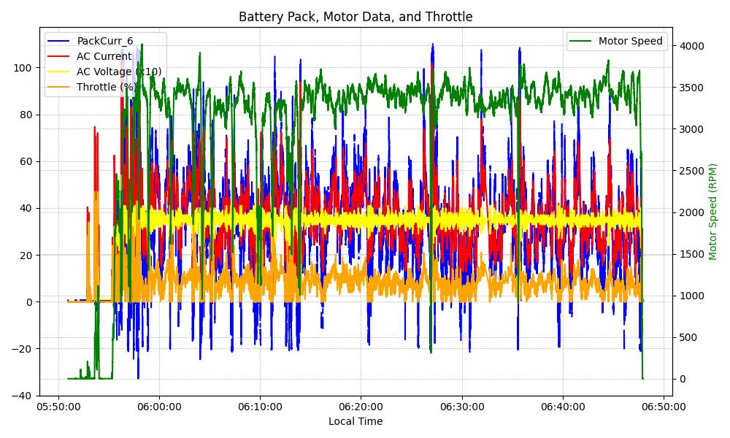
Graph Analysis

