Slide 1
Analysis Results from Folder - Battery_10

Slide 2
Analysis Results:
Metric | Value
Date and Time | 22/03/2024 16:38:00 to 22/03/2024 18:13:59
Byte Beam ID | 3
Total time taken for the ride | 0 days 01:35:59.897000
Actual Ampere-hours (Ah) | 27.842635833333333
Actual Watt-hours (Wh)- Calculated_UsingFormala | 1417.61611747
Starting SoC (Ah) | 11.573
Ending SoC (Ah) | 39.458
Starting SoC (%) | 99.0
Ending SoC (%) | 29.0
Total distance covered (km) | 36.841994648226546
Total energy consumption(WH/KM) | 38.47826728725285
Total SOC consumed(%) | 70.0
Mode | Sports mode 92.26% Eco mode 1.72%

Slide 3
Analysis Results:
Metric | Value
Peak Power(kW) | 5731.273335
Average Power(kW) | 891.4267288894323
Total Energy Regenerated(kWh) | 174.91307146111112
Regenerative Effectiveness(%) | 10.98335105421276
Highest Cell Voltage(V) | 3.396
Lowest Cell Voltage(V) | 3.083
Difference in Cell Voltage(V) | 0.3129999999999997
Minimum Temperature(C) | 34.0
Maximum Temperature(C) | 47.0
Difference in Temperature(C) | 13.0
Maximum Fet Temperature-BMS(C) | 72.0
Maximum Afe Temperature-BMS(C) | 68.0
Maximum PCB Temperature-BMS(C) | 67.0

Slide 4
Analysis Results:
Metric | Value
Maximum MCU Temperature(C) | 57.0
Maximum Motor Temperature(C) | 0.0
Abnormal Motor Temperature Detected(C) | False
highest cell temp(C) | 47.0
lowest cell temp(C) | 34.0
Difference between Highest and Lowest Cell Temperature at 100% SOC(C) | 13.0
Battery Voltage(V) | 55.0
Total energy charged(kWh)- Calculated_BatteryData | 1.5313449708333333
Electricity consumption units(kW) | 7.386240719035584e-08
Cycle Count of battery | 133.0
Idling time percentage | 30.783464642032772
Time spent in 0-10 km/h | 19.15072203887755
Time spent in 10-20 km/h | 6.78544857976765

Slide 5
Analysis Results:
Metric | Value
Time spent in 20-30 km/h | 9.335953148547338
Time spent in 30-40 km/h | 6.644283779401385
Time spent in 40-50 km/h | 7.23183457011503
Time spent in 50-60 km/h | 7.323400927109365
Time spent in 60-70 km/h | 12.685755708590069
Time spent in 70-80 km/h | 0.0
Time spent in 80-90 km/h | 0.0

Slide 6
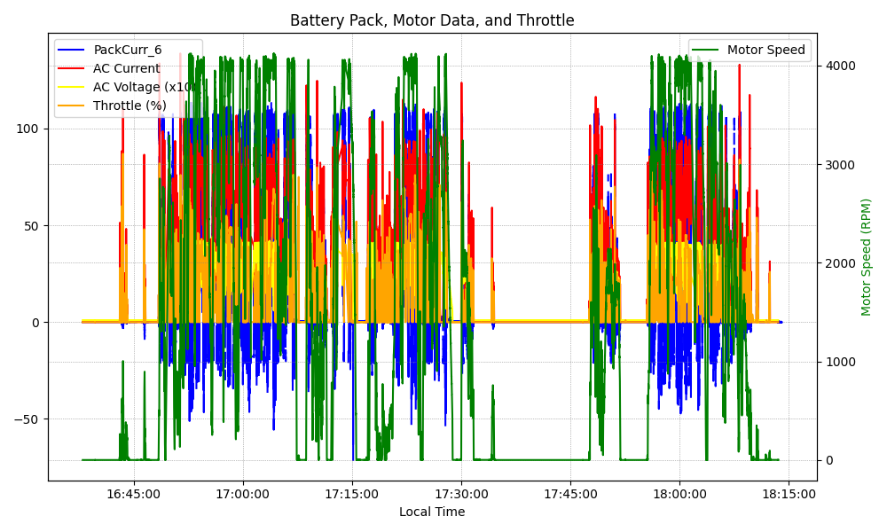
Graph Analysis

