Slide 1
Analysis Results from Folder - Battery_2

Slide 2
Analysis Results:
Metric | Value
Date and Time | 22/03/2024 06:50:38 to 22/03/2024 07:46:59
Byte Beam ID | 3
Total time taken for the ride | 0 days 00:56:21.072000
Actual Ampere-hours (Ah) | 23.937659444444442
Actual Watt-hours (Wh)- Calculated_UsingFormala | 1227.9650882777778
Starting SoC (Ah) | 10.534
Ending SoC (Ah) | 35.824
Starting SoC (%) | 90.0
Ending SoC (%) | 26.0
Total distance covered (km) | 38.004657706087286
Total energy consumption(WH/KM) | 32.3109103566822
Total SOC consumed(%) | 64.0
Mode | Sports mode 97.95% Eco mode 0.18%

Slide 3
Analysis Results:
Metric | Value
Peak Power(kW) | 5467.940025
Average Power(kW) | 1319.2104797970755
Total Energy Regenerated(kWh) | 15.223729259722223
Regenerative Effectiveness(%) | 1.2245709617849752
Highest Cell Voltage(V) | 3.397
Lowest Cell Voltage(V) | 3.08
Difference in Cell Voltage(V) | 0.3169999999999997
Minimum Temperature(C) | 0.0
Maximum Temperature(C) | 34.0
Difference in Temperature(C) | 34.0
Maximum Fet Temperature-BMS(C) | 50.0
Maximum Afe Temperature-BMS(C) | 50.0
Maximum PCB Temperature-BMS(C) | 48.0

Slide 4
Analysis Results:
Metric | Value
Maximum MCU Temperature(C) | 37.0
Maximum Motor Temperature(C) | 0.0
Abnormal Motor Temperature Detected(C) | False
highest cell temp(C) | 34.0
lowest cell temp(C) | 0.0
Difference between Highest and Lowest Cell Temperature at 100% SOC(C) | 34.0
Battery Voltage(V) | 71.0
Total energy charged(kWh)- Calculated_BatteryData | 1.6995738205555553
Electricity consumption units(kW) | 1.396343800778497e-07
Cycle Count of battery | 151.0
Idling time percentage | 24.649578195976638
Time spent in 0-10 km/h | 2.6119402985074625
Time spent in 10-20 km/h | 1.3432835820895521

Slide 5
Analysis Results:
Metric | Value
Time spent in 20-30 km/h | 0.6099935107073329
Time spent in 30-40 km/h | 1.190785204412719
Time spent in 40-50 km/h | 5.72680077871512
Time spent in 50-60 km/h | 62.650876054510064
Time spent in 60-70 km/h | 1.1323815704088254
Time spent in 70-80 km/h | 0.0
Time spent in 80-90 km/h | 0.0

Slide 6
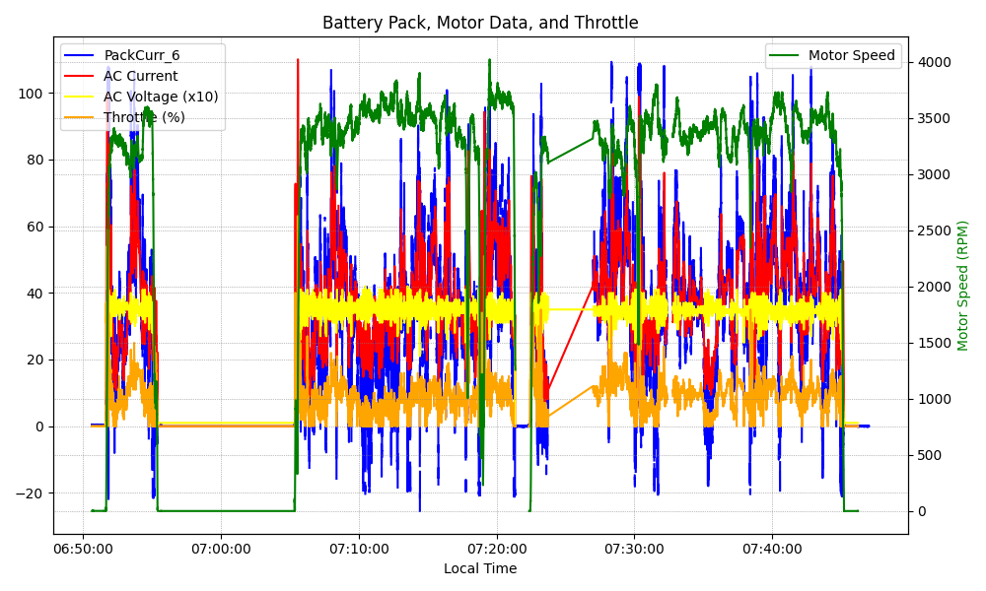
Graph Analysis

