Slide 1
Analysis Results from Folder - Battery_3

Slide 2
Analysis Results:
Metric | Value
Date and Time | 22/03/2024 07:57:39 to 22/03/2024 08:47:59
Byte Beam ID | 3
Total time taken for the ride | 0 days 00:50:20.540000
Actual Ampere-hours (Ah) | 29.877874722222224
Actual Watt-hours (Wh)- Calculated_UsingFormala | 1522.8499930805556
Starting SoC (Ah) | 9.275
Ending SoC (Ah) | 39.301
Starting SoC (%) | 99.0
Ending SoC (%) | 23.0
Total distance covered (km) | 41.203066080252995
Total energy consumption(WH/KM) | 36.959627958619265
Total SOC consumed(%) | 76.0
Mode | Sports mode 88.73% Eco mode 9.81%

Slide 3
Analysis Results:
Metric | Value
Peak Power(kW) | 5651.309715
Average Power(kW) | 1822.559832144282
Total Energy Regenerated(kWh) | 45.51884545555556
Regenerative Effectiveness(%) | 2.902304887544315
Highest Cell Voltage(V) | 3.381
Lowest Cell Voltage(V) | 3.054
Difference in Cell Voltage(V) | 0.32699999999999996
Minimum Temperature(C) | 26.0
Maximum Temperature(C) | 38.0
Difference in Temperature(C) | 12.0
Maximum Fet Temperature-BMS(C) | 56.0
Maximum Afe Temperature-BMS(C) | 54.0
Maximum PCB Temperature-BMS(C) | 53.0

Slide 4
Analysis Results:
Metric | Value
Maximum MCU Temperature(C) | 44.0
Maximum Motor Temperature(C) | 0.0
Abnormal Motor Temperature Detected(C) | True
highest cell temp(C) | 38.0
lowest cell temp(C) | 26.0
Difference between Highest and Lowest Cell Temperature at 100% SOC(C) | 12.0
Battery Voltage(V) | 55.0
Total energy charged(kWh)- Calculated_BatteryData | 1.6432831097222222
Electricity consumption units(kW) | 1.5114818890013081e-07
Cycle Count of battery | 58.0
Idling time percentage | 0.26465295176258863
Time spent in 0-10 km/h | 6.831574861498288
Time spent in 10-20 km/h | 4.354423233000459

Slide 5
Analysis Results:
Metric | Value
Time spent in 20-30 km/h | 6.206993895338579
Time spent in 30-40 km/h | 7.329122410811956
Time spent in 40-50 km/h | 8.080736793817707
Time spent in 50-60 km/h | 39.06983309220509
Time spent in 60-70 km/h | 27.675641342319775
Time spent in 70-80 km/h | 0.0
Time spent in 80-90 km/h | 0.0

Slide 6
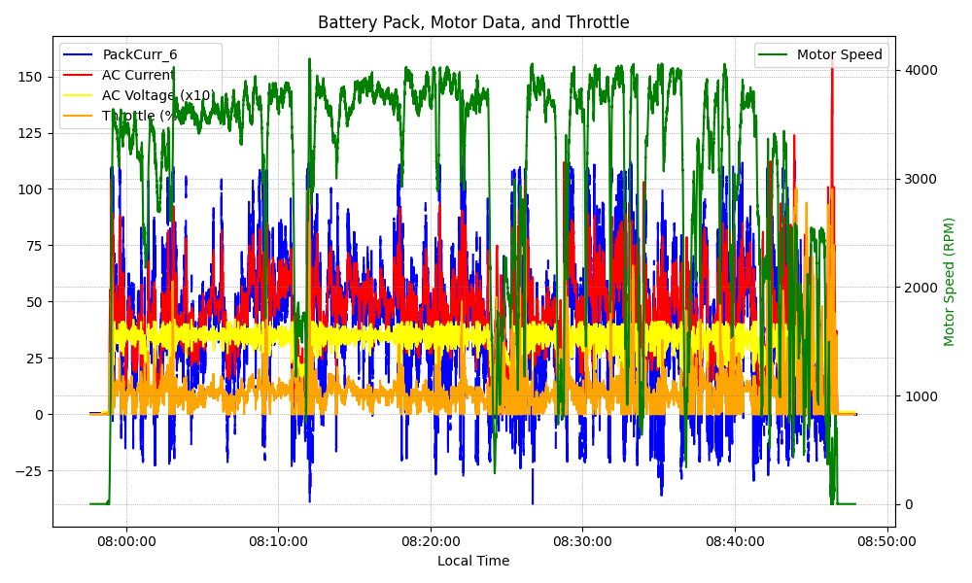
Graph Analysis

