Slide 1
Analysis Results from Folder - Battery_4

Slide 2
Analysis Results:
Metric | Value
Date and Time | 22/03/2024 11:14:14 to 22/03/2024 12:12:04
Byte Beam ID | 3
Total time taken for the ride | 0 days 00:57:49.322000
Actual Ampere-hours (Ah) | 15.433635833333334
Actual Watt-hours (Wh)- Calculated_UsingFormala | 800.3766628191668
Starting SoC (Ah) | 20.21
Ending SoC (Ah) | 36.073
Starting SoC (%) | 91.0
Ending SoC (%) | 50.0
Total distance covered (km) | 24.85012484288725
Total energy consumption(WH/KM) | 32.20815460201824
Total SOC consumed(%) | 41.0
Mode | Sports mode 94.55% Eco mode 0.35%

Slide 3
Analysis Results:
Metric | Value
Peak Power(kW) | 5578.385431000001
Average Power(kW) | 838.3345900928136
Total Energy Regenerated(kWh) | 47.00474402944444
Regenerative Effectiveness(%) | 5.547058697482381
Highest Cell Voltage(V) | 3.474
Lowest Cell Voltage(V) | 3.133
Difference in Cell Voltage(V) | 0.3410000000000002
Minimum Temperature(C) | 35.0
Maximum Temperature(C) | 40.0
Difference in Temperature(C) | 5.0
Maximum Fet Temperature-BMS(C) | 53.0
Maximum Afe Temperature-BMS(C) | 53.0
Maximum PCB Temperature-BMS(C) | 50.0

Slide 4
Analysis Results:
Metric | Value
Maximum MCU Temperature(C) | 43.0
Maximum Motor Temperature(C) | 0.0
Abnormal Motor Temperature Detected(C) | False
highest cell temp(C) | 40.0
lowest cell temp(C) | 35.0
Difference between Highest and Lowest Cell Temperature at 100% SOC(C) | 5.0
Battery Voltage(V) | 56.0
Total energy charged(kWh)- Calculated_BatteryData | 0.8642836066666666
Electricity consumption units(kW) | 6.920691254817804e-08
Cycle Count of battery | 151.0
Idling time percentage | 42.68128053484186
Time spent in 0-10 km/h | 4.480586268963744
Time spent in 10-20 km/h | 3.1563383903317046

Slide 5
Analysis Results:
Metric | Value
Time spent in 20-30 km/h | 5.052712779634867
Time spent in 30-40 km/h | 6.184109025456416
Time spent in 40-50 km/h | 9.652224222165081
Time spent in 50-60 km/h | 26.72280791977372
Time spent in 60-70 km/h | 2.0088711751092827
Time spent in 70-80 km/h | 0.0
Time spent in 80-90 km/h | 0.0

Slide 6
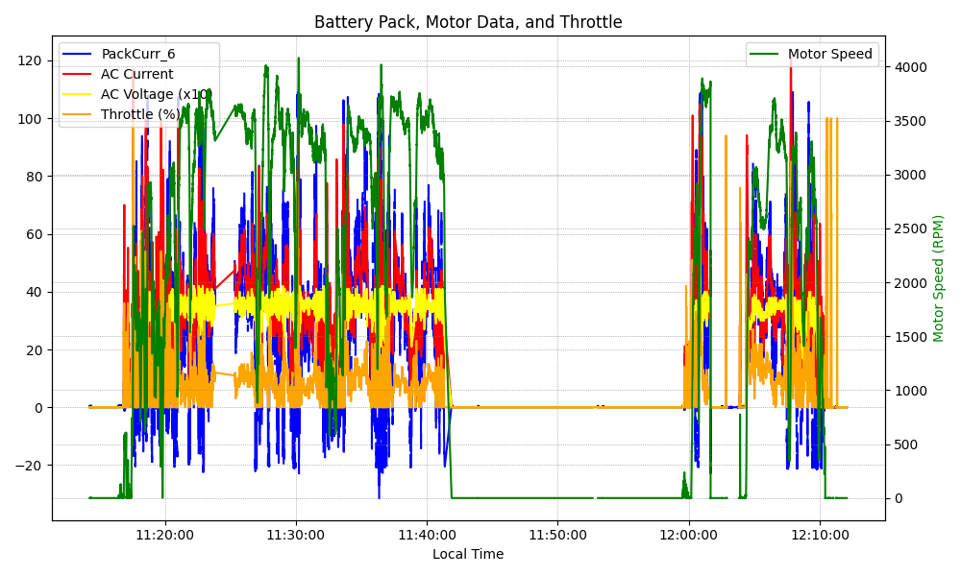
Graph Analysis

