Slide 1
Analysis Results from Folder - Battery_5

Slide 2
Analysis Results:
Metric | Value
Date and Time | 22/03/2024 12:13:24 to 22/03/2024 13:34:42
Byte Beam ID | 3
Total time taken for the ride | 0 days 01:21:17.895000
Actual Ampere-hours (Ah) | 25.41779916666667
Actual Watt-hours (Wh)- Calculated_UsingFormala | 1299.9074831300002
Starting SoC (Ah) | 5.977
Ending SoC (Ah) | 39.6
Starting SoC (%) | 99.0
Ending SoC (%) | 15.0
Total distance covered (km) | 33.95170018948828
Total energy consumption(WH/KM) | 38.286962828814744
Total SOC consumed(%) | 84.0
Mode | Sports mode 58.68% Eco mode 39.93%

Slide 3
Analysis Results:
Metric | Value
Peak Power(kW) | 5645.09817
Average Power(kW) | 964.2833173847106
Total Energy Regenerated(kWh) | 85.27504762499998
Regenerative Effectiveness(%) | 6.156231812894755
Highest Cell Voltage(V) | 3.517
Lowest Cell Voltage(V) | 3.096
Difference in Cell Voltage(V) | 0.4209999999999998
Minimum Temperature(C) | 32.0
Maximum Temperature(C) | 44.0
Difference in Temperature(C) | 12.0
Maximum Fet Temperature-BMS(C) | 62.0
Maximum Afe Temperature-BMS(C) | 60.0
Maximum PCB Temperature-BMS(C) | 57.0

Slide 4
Analysis Results:
Metric | Value
Maximum MCU Temperature(C) | 53.0
Maximum Motor Temperature(C) | 0.0
Abnormal Motor Temperature Detected(C) | False
highest cell temp(C) | 44.0
lowest cell temp(C) | -1.0
Difference between Highest and Lowest Cell Temperature at 100% SOC(C) | 45.0
Battery Voltage(V) | 64.0
Total energy charged(kWh)- Calculated_BatteryData | 1.6267391466666667
Electricity consumption units(kW) | 9.265367750362625e-08
Cycle Count of battery | 152.0
Idling time percentage | 26.388396811337465
Time spent in 0-10 km/h | 16.08503100088574
Time spent in 10-20 km/h | 5.487156775907883

Slide 5
Analysis Results:
Metric | Value
Time spent in 20-30 km/h | 6.357395925597873
Time spent in 30-40 km/h | 14.03675819309123
Time spent in 40-50 km/h | 11.83126660761736
Time spent in 50-60 km/h | 11.399468556244464
Time spent in 60-70 km/h | 7.940655447298495
Time spent in 70-80 km/h | 0.0
Time spent in 80-90 km/h | 0.0

Slide 6
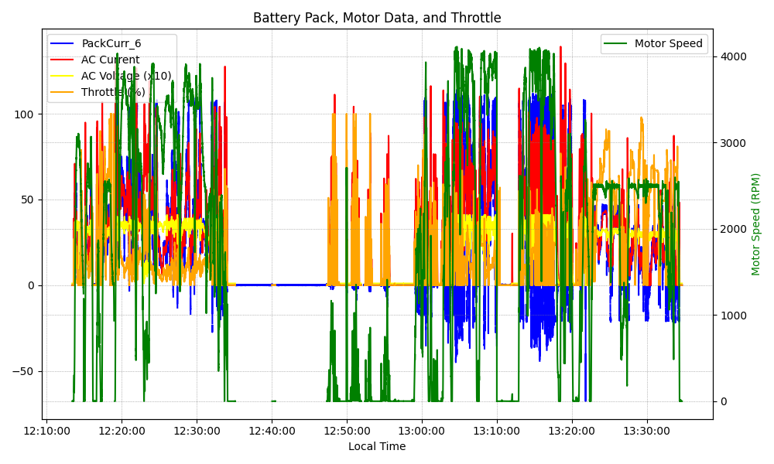
Graph Analysis

