Slide 1
Analysis Results from Folder - Battery_9

Slide 2
Analysis Results:
Metric | Value
Date and Time | 22/03/2024 15:36:12 to 22/03/2024 16:35:22
Byte Beam ID | 3
Total time taken for the ride | 0 days 00:59:10.102000
Actual Ampere-hours (Ah) | 27.043978333333328
Actual Watt-hours (Wh)- Calculated_UsingFormala | 1381.9712834347224
Starting SoC (Ah) | 12.73
Ending SoC (Ah) | 39.6
Starting SoC (%) | 99.0
Ending SoC (%) | 32.0
Total distance covered (km) | 34.58005725370848
Total energy consumption(WH/KM) | 39.964401252878645
Total SOC consumed(%) | 67.0
Mode | Sports mode 74.90% Eco mode 13.93%

Slide 3
Analysis Results:
Metric | Value
Peak Power(kW) | 5821.7697849999995
Average Power(kW) | 1411.7754314316119
Total Energy Regenerated(kWh) | 149.83781910361114
Regenerative Effectiveness(%) | 9.781755367252849
Highest Cell Voltage(V) | 3.511
Lowest Cell Voltage(V) | 3.097
Difference in Cell Voltage(V) | 0.41400000000000015
Minimum Temperature(C) | 38.0
Maximum Temperature(C) | 48.0
Difference in Temperature(C) | 10.0
Maximum Fet Temperature-BMS(C) | 72.0
Maximum Afe Temperature-BMS(C) | 69.0
Maximum PCB Temperature-BMS(C) | 66.0

Slide 4
Analysis Results:
Metric | Value
Maximum MCU Temperature(C) | 57.0
Maximum Motor Temperature(C) | 0.0
Abnormal Motor Temperature Detected(C) | True
highest cell temp(C) | 48.0
lowest cell temp(C) | 38.0
Difference between Highest and Lowest Cell Temperature at 100% SOC(C) | 10.0
Battery Voltage(V) | 56.0
Total energy charged(kWh)- Calculated_BatteryData | 1.5144627866666664
Electricity consumption units(kW) | 1.185025654668753e-07
Cycle Count of battery | 59.0
Idling time percentage | 11.700667825450553
Time spent in 0-10 km/h | 11.435367303997804
Time spent in 10-20 km/h | 5.476778580794682

Slide 5
Analysis Results:
Metric | Value
Time spent in 20-30 km/h | 9.92894825115116
Time spent in 30-40 km/h | 16.875552709419694
Time spent in 40-50 km/h | 15.408776263226908
Time spent in 50-60 km/h | 14.804988869575824
Time spent in 60-70 km/h | 14.14631171286555
Time spent in 70-80 km/h | 0.0
Time spent in 80-90 km/h | 0.0

Slide 6
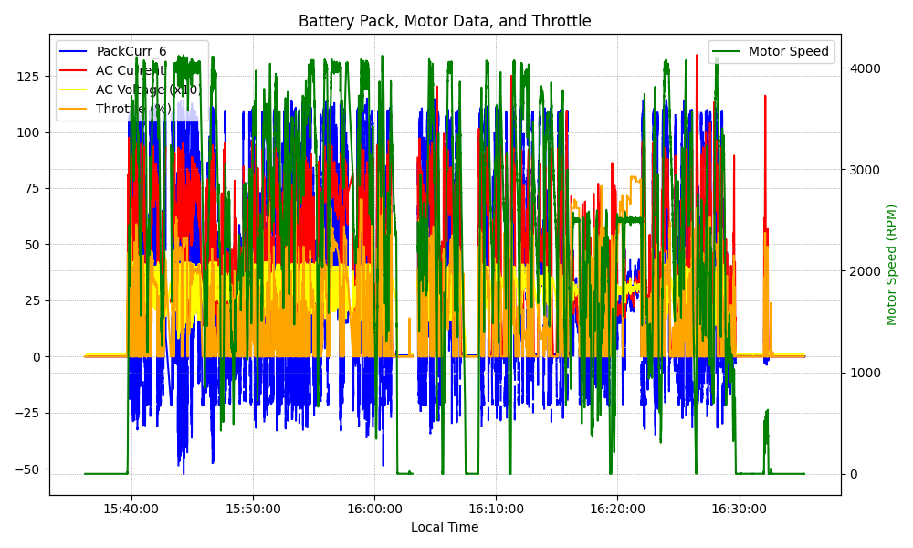
Graph Analysis

