Slide 1
Analysis Results from Folder - Battery_1

Slide 2
Analysis Results:
Metric | Value
Date and Time | 23/03/2024 08:19:25 to 23/03/2024 09:18:15
Byte Beam ID | 3
Total time taken for the ride | 0 days 00:58:49.533000
Actual Ampere-hours (Ah) | 25.521390833333335
Actual Watt-hours (Wh)- Calculated_UsingFormala | 1308.3921952502776
Starting SoC (Ah) | 10.231
Ending SoC (Ah) | 36.063
Starting SoC (%) | 91.0
Ending SoC (%) | 25.0
Total distance covered (km) | 36.86415882906042
Total energy consumption(WH/KM) | 35.492256891505626
Total SOC consumed(%) | 66.0
Mode | Sports mode 95.71% Eco mode 1.85%

Slide 3
Analysis Results:
Metric | Value
Peak Power(kW) | 5586.851794
Average Power(kW) | 1340.0318358182076
Total Energy Regenerated(kWh) | 52.69230902472222
Regenerative Effectiveness(%) | 3.871347360081032
Highest Cell Voltage(V) | 3.379
Lowest Cell Voltage(V) | 3.097
Difference in Cell Voltage(V) | 0.28200000000000003
Minimum Temperature(C) | 25.0
Maximum Temperature(C) | 35.0
Difference in Temperature(C) | 10.0
Maximum Fet Temperature-BMS(C) | 50.0
Maximum Afe Temperature-BMS(C) | 50.0
Maximum PCB Temperature-BMS(C) | 48.0

Slide 4
Analysis Results:
Metric | Value
Maximum MCU Temperature(C) | 39.0
Maximum Motor Temperature(C) | 0.0
Abnormal Motor Temperature Detected(C) | False
highest cell temp(C) | 35.0
lowest cell temp(C) | 25.0
Difference between Highest and Lowest Cell Temperature at 100% SOC(C) | 10.0
Battery Voltage(V) | 55.0
Total energy charged(kWh)- Calculated_BatteryData | 1.4036764958333334
Electricity consumption units(kW) | 1.1048742922399589e-07
Cycle Count of battery | 153.0
Idling time percentage | 15.927998789895629
Time spent in 0-10 km/h | 4.88277113901074
Time spent in 10-20 km/h | 4.6044471335652695

Slide 5
Analysis Results:
Metric | Value
Time spent in 20-30 km/h | 5.505974890334291
Time spent in 30-40 km/h | 7.260626229012253
Time spent in 40-50 km/h | 17.513235516563302
Time spent in 50-60 km/h | 43.91771290273786
Time spent in 60-70 km/h | 0.28134926637422475
Time spent in 70-80 km/h | 0.0
Time spent in 80-90 km/h | 0.0

Slide 6
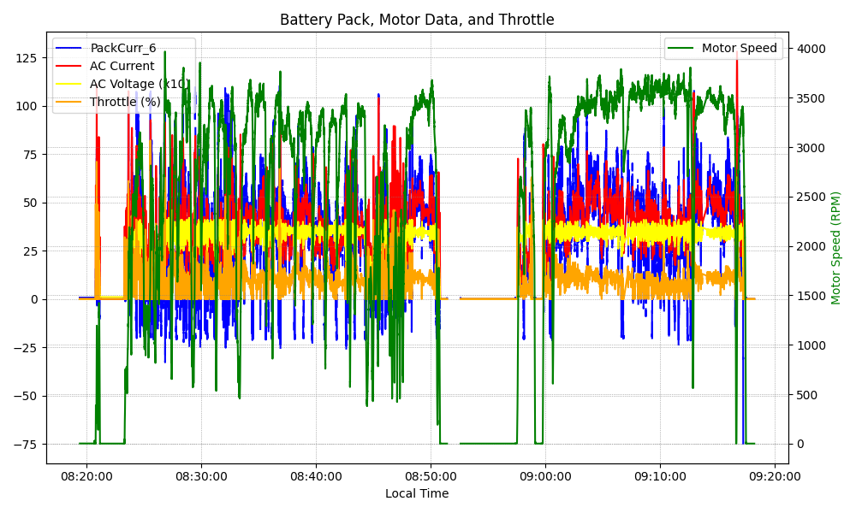
Graph Analysis

