Slide 1
Analysis Results from Folder - Battery_2

Slide 2
Analysis Results:
Metric | Value
Date and Time | 23/03/2024 09:19:18 to 23/03/2024 10:21:08
Byte Beam ID | 3
Total time taken for the ride | 0 days 01:01:49.628000
Actual Ampere-hours (Ah) | 28.941836944444443
Actual Watt-hours (Wh)- Calculated_UsingFormala | 1477.6886010861112
Starting SoC (Ah) | 10.506
Ending SoC (Ah) | 39.314
Starting SoC (%) | 99.0
Ending SoC (%) | 26.0
Total distance covered (km) | 40.98790792049782
Total energy consumption(WH/KM) | 36.051818110656185
Total SOC consumed(%) | 73.0
Mode | Sports mode 99.75% Eco mode 0.06%

Slide 3
Analysis Results:
Metric | Value
Peak Power(kW) | 5685.950856
Average Power(kW) | 1440.8664582638137
Total Energy Regenerated(kWh) | 64.90662641472223
Regenerative Effectiveness(%) | 4.207625257591247
Highest Cell Voltage(V) | 3.38
Lowest Cell Voltage(V) | 3.046
Difference in Cell Voltage(V) | 0.3340000000000001
Minimum Temperature(C) | 27.0
Maximum Temperature(C) | 39.0
Difference in Temperature(C) | 12.0
Maximum Fet Temperature-BMS(C) | 63.0
Maximum Afe Temperature-BMS(C) | 59.0
Maximum PCB Temperature-BMS(C) | 57.0

Slide 4
Analysis Results:
Metric | Value
Maximum MCU Temperature(C) | 50.0
Maximum Motor Temperature(C) | 0.0
Abnormal Motor Temperature Detected(C) | False
highest cell temp(C) | 39.0
lowest cell temp(C) | -1.0
Difference between Highest and Lowest Cell Temperature at 100% SOC(C) | 40.0
Battery Voltage(V) | 55.0
Total energy charged(kWh)- Calculated_BatteryData | 1.5918010319444442
Electricity consumption units(kW) | 1.1921460051709387e-07
Cycle Count of battery | 57.0
Idling time percentage | 13.72842347525892
Time spent in 0-10 km/h | 3.8751438434982735
Time spent in 10-20 km/h | 4.502301495972382

Slide 5
Analysis Results:
Metric | Value
Time spent in 20-30 km/h | 8.276754890678943
Time spent in 30-40 km/h | 8.417721518987342
Time spent in 40-50 km/h | 13.098388952819331
Time spent in 50-60 km/h | 44.76409666283084
Time spent in 60-70 km/h | 3.2278481012658227
Time spent in 70-80 km/h | 0.0
Time spent in 80-90 km/h | 0.0

Slide 6
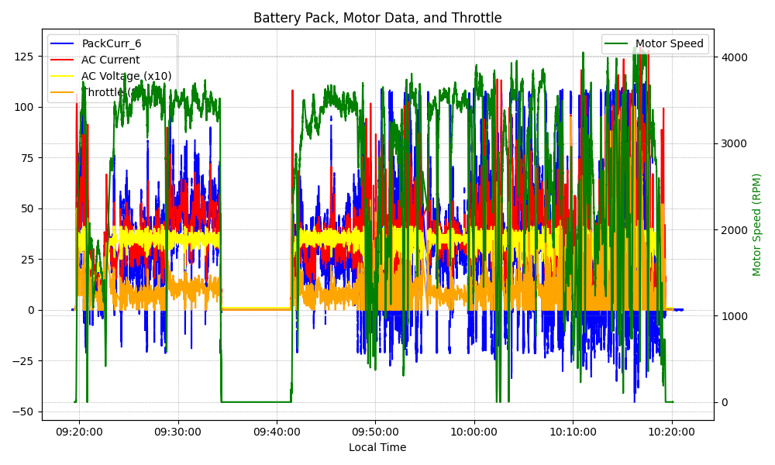
Graph Analysis

