Slide 1
Analysis Results from Folder - Battery_3

Slide 2
Analysis Results:
Metric | Value
Date and Time | 23/03/2024 10:21:08 to 23/03/2024 11:22:45
Byte Beam ID | 3
Total time taken for the ride | 0 days 01:01:37.246000
Actual Ampere-hours (Ah) | 28.25363472222222
Actual Watt-hours (Wh)- Calculated_UsingFormala | 1442.9561066158333
Starting SoC (Ah) | 11.31
Ending SoC (Ah) | 10.506
Starting SoC (%) | 99.0
Ending SoC (%) | 26.0
Total distance covered (km) | 38.50782327326349
Total energy consumption(WH/KM) | 37.471765058652316
Total SOC consumed(%) | 73.0
Mode | Sports mode 94.29% Eco mode 3.30%

Slide 3
Analysis Results:
Metric | Value
Peak Power(kW) | 5552.68134
Average Power(kW) | 1406.9994539049296
Total Energy Regenerated(kWh) | 34.49318298694445
Regenerative Effectiveness(%) | 2.334644121438386
Highest Cell Voltage(V) | 3.471
Lowest Cell Voltage(V) | 3.073
Difference in Cell Voltage(V) | 0.39800000000000013
Minimum Temperature(C) | 28.0
Maximum Temperature(C) | 41.0
Difference in Temperature(C) | 13.0
Maximum Fet Temperature-BMS(C) | 66.0
Maximum Afe Temperature-BMS(C) | 64.0
Maximum PCB Temperature-BMS(C) | 63.0

Slide 4
Analysis Results:
Metric | Value
Maximum MCU Temperature(C) | 48.0
Maximum Motor Temperature(C) | 0.0
Abnormal Motor Temperature Detected(C) | True
highest cell temp(C) | 41.0
lowest cell temp(C) | 28.0
Difference between Highest and Lowest Cell Temperature at 100% SOC(C) | 13.0
Battery Voltage(V) | 56.0
Total energy charged(kWh)- Calculated_BatteryData | 1.5822035444444444
Electricity consumption units(kW) | 1.1888043942869929e-07
Cycle Count of battery | 134.0
Idling time percentage | 3.141483090288551
Time spent in 0-10 km/h | 6.68631709587341
Time spent in 10-20 km/h | 6.236425690350605

Slide 5
Analysis Results:
Metric | Value
Time spent in 20-30 km/h | 4.975954080049643
Time spent in 30-40 km/h | 4.4717654359292585
Time spent in 40-50 km/h | 4.809183990071362
Time spent in 50-60 km/h | 24.550108594477198
Time spent in 60-70 km/h | 44.965870307167236
Time spent in 70-80 km/h | 0.0
Time spent in 80-90 km/h | 0.0

Slide 6
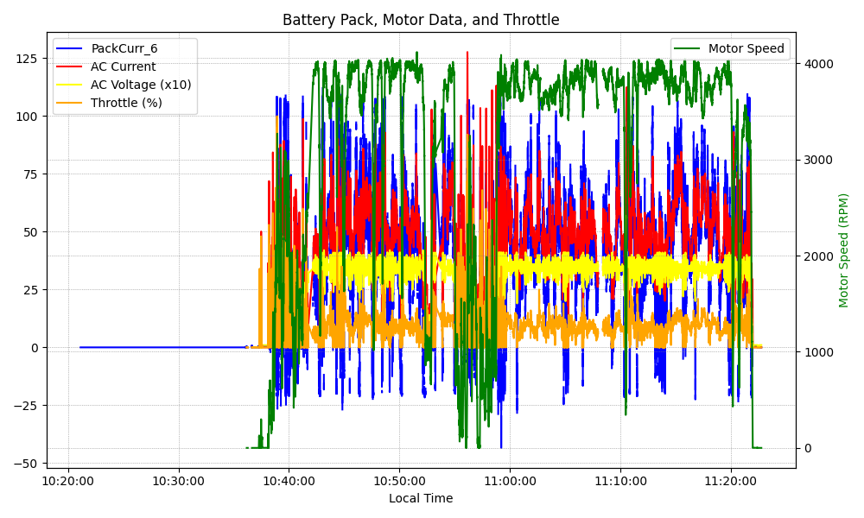
Graph Analysis

