Slide 1
Analysis Results from Folder - Battery_4

Slide 2
Analysis Results:
Metric | Value
Date and Time | 23/03/2024 11:22:45 to 23/03/2024 12:26:50
Byte Beam ID | 3
Total time taken for the ride | 0 days 01:04:05.202000
Actual Ampere-hours (Ah) | 27.87842361111111
Actual Watt-hours (Wh)- Calculated_UsingFormala | 1423.0106088972223
Starting SoC (Ah) | 12.119
Ending SoC (Ah) | 11.31
Starting SoC (%) | 99.0
Ending SoC (%) | 28.0
Total distance covered (km) | 35.6273434904906
Total energy consumption(WH/KM) | 39.94153000144516
Total SOC consumed(%) | 71.0
Mode | Sports mode 83.05% Eco mode 0.08%

Slide 3
Analysis Results:
Metric | Value
Peak Power(kW) | 5588.03727
Average Power(kW) | 1336.1601961476267
Total Energy Regenerated(kWh) | 73.50387979833333
Regenerative Effectiveness(%) | 4.911671778226708
Highest Cell Voltage(V) | 3.449
Lowest Cell Voltage(V) | 3.065
Difference in Cell Voltage(V) | 0.3839999999999999
Minimum Temperature(C) | 29.0
Maximum Temperature(C) | 42.0
Difference in Temperature(C) | 13.0
Maximum Fet Temperature-BMS(C) | 67.0
Maximum Afe Temperature-BMS(C) | 63.0
Maximum PCB Temperature-BMS(C) | 63.0

Slide 4
Analysis Results:
Metric | Value
Maximum MCU Temperature(C) | 58.0
Maximum Motor Temperature(C) | 0.0
Abnormal Motor Temperature Detected(C) | True
highest cell temp(C) | 42.0
lowest cell temp(C) | 29.0
Difference between Highest and Lowest Cell Temperature at 100% SOC(C) | 13.0
Battery Voltage(V) | 55.0
Total energy charged(kWh)- Calculated_BatteryData | 1.533313298611111
Electricity consumption units(kW) | 1.1077252554624412e-07
Cycle Count of battery | 134.0
Idling time percentage | 22.109567183033043
Time spent in 0-10 km/h | 3.404028987434346
Time spent in 10-20 km/h | 5.3819559869689515

Slide 5
Analysis Results:
Metric | Value
Time spent in 20-30 km/h | 8.380426833322252
Time spent in 30-40 km/h | 8.107838574562862
Time spent in 40-50 km/h | 7.462934645302839
Time spent in 50-60 km/h | 18.801941360281894
Time spent in 60-70 km/h | 26.19839106442391
Time spent in 70-80 km/h | 0.0
Time spent in 80-90 km/h | 0.0

Slide 6
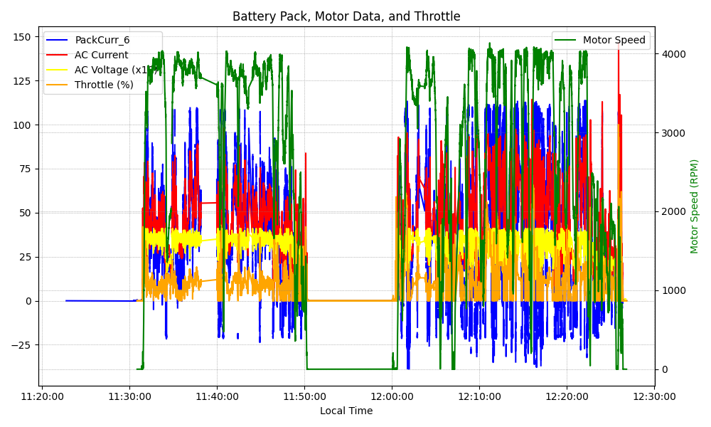
Graph Analysis

