Slide 1
Analysis Results from Folder - Battery_1

Slide 2
Analysis Results:
Metric | Value
Date and Time | 26/03/2024 08:43:13 to 26/03/2024 11:33:31
Byte Beam ID | 3
Total time taken for the ride | 0 days 02:50:17.836000
Actual Ampere-hours (Ah) | 26.34176722222222
Actual Watt-hours (Wh)- Calculated_UsingFormala | 1352.7782614530556
Starting SoC (Ah) | 4.209
Ending SoC (Ah) | 30.37
Starting SoC (%) | 76.0
Ending SoC (%) | 10.0
Total distance covered (km) | 47.58447383995274
Total energy consumption(WH/KM) | 28.42898433642529
Total SOC consumed(%) | 66.0
Mode | Sports mode 78.10% Eco mode 18.89%

Slide 3
Analysis Results:
Metric | Value
Peak Power(kW) | 3404.9920300000003
Average Power(kW) | 479.6613553856988
Total Energy Regenerated(kWh) | 77.28716715638888
Regenerative Effectiveness(%) | 5.404449727278615
Highest Cell Voltage(V) | 6.553
Lowest Cell Voltage(V) | 3.071
Difference in Cell Voltage(V) | 3.4819999999999998
Minimum Temperature(C) | -1.0
Maximum Temperature(C) | 36.0
Difference in Temperature(C) | 37.0
Maximum Fet Temperature-BMS(C) | 42.0
Maximum Afe Temperature-BMS(C) | 46.0
Maximum PCB Temperature-BMS(C) | 43.0

Slide 4
Analysis Results:
Metric | Value
Maximum MCU Temperature(C) | 39.0
Maximum Motor Temperature(C) | 0.0
Abnormal Motor Temperature Detected(C) | False
highest cell temp(C) | 36.0
lowest cell temp(C) | -1.0
Difference between Highest and Lowest Cell Temperature at 100% SOC(C) | 37.0
Battery Voltage(V) | 55.0
Total energy charged(kWh)- Calculated_BatteryData | 1.4487971972222222
Electricity consumption units(kW) | 3.9389612008912765e-08
Cycle Count of battery | 154.0
Idling time percentage | 40.42642726890167
Time spent in 0-10 km/h | 11.949027266743636
Time spent in 10-20 km/h | 5.387528728810817

Slide 5
Analysis Results:
Metric | Value
Time spent in 20-30 km/h | 8.734637504450943
Time spent in 30-40 km/h | 15.227078994788352
Time spent in 40-50 km/h | 17.649470742471163
Time spent in 50-60 km/h | 0.32694195970952883
Time spent in 60-70 km/h | 0.0
Time spent in 70-80 km/h | 0.0
Time spent in 80-90 km/h | 0.0

Slide 6
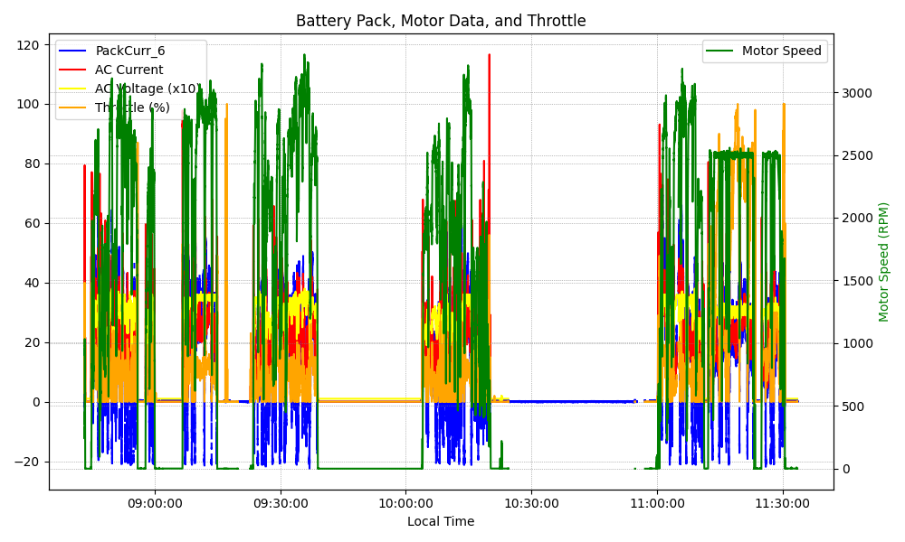
Graph Analysis

