Slide 1
Analysis Results from Folder - Battery_2

Slide 2
Analysis Results:
Metric | Value
Date and Time | 26/03/2024 11:34:49 to 26/03/2024 12:46:16
Byte Beam ID | 3
Total time taken for the ride | 0 days 01:11:27.088000
Actual Ampere-hours (Ah) | 22.19020277777778
Actual Watt-hours (Wh)- Calculated_UsingFormala | 1133.1719994530556
Starting SoC (Ah) | 6.198
Ending SoC (Ah) | 29.353
Starting SoC (%) | 74.0
Ending SoC (%) | 15.0
Total distance covered (km) | 38.411503924113624
Total energy consumption(WH/KM) | 29.50084958120276
Total SOC consumed(%) | 59.0
Mode | Sports mode 72.06% Eco mode 22.85%

Slide 3
Analysis Results:
Metric | Value
Peak Power(kW) | 5412.710386
Average Power(kW) | 955.8151822940488
Total Energy Regenerated(kWh) | 52.4727422711111
Regenerative Effectiveness(%) | 4.425671571300958
Highest Cell Voltage(V) | 3.351
Lowest Cell Voltage(V) | 3.074
Difference in Cell Voltage(V) | 0.27700000000000014
Minimum Temperature(C) | 30.0
Maximum Temperature(C) | 39.0
Difference in Temperature(C) | 9.0
Maximum Fet Temperature-BMS(C) | 48.0
Maximum Afe Temperature-BMS(C) | 50.0
Maximum PCB Temperature-BMS(C) | 48.0

Slide 4
Analysis Results:
Metric | Value
Maximum MCU Temperature(C) | 45.0
Maximum Motor Temperature(C) | 0.0
Abnormal Motor Temperature Detected(C) | False
highest cell temp(C) | 39.0
lowest cell temp(C) | 30.0
Difference between Highest and Lowest Cell Temperature at 100% SOC(C) | 9.0
Battery Voltage(V) | 55.0
Total energy charged(kWh)- Calculated_BatteryData | 1.220461152777778
Electricity consumption units(kW) | 7.908023953410685e-08
Cycle Count of battery | 134.0
Idling time percentage | 11.103560039730253
Time spent in 0-10 km/h | 9.647655392336244
Time spent in 10-20 km/h | 5.936013382821893

Slide 5
Analysis Results:
Metric | Value
Time spent in 20-30 km/h | 9.17193789534215
Time spent in 30-40 km/h | 22.609650269224737
Time spent in 40-50 km/h | 25.23132416749438
Time spent in 50-60 km/h | 15.620262428773065
Time spent in 60-70 km/h | 0.036593653614930215
Time spent in 70-80 km/h | 0.0
Time spent in 80-90 km/h | 0.0

Slide 6
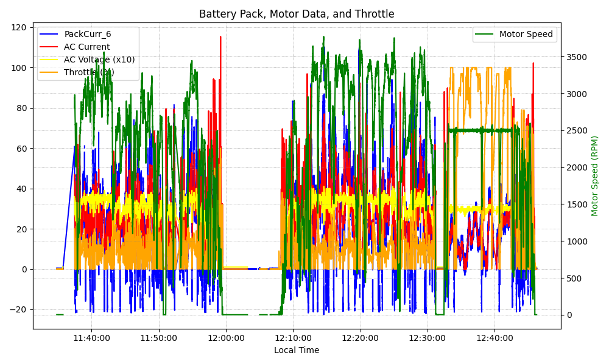
Graph Analysis

