Slide 1
Analysis Results from Folder - Battery_1

Slide 2
Analysis Results:
Metric | Value
Date and Time | 27/03/2024 15:58:35 to 27/03/2024 17:47:51
Byte Beam ID | 3
Total time taken for the ride | 0 days 01:49:15.583000
Actual Ampere-hours (Ah) | 35.764025000000004
Actual Watt-hours (Wh)- Calculated_UsingFormala | 1820.832711823889
Starting SoC (Ah) | 2.897
Ending SoC (Ah) | 39.178
Starting SoC (%) | 98.0
Ending SoC (%) | 7.0
Total distance covered (km) | 41.5258254293846
Total energy consumption(WH/KM) | 43.84820031862455
Total SOC consumed(%) | 91.0
Mode | Sports mode 47.00% Eco mode 34.29% Custom mode 2.05%

Slide 3
Analysis Results:
Metric | Value
Peak Power(kW) | 5706.837864
Average Power(kW) | 1005.5219761567726
Total Energy Regenerated(kWh) | 35.16456962833333
Regenerative Effectiveness(%) | 1.894645535300508
Highest Cell Voltage(V) | 3.359
Lowest Cell Voltage(V) | 3.068
Difference in Cell Voltage(V) | 0.2909999999999999
Minimum Temperature(C) | 32.0
Maximum Temperature(C) | 47.0
Difference in Temperature(C) | 15.0
Maximum Fet Temperature-BMS(C) | 71.0
Maximum Afe Temperature-BMS(C) | 67.0
Maximum PCB Temperature-BMS(C) | 64.0

Slide 4
Analysis Results:
Metric | Value
Maximum MCU Temperature(C) | 55.0
Maximum Motor Temperature(C) | 91.0
Abnormal Motor Temperature Detected(C) | False
highest cell temp(C) | 47.0
lowest cell temp(C) | 32.0
Difference between Highest and Lowest Cell Temperature at 100% SOC(C) | 15.0
Battery Voltage(V) | 53.0
Total energy charged(kWh)- Calculated_BatteryData | 1.8954933250000001
Electricity consumption units(kW) | 8.032432091702687e-08
Cycle Count of battery | 62.0
Idling time percentage | 19.333374030889445
Time spent in 0-10 km/h | 9.535437396984312
Time spent in 10-20 km/h | 3.660745172252406

Slide 5
Analysis Results:
Metric | Value
Time spent in 20-30 km/h | 7.016258673666647
Time spent in 30-40 km/h | 34.682457318438026
Time spent in 40-50 km/h | 6.877886982886677
Time spent in 50-60 km/h | 9.081659646338238
Time spent in 60-70 km/h | 7.7142217609832535
Time spent in 70-80 km/h | 0.026453411472641068
Time spent in 80-90 km/h | 0.008139511222351098

Slide 6
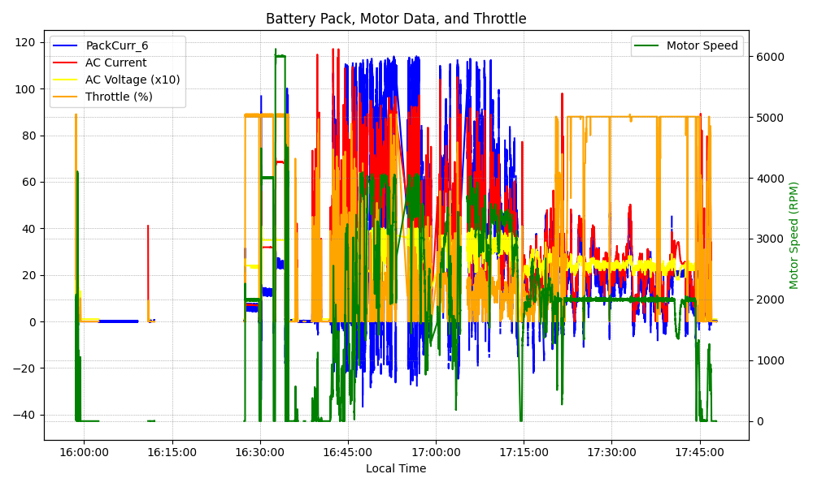
Graph Analysis

