Slide 1
Analysis Results from Folder - Battery_2

Slide 2
Analysis Results:
Metric | Value
Date and Time | 27/03/2024 17:49:11 to 27/03/2024 19:23:18
Byte Beam ID | 3
Total time taken for the ride | 0 days 01:34:07.080000
Actual Ampere-hours (Ah) | 36.38621916666666
Actual Watt-hours (Wh)- Calculated_UsingFormala | 1857.0948435986109
Starting SoC (Ah) | 2.888
Ending SoC (Ah) | 39.087
Starting SoC (%) | 98.0
Ending SoC (%) | 0.0
Total distance covered (km) | 41.877452697962724
Total energy consumption(WH/KM) | 44.34593615310694
Total SOC consumed(%) | 98.0
Mode | Sports mode 55.55% Eco mode 38.13%

Slide 3
Analysis Results:
Metric | Value
Peak Power(kW) | 5555.520405
Average Power(kW) | 1191.7186162130124
Total Energy Regenerated(kWh) | 45.353797405555554
Regenerative Effectiveness(%) | 2.3839696078006356
Highest Cell Voltage(V) | 3.337
Lowest Cell Voltage(V) | 2.919
Difference in Cell Voltage(V) | 0.41800000000000015
Minimum Temperature(C) | 33.0
Maximum Temperature(C) | 46.0
Difference in Temperature(C) | 13.0
Maximum Fet Temperature-BMS(C) | 70.0
Maximum Afe Temperature-BMS(C) | 65.0
Maximum PCB Temperature-BMS(C) | 65.0

Slide 4
Analysis Results:
Metric | Value
Maximum MCU Temperature(C) | 53.0
Maximum Motor Temperature(C) | 89.0
Abnormal Motor Temperature Detected(C) | False
highest cell temp(C) | 46.0
lowest cell temp(C) | 33.0
Difference between Highest and Lowest Cell Temperature at 100% SOC(C) | 13.0
Battery Voltage(V) | 54.0
Total energy charged(kWh)- Calculated_BatteryData | 1.9648558349999998
Electricity consumption units(kW) | 9.665190145209844e-08
Cycle Count of battery | 135.0
Idling time percentage | 13.032757345270385
Time spent in 0-10 km/h | 14.127197890783558
Time spent in 10-20 km/h | 10.187591282411184

Slide 5
Analysis Results:
Metric | Value
Time spent in 20-30 km/h | 15.462529162952144
Time spent in 30-40 km/h | 23.690749416740957
Time spent in 40-50 km/h | 12.019878226892509
Time spent in 50-60 km/h | 9.996016767511998
Time spent in 60-70 km/h | 1.3751635970486145
Time spent in 70-80 km/h | 0.0
Time spent in 80-90 km/h | 0.0

Slide 6
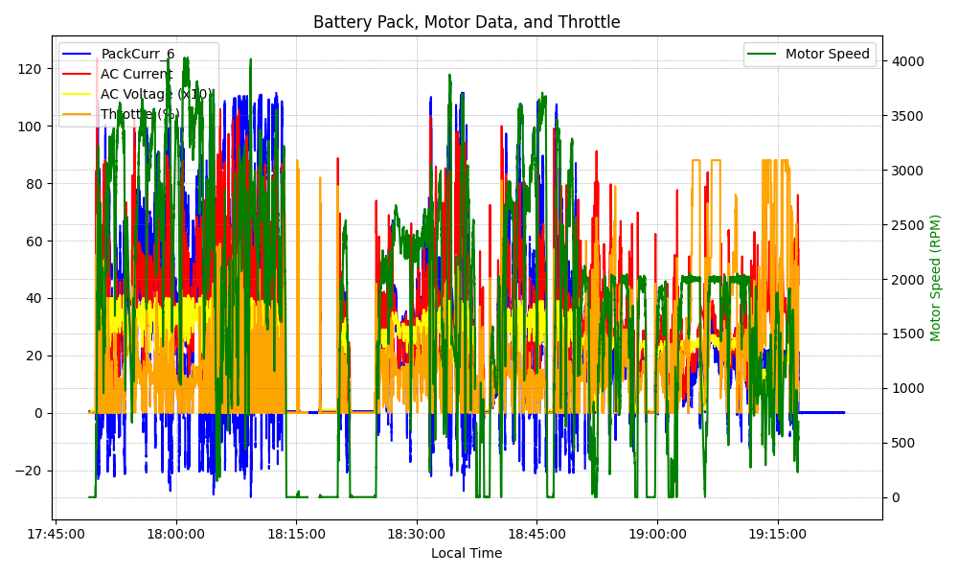
Graph Analysis

