Slide 1
Analysis Results from Folder - Battery_1

Slide 2
Analysis Results:
Metric | Value
Date and Time | 29/03/2024 08:43:53 to 29/03/2024 10:28:14
Byte Beam ID | 3
Total time taken for the ride | 0 days 01:44:20.305000
Actual Ampere-hours (Ah) | 36.08945055555556
Actual Watt-hours (Wh)- Calculated_UsingFormala | 1838.8233674841667
Starting SoC (Ah) | 3.124
Ending SoC (Ah) | 38.948
Starting SoC (%) | 98.0
Ending SoC (%) | 0.0
Total distance covered (km) | 54.076322350928216
Total energy consumption(WH/KM) | 34.004223799671976
Total SOC consumed(%) | 98.0
Mode | Sports mode 72.19% Eco mode 25.52%

Slide 3
Analysis Results:
Metric | Value
Peak Power(kW) | 5490.093675
Average Power(kW) | 1061.0296718934123
Total Energy Regenerated(kWh) | 53.154287833055555
Regenerative Effectiveness(%) | 2.809456426912364
Highest Cell Voltage(V) | 3.331
Lowest Cell Voltage(V) | 2.939
Difference in Cell Voltage(V) | 0.3919999999999999
Minimum Temperature(C) | 27.0
Maximum Temperature(C) | 42.0
Difference in Temperature(C) | 15.0
Maximum Fet Temperature-BMS(C) | 59.0
Maximum Afe Temperature-BMS(C) | 57.0
Maximum PCB Temperature-BMS(C) | 57.0

Slide 4
Analysis Results:
Metric | Value
Maximum MCU Temperature(C) | 43.0
Maximum Motor Temperature(C) | 76.0
Abnormal Motor Temperature Detected(C) | False
highest cell temp(C) | 42.0
lowest cell temp(C) | 27.0
Difference between Highest and Lowest Cell Temperature at 100% SOC(C) | 15.0
Battery Voltage(V) | 53.0
Total energy charged(kWh)- Calculated_BatteryData | 1.9127408794444445
Electricity consumption units(kW) | 8.487490590364059e-08
Cycle Count of battery | 136.0
Idling time percentage | 5.957511534756376
Time spent in 0-10 km/h | 24.98098666531461
Time spent in 10-20 km/h | 3.5136642498605686

Slide 5
Analysis Results:
Metric | Value
Time spent in 20-30 km/h | 4.745728337474016
Time spent in 30-40 km/h | 24.64973212324021
Time spent in 40-50 km/h | 6.8397302641585975
Time spent in 50-60 km/h | 18.540113911000695
Time spent in 60-70 km/h | 10.711690243201677
Time spent in 70-80 km/h | 0.0
Time spent in 80-90 km/h | 0.0

Slide 6
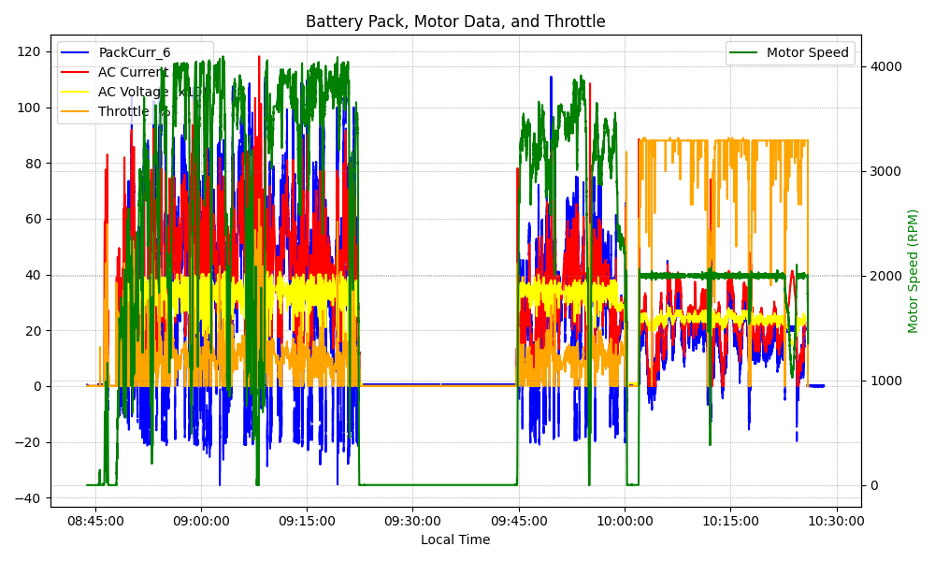
Graph Analysis

