Slide 1
Analysis Results from Folder - Battery_2

Slide 2
Analysis Results:
Metric | Value
Date and Time | 29/03/2024 10:29:34 to 29/03/2024 11:57:19
Byte Beam ID | 3
Total time taken for the ride | 0 days 01:27:45.276000
Actual Ampere-hours (Ah) | 33.30553833333333
Actual Watt-hours (Wh)- Calculated_UsingFormala | 1695.3982639791666
Starting SoC (Ah) | 2.587
Ending SoC (Ah) | 38.288
Starting SoC (%) | 96.0
Ending SoC (%) | 6.0
Total distance covered (km) | 44.37952541108907
Total energy consumption(WH/KM) | 38.202262152977845
Total SOC consumed(%) | 90.0
Mode | Sports mode 64.73% Eco mode 34.20%

Slide 3
Analysis Results:
Metric | Value
Peak Power(kW) | 5600.275344
Average Power(kW) | 1166.112676791173
Total Energy Regenerated(kWh) | 57.6686188036111
Regenerative Effectiveness(%) | 3.2895846342193904
Highest Cell Voltage(V) | 3.331
Lowest Cell Voltage(V) | 3.074
Difference in Cell Voltage(V) | 0.2570000000000001
Minimum Temperature(C) | 0.0
Maximum Temperature(C) | 43.0
Difference in Temperature(C) | 43.0
Maximum Fet Temperature-BMS(C) | 62.0
Maximum Afe Temperature-BMS(C) | 62.0
Maximum PCB Temperature-BMS(C) | 60.0

Slide 4
Analysis Results:
Metric | Value
Maximum MCU Temperature(C) | 49.0
Maximum Motor Temperature(C) | 86.0
Abnormal Motor Temperature Detected(C) | False
highest cell temp(C) | 43.0
lowest cell temp(C) | 0.0
Difference between Highest and Lowest Cell Temperature at 100% SOC(C) | 43.0
Battery Voltage(V) | 61.0
Total energy charged(kWh)- Calculated_BatteryData | 2.031637838333333
Electricity consumption units(kW) | 1.0718781462136399e-07
Cycle Count of battery | 59.0
Idling time percentage | 20.65314871929479
Time spent in 0-10 km/h | 7.957652514381959
Time spent in 10-20 km/h | 3.4866679790887414

Slide 5
Analysis Results:
Metric | Value
Time spent in 20-30 km/h | 6.35868495308091
Time spent in 30-40 km/h | 25.878775947678108
Time spent in 40-50 km/h | 9.598180108056084
Time spent in 50-60 km/h | 16.820876260472033
Time spent in 60-70 km/h | 9.156331342826519
Time spent in 70-80 km/h | 0.0
Time spent in 80-90 km/h | 0.0

Slide 6
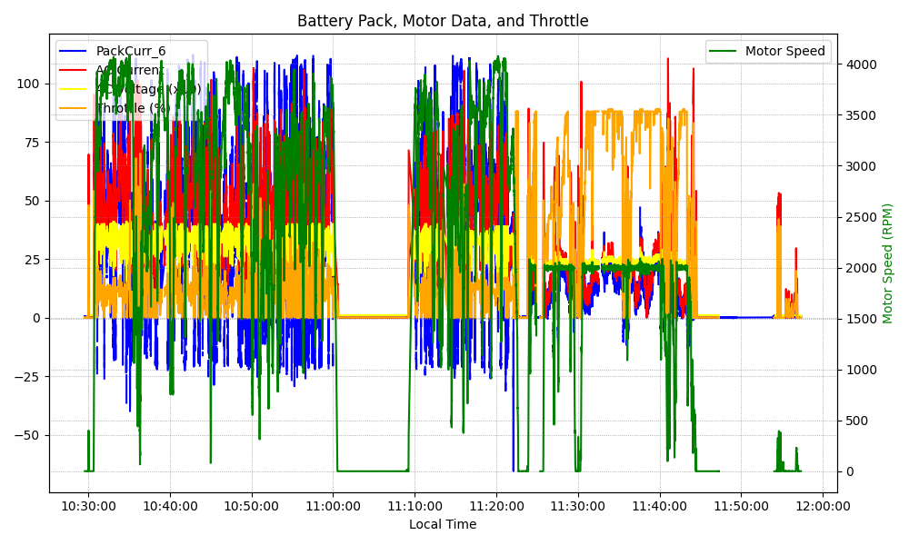
Graph Analysis

