Slide 1
Analysis Results from Folder - Battery_3

Slide 2
Analysis Results:
Metric | Value
Date and Time | 29/03/2024 12:03:07 to 29/03/2024 13:06:51
Byte Beam ID | 3
Total time taken for the ride | 0 days 01:03:43.781000
Actual Ampere-hours (Ah) | 20.332472222222222
Actual Watt-hours (Wh)- Calculated_UsingFormala | 1044.7693491916668
Starting SoC (Ah) | 15.477
Ending SoC (Ah) | 35.909
Starting SoC (%) | 99.0
Ending SoC (%) | 39.0
Total distance covered (km) | 24.613425199214984
Total energy consumption(WH/KM) | 42.447133657163185
Total SOC consumed(%) | 60.0
Mode | Sports mode 80.20% Eco mode 0.18%

Slide 3
Analysis Results:
Metric | Value
Peak Power(kW) | 5693.310865
Average Power(kW) | 993.9666112817125
Total Energy Regenerated(kWh) | 26.59260405527778
Regenerative Effectiveness(%) | 2.4821307098580805
Highest Cell Voltage(V) | 3.491
Lowest Cell Voltage(V) | 3.111
Difference in Cell Voltage(V) | 0.3799999999999999
Minimum Temperature(C) | -6.0
Maximum Temperature(C) | 40.0
Difference in Temperature(C) | 46.0
Maximum Fet Temperature-BMS(C) | 58.0
Maximum Afe Temperature-BMS(C) | 57.0
Maximum PCB Temperature-BMS(C) | 55.0

Slide 4
Analysis Results:
Metric | Value
Maximum MCU Temperature(C) | 52.0
Maximum Motor Temperature(C) | 85.0
Abnormal Motor Temperature Detected(C) | False
highest cell temp(C) | 40.0
lowest cell temp(C) | -7.0
Difference between Highest and Lowest Cell Temperature at 100% SOC(C) | 47.0
Battery Voltage(V) | 68.0
Total energy charged(kWh)- Calculated_BatteryData | 1.3826081111111113
Electricity consumption units(kW) | 1.0045979823227186e-07
Cycle Count of battery | 154.0
Idling time percentage | 35.32623348611486
Time spent in 0-10 km/h | 9.679158802911836
Time spent in 10-20 km/h | 5.941628471286061

Slide 5
Analysis Results:
Metric | Value
Time spent in 20-30 km/h | 5.196818549474251
Time spent in 30-40 km/h | 5.2338905365327575
Time spent in 40-50 km/h | 7.448099218118092
Time spent in 50-60 km/h | 19.108924238339174
Time spent in 60-70 km/h | 11.991102723105959
Time spent in 70-80 km/h | 0.0
Time spent in 80-90 km/h | 0.0

Slide 6
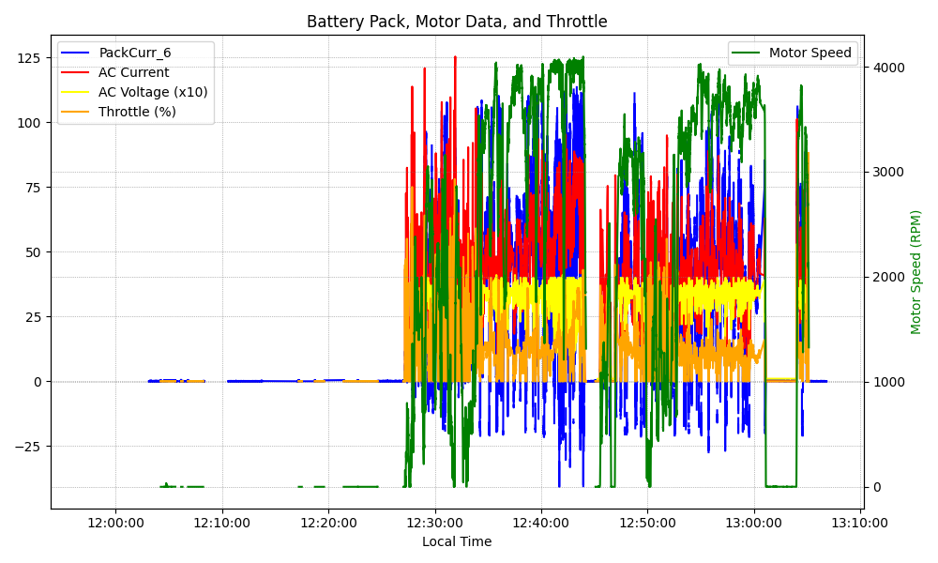
Graph Analysis

