Slide 1
Analysis Results from Folder - Battery_4

Slide 2
Analysis Results:
Metric | Value
Date and Time | 29/03/2024 13:08:11 to 29/03/2024 14:07:47
Byte Beam ID | 3
Total time taken for the ride | 0 days 00:59:35.959000
Actual Ampere-hours (Ah) | 20.866296388888884
Actual Watt-hours (Wh)- Calculated_UsingFormala | 1071.1105080813888
Starting SoC (Ah) | 0.964
Ending SoC (Ah) | 39.568
Starting SoC (%) | 99.0
Ending SoC (%) | 2.0
Total distance covered (km) | 24.44267882751233
Total energy consumption(WH/KM) | 43.821322353414146
Total SOC consumed(%) | 97.0
Mode | Sports mode 95.74% Eco mode 0.10%

Slide 3
Analysis Results:
Metric | Value
Peak Power(kW) | 5704.181581
Average Power(kW) | 1085.8906868749646
Total Energy Regenerated(kWh) | 33.639729975555554
Regenerative Effectiveness(%) | 3.0450077145691994
Highest Cell Voltage(V) | 3.474
Lowest Cell Voltage(V) | 2.994
Difference in Cell Voltage(V) | 0.48
Minimum Temperature(C) | 32.0
Maximum Temperature(C) | 43.0
Difference in Temperature(C) | 11.0
Maximum Fet Temperature-BMS(C) | 66.0
Maximum Afe Temperature-BMS(C) | 63.0
Maximum PCB Temperature-BMS(C) | 61.0

Slide 4
Analysis Results:
Metric | Value
Maximum MCU Temperature(C) | 59.0
Maximum Motor Temperature(C) | 99.0
Abnormal Motor Temperature Detected(C) | False
highest cell temp(C) | 43.0
lowest cell temp(C) | 32.0
Difference between Highest and Lowest Cell Temperature at 100% SOC(C) | 11.0
Battery Voltage(V) | 54.0
Total energy charged(kWh)- Calculated_BatteryData | 1.1267800049999996
Electricity consumption units(kW) | 8.75508939393939e-08
Cycle Count of battery | 136.0
Idling time percentage | 47.99435662295187
Time spent in 0-10 km/h | 3.661782152820085
Time spent in 10-20 km/h | 4.31590085612595

Slide 5
Analysis Results:
Metric | Value
Time spent in 20-30 km/h | 5.133549235258281
Time spent in 30-40 km/h | 5.043768236765319
Time spent in 40-50 km/h | 4.341552569981082
Time spent in 50-60 km/h | 11.889569371853657
Time spent in 60-70 km/h | 17.548978741142143
Time spent in 70-80 km/h | 0.0
Time spent in 80-90 km/h | 0.0

Slide 6
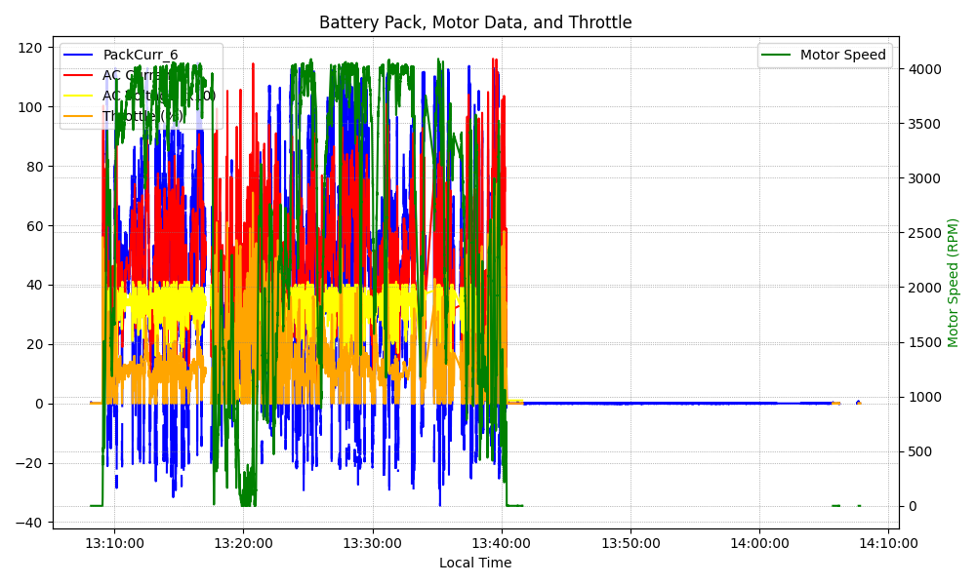
Graph Analysis

