Slide 1
Analysis Results from Folder - Battery_1

Slide 2
Analysis Results:
Metric | Value
Date and Time | 30/03/2024 08:01:58 to 30/03/2024 09:38:47
Byte Beam ID | 3
Total time taken for the ride | 0 days 01:36:48.408000
Actual Ampere-hours (Ah) | 32.92925222222222
Actual Watt-hours (Wh)- Calculated_UsingFormala | 1685.1588381830557
Starting SoC (Ah) | 7.696
Ending SoC (Ah) | 33.24
Starting SoC (%) | 99.0
Ending SoC (%) | 19.0
Total distance covered (km) | 47.84151049757937
Total energy consumption(WH/KM) | 35.223779948760594
Total SOC consumed(%) | 80.0
Mode | Sports mode 63.70% Custom mode 22.07% Eco mode 8.08%

Slide 3
Analysis Results:
Metric | Value
Peak Power(kW) | 5853.216617
Average Power(kW) | 1047.7671532744387
Total Energy Regenerated(kWh) | 44.77938417944444
Regenerative Effectiveness(%) | 2.588496144000519
Highest Cell Voltage(V) | 3.383
Lowest Cell Voltage(V) | 3.051
Difference in Cell Voltage(V) | 0.33199999999999985
Minimum Temperature(C) | 27.0
Maximum Temperature(C) | 40.0
Difference in Temperature(C) | 13.0
Maximum Fet Temperature-BMS(C) | 57.0
Maximum Afe Temperature-BMS(C) | 56.0
Maximum PCB Temperature-BMS(C) | 55.0

Slide 4
Analysis Results:
Metric | Value
Maximum MCU Temperature(C) | 41.0
Maximum Motor Temperature(C) | 72.0
Abnormal Motor Temperature Detected(C) | False
highest cell temp(C) | 40.0
lowest cell temp(C) | 27.0
Difference between Highest and Lowest Cell Temperature at 100% SOC(C) | 13.0
Battery Voltage(V) | 54.0
Total energy charged(kWh)- Calculated_BatteryData | 1.7781796199999997
Electricity consumption units(kW) | 8.504455635904499e-08
Cycle Count of battery | 137.0
Idling time percentage | 32.24925363653687
Time spent in 0-10 km/h | 4.253742404031422
Time spent in 10-20 km/h | 2.3989497977937284

Slide 5
Analysis Results:
Metric | Value
Time spent in 20-30 km/h | 2.7525461051472613
Time spent in 30-40 km/h | 10.207711363780728
Time spent in 40-50 km/h | 5.210781511359546
Time spent in 50-60 km/h | 32.32971267653348
Time spent in 60-70 km/h | 10.52319549429376
Time spent in 70-80 km/h | 0.0
Time spent in 80-90 km/h | 0.0

Slide 6
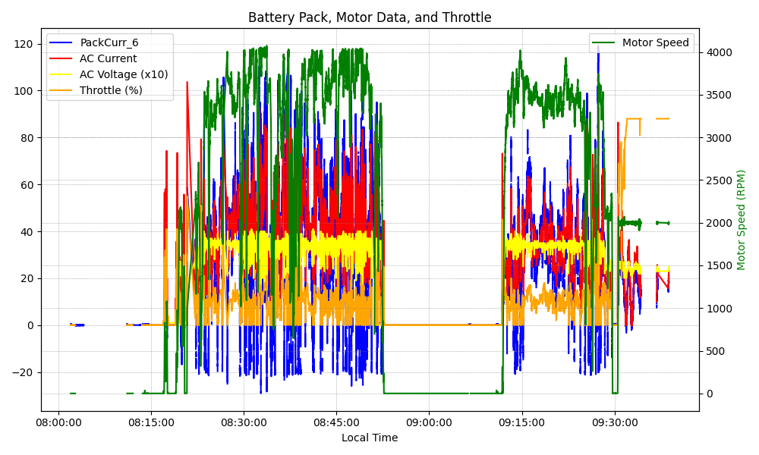
Graph Analysis

