Slide 1
Analysis Results from Folder - Battery_2

Slide 2
Analysis Results:
Metric | Value
Date and Time | 30/03/2024 10:04:25 to 30/03/2024 11:07:37
Byte Beam ID | 3
Total time taken for the ride | 0 days 01:03:11.053000
Actual Ampere-hours (Ah) | 24.150104722222224
Actual Watt-hours (Wh)- Calculated_UsingFormala | 1237.549269568333
Starting SoC (Ah) | 5.04
Ending SoC (Ah) | 32.626
Starting SoC (%) | 82.0
Ending SoC (%) | 12.0
Total distance covered (km) | 39.45268526053181
Total energy consumption(WH/KM) | 31.36793506946329
Total SOC consumed(%) | 70.0
Mode | Sports mode 58.32% Eco mode 41.68%

Slide 3
Analysis Results:
Metric | Value
Peak Power(kW) | 5638.932333999999
Average Power(kW) | 1181.431283597454
Total Energy Regenerated(kWh) | 27.411428162222222
Regenerative Effectiveness(%) | 2.1669786430045295
Highest Cell Voltage(V) | 3.293
Lowest Cell Voltage(V) | 3.067
Difference in Cell Voltage(V) | 0.22599999999999998
Minimum Temperature(C) | 32.0
Maximum Temperature(C) | 43.0
Difference in Temperature(C) | 11.0
Maximum Fet Temperature-BMS(C) | 61.0
Maximum Afe Temperature-BMS(C) | 60.0
Maximum PCB Temperature-BMS(C) | 57.0

Slide 4
Analysis Results:
Metric | Value
Maximum MCU Temperature(C) | 48.0
Maximum Motor Temperature(C) | 84.0
Abnormal Motor Temperature Detected(C) | False
highest cell temp(C) | 43.0
lowest cell temp(C) | 32.0
Difference between Highest and Lowest Cell Temperature at 100% SOC(C) | 11.0
Battery Voltage(V) | 53.0
Total energy charged(kWh)- Calculated_BatteryData | 1.2799555502777777
Electricity consumption units(kW) | 9.378612725151512e-08
Cycle Count of battery | 64.0
Idling time percentage | 6.486952240275726
Time spent in 0-10 km/h | 12.276382734285244
Time spent in 10-20 km/h | 6.03151157065485

Slide 5
Analysis Results:
Metric | Value
Time spent in 20-30 km/h | 7.795831281798786
Time spent in 30-40 km/h | 42.65960938782209
Time spent in 40-50 km/h | 3.9102248481864437
Time spent in 50-60 km/h | 8.887247661250615
Time spent in 60-70 km/h | 11.898900377482356
Time spent in 70-80 km/h | 0.0
Time spent in 80-90 km/h | 0.0

Slide 6
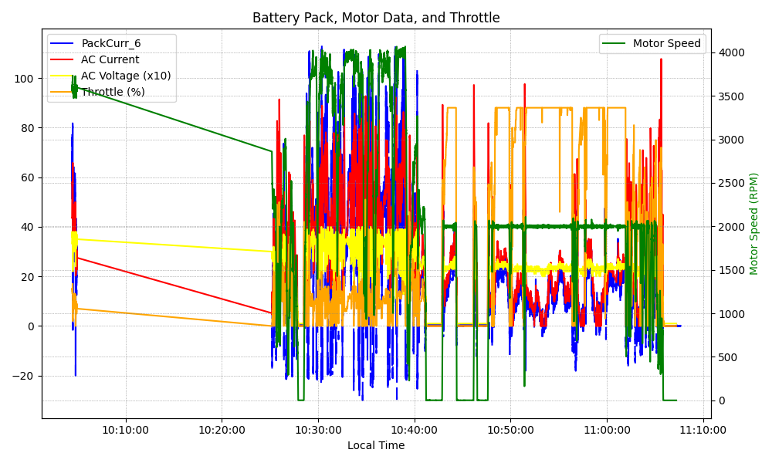
Graph Analysis

