Slide 1
Analysis Results from Folder - Battery_3

Slide 2
Analysis Results:
Metric | Value
Date and Time | 30/03/2024 11:08:51 to 30/03/2024 17:16:03
Byte Beam ID | 3
Total time taken for the ride | 0 days 06:07:12.195000
Actual Ampere-hours (Ah) | 36.88209194444445
Actual Watt-hours (Wh)- Calculated_UsingFormala | 1908.812668406667
Starting SoC (Ah) | 2.514
Ending SoC (Ah) | 35.724
Starting SoC (%) | 99.0
Ending SoC (%) | 6.0
Total distance covered (km) | 65.70010983250648
Total energy consumption(WH/KM) | 29.05341670315203
Total SOC consumed(%) | 93.0
Mode | Eco mode 99.63% Sports mode 0.37%

Slide 3
Analysis Results:
Metric | Value
Peak Power(kW) | 5413.50075
Average Power(kW) | 312.4221689594908
Total Energy Regenerated(kWh) | 77.71281259666668
Regenerative Effectiveness(%) | 3.911996767210674
Highest Cell Voltage(V) | 3.475
Lowest Cell Voltage(V) | 3.008
Difference in Cell Voltage(V) | 0.4670000000000001
Minimum Temperature(C) | 28.0
Maximum Temperature(C) | 47.0
Difference in Temperature(C) | 19.0
Maximum Fet Temperature-BMS(C) | 52.0
Maximum Afe Temperature-BMS(C) | 55.0
Maximum PCB Temperature-BMS(C) | 52.0

Slide 4
Analysis Results:
Metric | Value
Maximum MCU Temperature(C) | 51.0
Maximum Motor Temperature(C) | 67.0
Abnormal Motor Temperature Detected(C) | False
highest cell temp(C) | 47.0
lowest cell temp(C) | 28.0
Difference between Highest and Lowest Cell Temperature at 100% SOC(C) | 19.0
Battery Voltage(V) | 54.0
Total energy charged(kWh)- Calculated_BatteryData | 1.9916329650000002
Electricity consumption units(kW) | 2.511035671598887e-08
Cycle Count of battery | 154.0
Idling time percentage | 7.491453760345449
Time spent in 0-10 km/h | 11.214690536164088
Time spent in 10-20 km/h | 6.777392947103275

Slide 5
Analysis Results:
Metric | Value
Time spent in 20-30 km/h | 18.069674343288952
Time spent in 30-40 km/h | 56.390563152213026
Time spent in 40-50 km/h | 0.0
Time spent in 50-60 km/h | 0.0
Time spent in 60-70 km/h | 0.0
Time spent in 70-80 km/h | 0.0
Time spent in 80-90 km/h | 0.0

Slide 6
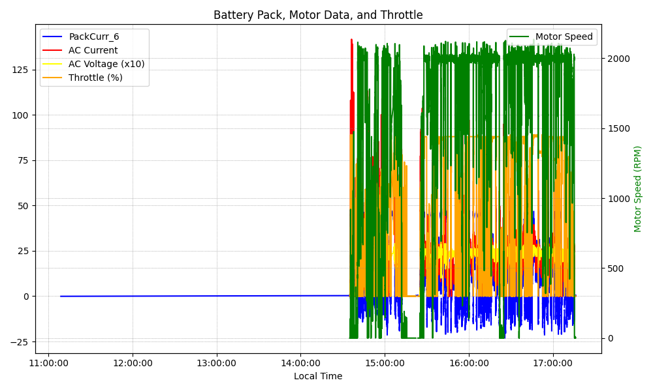
Graph Analysis

