Slide 1
Analysis Results from Folder - Battery_4

Slide 2
Analysis Results:
Metric | Value
Date and Time | 30/03/2024 17:17:23 to 30/03/2024 18:07:43
Byte Beam ID | 3
Total time taken for the ride | 0 days 00:50:19.795000
Actual Ampere-hours (Ah) | 29.158254166666666
Actual Watt-hours (Wh)- Calculated_UsingFormala | 1489.9211397208335
Starting SoC (Ah) | 11.477
Ending SoC (Ah) | 39.528
Starting SoC (%) | 99.0
Ending SoC (%) | 28.0
Total distance covered (km) | 32.221888550145906
Total energy consumption(WH/KM) | 46.23941074720423
Total SOC consumed(%) | 71.0
Mode | Sports mode 93.81% Eco mode 0.45%

Slide 3
Analysis Results:
Metric | Value
Peak Power(kW) | 5820.2098240000005
Average Power(kW) | 1787.9053676650003
Total Energy Regenerated(kWh) | 102.30574759861112
Regenerative Effectiveness(%) | 6.425324708016049
Highest Cell Voltage(V) | 3.456
Lowest Cell Voltage(V) | 3.098
Difference in Cell Voltage(V) | 0.3580000000000001
Minimum Temperature(C) | 35.0
Maximum Temperature(C) | 47.0
Difference in Temperature(C) | 12.0
Maximum Fet Temperature-BMS(C) | 71.0
Maximum Afe Temperature-BMS(C) | 68.0
Maximum PCB Temperature-BMS(C) | 67.0

Slide 4
Analysis Results:
Metric | Value
Maximum MCU Temperature(C) | 53.0
Maximum Motor Temperature(C) | 91.0
Abnormal Motor Temperature Detected(C) | False
highest cell temp(C) | 47.0
lowest cell temp(C) | 35.0
Difference between Highest and Lowest Cell Temperature at 100% SOC(C) | 12.0
Battery Voltage(V) | 54.0
Total energy charged(kWh)- Calculated_BatteryData | 1.574545725
Electricity consumption units(kW) | 1.4487373716462406e-07
Cycle Count of battery | 86.0
Idling time percentage | 5.031084917526144
Time spent in 0-10 km/h | 13.05925899306429
Time spent in 10-20 km/h | 3.8883099148309195

Slide 5
Analysis Results:
Metric | Value
Time spent in 20-30 km/h | 9.70640025874151
Time spent in 30-40 km/h | 11.341502856937506
Time spent in 40-50 km/h | 14.877636827541597
Time spent in 50-60 km/h | 27.308010205915117
Time spent in 60-70 km/h | 14.687174327092393
Time spent in 70-80 km/h | 0.0
Time spent in 80-90 km/h | 0.0

Slide 6
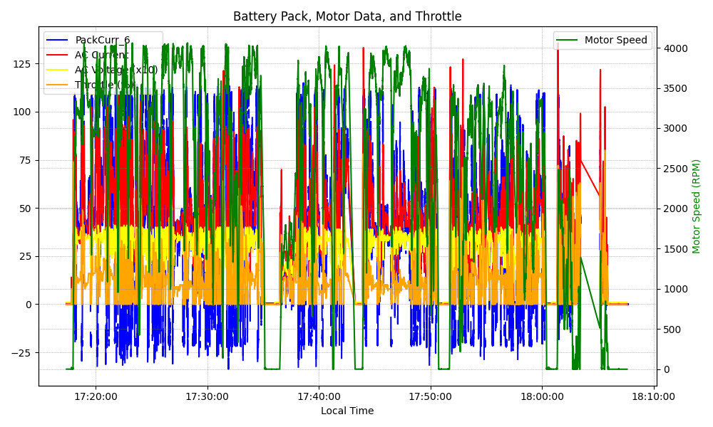
Graph Analysis

