Slide 1
Analysis Results from Folder - Battery_5

Slide 2
Analysis Results:
Metric | Value
Date and Time | 30/03/2024 18:11:09 to 30/03/2024 19:44:11
Byte Beam ID | 3
Total time taken for the ride | 0 days 01:33:02.857000
Actual Ampere-hours (Ah) | 33.3879175
Actual Watt-hours (Wh)- Calculated_UsingFormala | 1703.4534240961111
Starting SoC (Ah) | 4.111
Ending SoC (Ah) | 39.456
Starting SoC (%) | 99.0
Ending SoC (%) | 10.0
Total distance covered (km) | 39.93372127984054
Total energy consumption(WH/KM) | 42.65701691457574
Total SOC consumed(%) | 89.0
Mode | Sports mode 58.68% Eco mode 30.67%

Slide 3
Analysis Results:
Metric | Value
Peak Power(kW) | 5732.056286999999
Average Power(kW) | 1105.7396910829427
Total Energy Regenerated(kWh) | 69.13506965055555
Regenerative Effectiveness(%) | 3.900232337874813
Highest Cell Voltage(V) | 3.509
Lowest Cell Voltage(V) | 3.063
Difference in Cell Voltage(V) | 0.44599999999999973
Minimum Temperature(C) | 33.0
Maximum Temperature(C) | 46.0
Difference in Temperature(C) | 13.0
Maximum Fet Temperature-BMS(C) | 71.0
Maximum Afe Temperature-BMS(C) | 62.0
Maximum PCB Temperature-BMS(C) | 63.0

Slide 4
Analysis Results:
Metric | Value
Maximum MCU Temperature(C) | 54.0
Maximum Motor Temperature(C) | 94.0
Abnormal Motor Temperature Detected(C) | False
highest cell temp(C) | 46.0
lowest cell temp(C) | 33.0
Difference between Highest and Lowest Cell Temperature at 100% SOC(C) | 13.0
Battery Voltage(V) | 54.0
Total energy charged(kWh)- Calculated_BatteryData | 1.802947545
Electricity consumption units(kW) | 8.972030858115372e-08
Cycle Count of battery | 137.0
Idling time percentage | 13.879449114648542
Time spent in 0-10 km/h | 11.599992050716429
Time spent in 10-20 km/h | 16.06947673840895

Slide 5
Analysis Results:
Metric | Value
Time spent in 20-30 km/h | 18.895447047834814
Time spent in 30-40 km/h | 19.565174188676245
Time spent in 40-50 km/h | 7.748564160655021
Time spent in 50-60 km/h | 6.480653431109522
Time spent in 60-70 km/h | 5.661877223315249
Time spent in 70-80 km/h | 0.0
Time spent in 80-90 km/h | 0.0

Slide 6
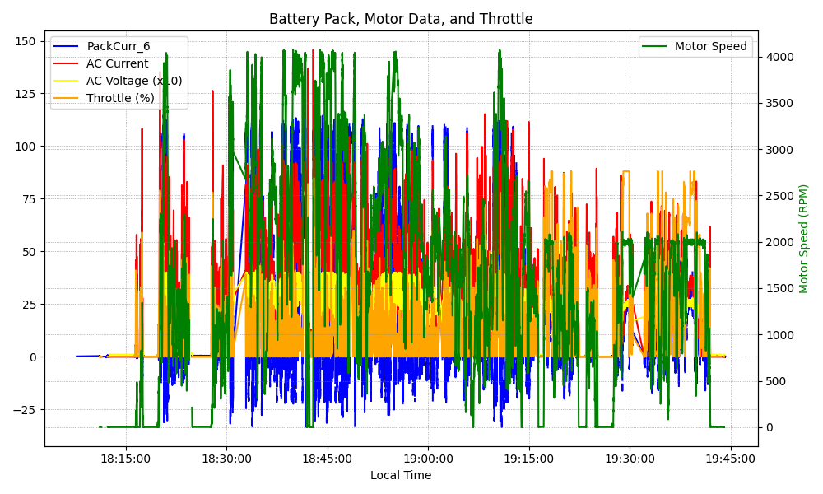
Graph Analysis

