Slide 1
Analysis Results from Folder - Battery_6

Slide 2
Analysis Results:
Metric | Value
Date and Time | 30/03/2024 19:45:49 to 30/03/2024 21:20:22
Byte Beam ID | 3
Total time taken for the ride | 0 days 01:34:33.818000
Actual Ampere-hours (Ah) | 31.113624722222223
Actual Watt-hours (Wh)- Calculated_UsingFormala | 1592.2465592030555
Starting SoC (Ah) | 6.526
Ending SoC (Ah) | 39.445
Starting SoC (%) | 99.0
Ending SoC (%) | 16.0
Total distance covered (km) | 41.31951856138454
Total energy consumption(WH/KM) | 38.53497365506822
Total SOC consumed(%) | 83.0
Mode | Sports mode 67.53% Eco mode 22.85% Custom mode 0.04%

Slide 3
Analysis Results:
Metric | Value
Peak Power(kW) | 5584.624452
Average Power(kW) | 1017.409941982783
Total Energy Regenerated(kWh) | 75.6588469438889
Regenerative Effectiveness(%) | 4.53615934483177
Highest Cell Voltage(V) | 3.532
Lowest Cell Voltage(V) | 3.081
Difference in Cell Voltage(V) | 0.45100000000000007
Minimum Temperature(C) | 31.0
Maximum Temperature(C) | 45.0
Difference in Temperature(C) | 14.0
Maximum Fet Temperature-BMS(C) | 71.0
Maximum Afe Temperature-BMS(C) | 67.0
Maximum PCB Temperature-BMS(C) | 66.0

Slide 4
Analysis Results:
Metric | Value
Maximum MCU Temperature(C) | 50.0
Maximum Motor Temperature(C) | 87.0
Abnormal Motor Temperature Detected(C) | False
highest cell temp(C) | 45.0
lowest cell temp(C) | 31.0
Difference between Highest and Lowest Cell Temperature at 100% SOC(C) | 14.0
Battery Voltage(V) | 68.0
Total energy charged(kWh)- Calculated_BatteryData | 2.1157264811111114
Electricity consumption units(kW) | 1.0359629830929704e-07
Cycle Count of battery | 138.0
Idling time percentage | 14.633905273978018
Time spent in 0-10 km/h | 9.887720408001897
Time spent in 10-20 km/h | 11.340634142484383

Slide 5
Analysis Results:
Metric | Value
Time spent in 20-30 km/h | 22.63382620384281
Time spent in 30-40 km/h | 21.59603067921246
Time spent in 40-50 km/h | 10.33248991855776
Time spent in 50-60 km/h | 6.19514509369811
Time spent in 60-70 km/h | 3.2557128172689174
Time spent in 70-80 km/h | 0.0
Time spent in 80-90 km/h | 0.0

Slide 6
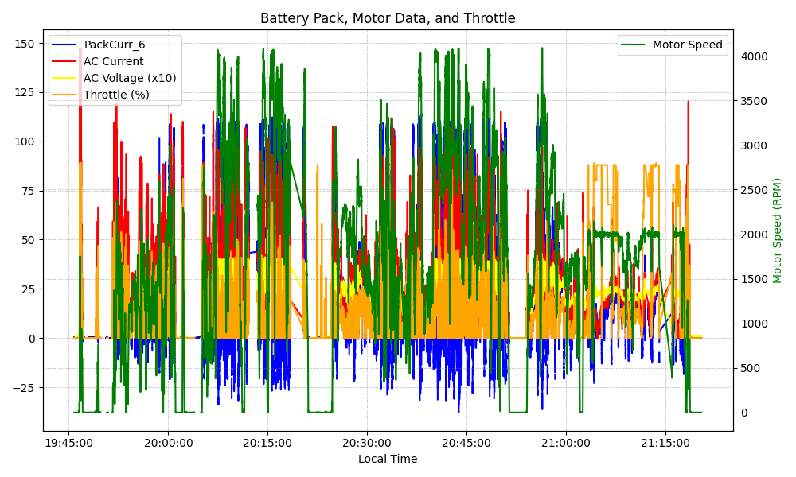
Graph Analysis

