Slide 1
Analysis Results from Folder - Battery_1

Slide 2
Analysis Results:
Metric | Value
Date and Time | 13/03/2024 06:20:34 to 13/03/2024 08:29:59
Byte Beam ID | 3
Total time taken for the ride | 0 days 02:09:25.258000
Actual Ampere-hours (Ah) | 35.866119999999995
Actual Watt-hours (Wh)- Calculated_UsingFormala | 1843.3347974430553
Starting SoC (Ah) | 3.77
Ending SoC (Ah) | 39.574
Starting SoC (%) | 99.0
Ending SoC (%) | 9.0
Total distance covered (km) | 63.080909913633725
Total energy consumption(WH/KM) | 29.221753458642706
Total SOC consumed(%) | 90.0
Mode | Eco mode 99.75% Sports mode 0.01%

Slide 3
Analysis Results:
Metric | Value
Peak Power(kW) | 2525.98787
Average Power(kW) | 858.6963342126033
Total Energy Regenerated(kWh) | 108.10490328805557
Regenerative Effectiveness(%) | 5.5397511512937765
Highest Cell Voltage(V) | 3.459
Lowest Cell Voltage(V) | 2.878
Difference in Cell Voltage(V) | 0.581
Minimum Temperature(C) | 27.0
Maximum Temperature(C) | 39.0
Difference in Temperature(C) | 12.0
Maximum Fet Temperature-BMS(C) | 55.0
Maximum Afe Temperature-BMS(C) | 60.0
Maximum PCB Temperature-BMS(C) | 54.0

Slide 4
Analysis Results:
Metric | Value
Maximum MCU Temperature(C) | 35.0
Maximum Motor Temperature(C) | 0.0
Abnormal Motor Temperature Detected(C) | False
highest cell temp(C) | 39.0
lowest cell temp(C) | 27.0
Difference between Highest and Lowest Cell Temperature at 100% SOC(C) | 12.0
Battery Voltage(V) | 56.0
Total energy charged(kWh)- Calculated_BatteryData | 2.0085027199999996
Electricity consumption units(kW) | 7.185027974529582e-08
Cycle Count of battery | 78.0
Idling time percentage | 7.23357703185869
Time spent in 0-10 km/h | 7.945994983723785
Time spent in 10-20 km/h | 9.577618869736911

Slide 5
Analysis Results:
Metric | Value
Time spent in 20-30 km/h | 15.18490847964139
Time spent in 30-40 km/h | 41.97662628742195
Time spent in 40-50 km/h | 16.809861785580875
Time spent in 50-60 km/h | 0.0
Time spent in 60-70 km/h | 0.0
Time spent in 70-80 km/h | 0.0
Time spent in 80-90 km/h | 0.0

Slide 6
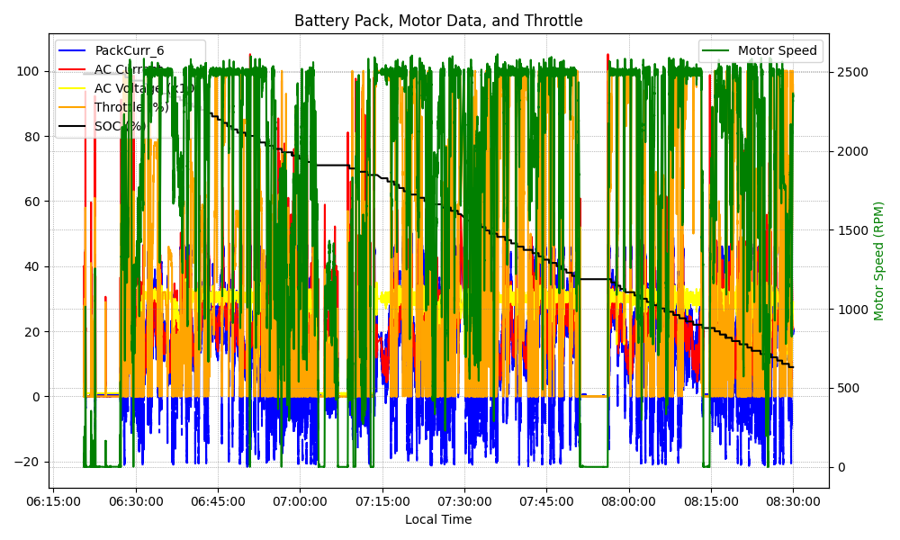
Graph Analysis

