Slide 1
Analysis Results from Folder - B4_17.33_21.40

Slide 2
Analysis Results:
Metric | Value
Total time taken for the ride | 0 days 03:07:38.976000
Actual Ampere-hours (Ah) | 95.66005027777777
Actual Watt-hours (Wh) | 4811.2129312216675
Starting SoC (Ah) | 38.775
Ending SoC (Ah) | 29.046
Starting SoC (%) | 99.0
Ending SoC (%) | 22.0
Total distance covered (km) | 99.76402742530136
Total energy consumption(WH/KM) | 48.22592927920917
Total SOC consumed(%) | 77.0
Mode | Custom mode 78.44% Eco mode 14.93% Sports mode 0.05%
Peak Power(kW) | 5724.067349
Average Power(kW) | -1546.7375024466871

Slide 3
Analysis Results:
Metric | Value
Total Energy Regenerated(kWh) | 0.26685383888888886
Regenerative Effectiveness(%) | 0.005546190586053358
Highest Cell Voltage(V) | 3.331
Lowest Cell Voltage(V) | 2.963
Difference in Cell Voltage(V) | 0.3679999999999999
Minimum Temperature(C) | 25.0
Maximum Temperature(C) | 41.0
Difference in Temperature(C) | 16.0
Maximum Fet Temperature-BMS(C) | 70.0
Maximum Afe Temperature-BMS(C) | 63.0
Maximum PCB Temperature-BMS(C) | 64.0
Maximum MCU Temperature(C) | 66.0
Maximum Motor Temperature(C) | 102.0

Slide 4
Analysis Results:
Metric | Value
Abnormal Motor Temperature Detected(C) | False
highest cell temp(C) | 41.0
lowest cell temp(C) | 25.0
Difference between Highest and Lowest Cell Temperature at 100% SOC(C) | 16.0
Battery Voltage(V) | 55.0
Total energy charged(kWh) | 5.261302765277778
Electricity consumption units(kW) | 1.2981639637190782e-07
Idling time percentage | 30.276850579226387
Time spent in 0-10 km/h | 7.0582405355623505
Time spent in 10-20 km/h | 4.686170560900583
Time spent in 20-30 km/h | 7.4397165109908086
Time spent in 30-40 km/h | 8.744027750507232
Time spent in 40-50 km/h | 8.604714220264977

Slide 5
Analysis Results:
Metric | Value
Time spent in 50-60 km/h | 8.254092919319701
Time spent in 60-70 km/h | 12.130562022570663
Time spent in 70-80 km/h | 12.67753125204529
Time spent in 80-90 km/h | 0.0

Slide 6
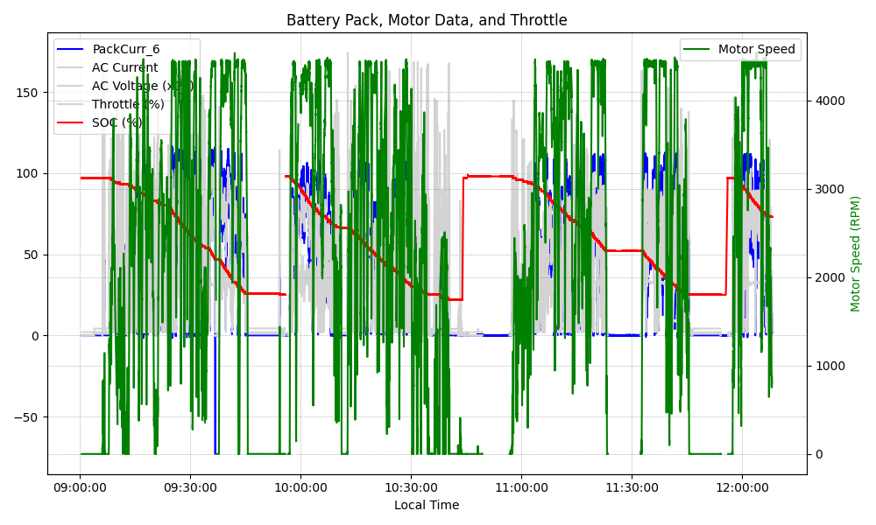
Graph Analysis

