Slide 1



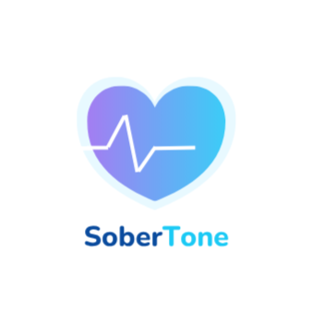


SOBERTONE
PITCH DECK
An AI-Powered ADDICTION PREVENTION SUPPORT

Slide 2

PROBLEM
  350M+ people worldwide struggle with addiction.
  Relapse rates exceed 60% due to lack of real-time emotional support.
  Existing rehab and therapy options are expensive, inaccessible, and impersonal.
02

Slide 3

SOBERTONE
  Sobertone: An AI-driven mobile app that uses personalized voice-based interaction to guide users through cravings and triggers.
  Users can choose a familiar, comforting voice (friend/family) to receive tailored support messages and guidance.
  Combines emotional AI + CBT-based behavior modeling.
03

Slide 4
MARKET OPPORTUNITY
1.
Target TAM (Global Addiction Treatment Market): $35B+ (growing at 6.5% CAGR).
2.
SAM (India & SE Asia): $4.8B.
3.
SOM (Initial Focus): ₹200 Cr potential user base in India’s digital wellness segment.
4.
Increasing smartphone usage + rising acceptance of digital therapy apps.
04

Slide 5
MARKET STRATEGY
1.
Freemium Model: Free access + premium subscription (₹1,500/month).
2.
User Acquisition Channels:
  Partnerships with rehab centers & universities.
  Influencer campaigns on Instagram/YouTube.
  Referral incentives for users.
3.
Retention: Gamified habit tracking, streak rewards, and voice personalization.
05

Slide 6
BUSINESS MODEL
1.
Revenue Streams:
  Premium Subscriptions (B2C)
  Enterprise Wellness Partnerships (B2B)
  In-app AI voice licensing
2.
Pricing: ₹1,500/month premium subscription.
3.
Gross Margin: 70%.
4.
CLV:CAC Ratio: 11.25:1
06

Slide 7
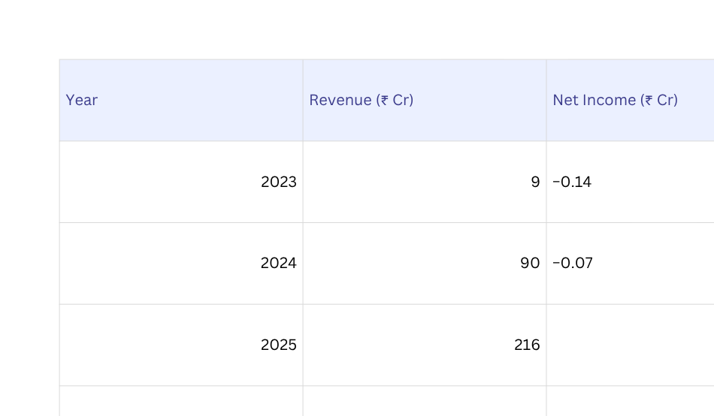
FINANCIAL PROJECTIONS
07

Slide 8
VALUATION(PRE-REVENUE)
  We used Berkus Method because it emphasizes qualitative risk reduction milestones — idea, team, prototype, and traction — which accurately reflect Sobertone’s current development stage.
  We used Scorecard Method to complement this by benchmarking Sobertone against comparable early-stage AI wellness startups in India, adjusting valuation based on relative strengths and weaknesses.
08

Slide 9
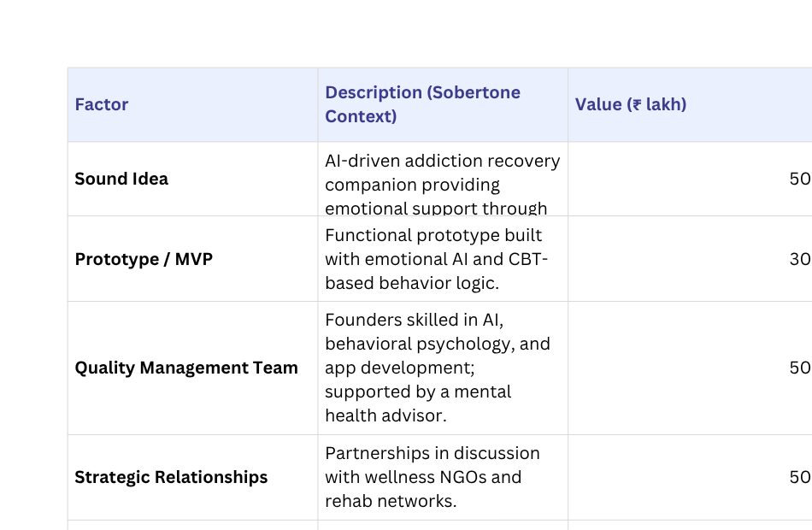
BERKUS METHOD
09

Slide 10
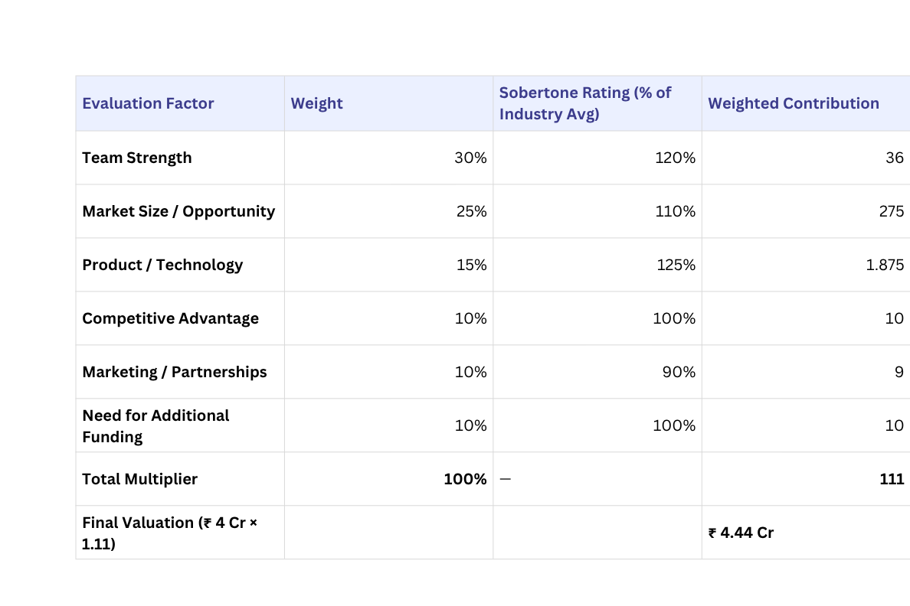
SCORECARD METHOD
10

Slide 11
ASK
  Ask: ₹1 Cr Seed Round
  Pre-Money Valuation: ₹3.25 Cred support messages and guidance.
  Equity Offered: ~23.5%
  Post-Money Valuation: ₹4.25 Cr
11

Slide 12
USE OF FUND
  40% Product & AI Development
  35% Marketing & Partnerships
  15% Team Expansion
  10% Operations & Infrastructure
12

Slide 13
INVESTOR TARGETING STRATEGY
Ideal Investor Profile: Angel / Micro-VCs focusing on AI, HealthTech, and social impact.
Cheque Size: ₹50L–₹2Cr
Value Add: Mentorship, healthtech network access, AI expertise..
13

Slide 14
INVESTOR TARGET LIST
Investor / Firm | Type | Rationale
LetsVenture Angels | Angel Network | Early AI wellness focus
Better Capital | Seed VC | AI SaaS & wellness interest
Indian Angel Network | Angel | Large investor base
Venture Catalysts | Angel+VC | Social-impact focus
Blue Ashva Capital | Impact VC | Wellness & sustainability
14

Slide 15
EXIT STRATEGY
Potential Exit Paths:
  Acquisition by major health-tech or AI wellness platforms (e.g., Headspace, Calm).
  Strategic buyout by healthcare corporations entering digital mental wellness.
  Expected Horizon: 5–7 years.
  Projected Exit Multiple: 6–8x for early investors.
15

Slide 16

COMPETITIVE EDGE
  Emotional AI + Familiar Voice Tech (unique IP)
  Hybrid of psychology + technology
  High retention and low CAC via community-driven approach.
16

Slide 17

TEAM
  Ankit Jangir – Founder & CEO (AI/ML Specialist, Behavioral Psychology Enthusiast)
  Ayush(Tech Lead) – Responsible for AI voice engine and app architecture.
  Vikas kumar(Marketing Specialist)– Responsible for social media and all forms of marketing.
  Rao Krishna (Advisor) – Mental Health Enthusiast
17

Slide 18
THANK YOU
18

