Slide 1
COMP1521 WEEK 2 - MIPS
Siyu (Annie) Qiu

Slide 2

Announcements
Lab start this week!
Lab1 has been released, due on Week3 Monday midday
Lab2 has been released, due on Week3 Monday midday
No weekly quiz this week!
Feel free to email me!
Notes:
(lab extantion)

Slide 3
01. Mipsy and Mipsy web 02. Quick Revision 03. coding in mips
Table of
content

Slide 4
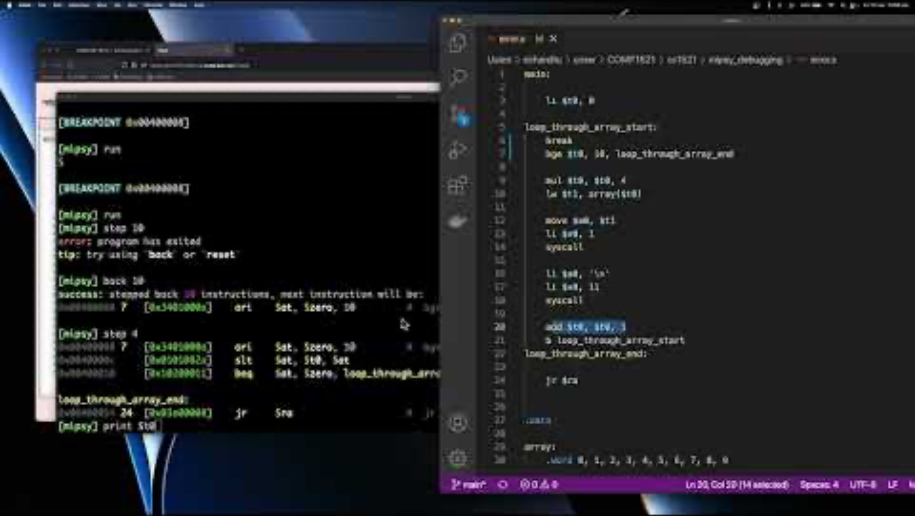
Debugging methods
mipsy-interactive (1521 mipsy)
mipsy-web (https://cs1521.web.cse.unsw.edu.au/mipsy/)
Line-by-line debugging (stepping)
Breakpoints
Printf (syscall) debugging
how to debug in mips:
https://www.youtube.com/watch?v=25lGn6WNC5o

Slide 5
(optional): Transform into simplified C first.
Recommended by the course
Depends on personal taste
More useful as you are first starting MIPS.

Slide 6
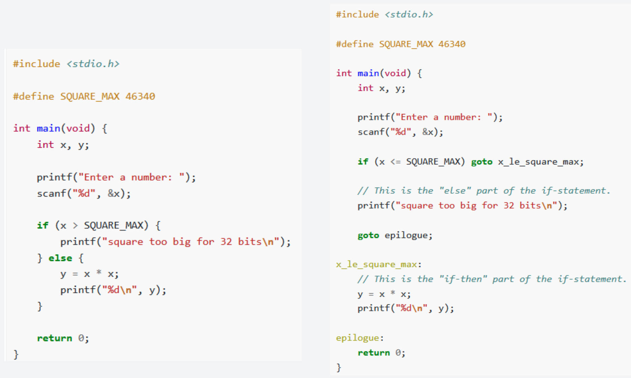
(optional): Transform into simplified C first.
Opposite condition, go to the end
Make labels at each condition

Slide 7
Environment Setup
Try this demo on your laptops!
Open MIPS documentation from course website
Setup C code and MIPS code side by side.
Begin MIPS code with .text and .data sections
set tab size to spaces: 8
Install “Mipsy Editor Features” By Xavier Cooney

Slide 8
Begin Coding! – tutorial q5
Turn Brain Off
Begin translating line by line.
#Includes - Nothing to be done.
#defines - Repeat at the top of .text section.
Make a label with the same name
Assign them (in comments) to a register.
All String Literals must go into the .data

Slide 9
Run your file
1521 mipsy <name_of_file>
Or copy code onto MIPSY web to debug!

Slide 10
Loops
A Conditional (if) statement that loops back to itself at the end!
Same as conditional statements, take the opposite condition and branch to the end,
But create labels for both the end of the conditional statements, and the start!
Make sure to loop back to itself.

Slide 11

Questions and Answers

Slide 12
