Slide 1
COMP1521 WEEK 3 – MIPS – load/store
Siyu (Annie) Qiu

Slide 2

Announcements
Lab start this week!
Lab3 has been released, due on Week 4 Monday 12:00:00 (midday)
The first weekly quiz will be released soon!
come out on Thursday
Due Week 4 Thursday 21:00:00
Assignment1 is on the way!!
Will be released mid week
Notes:
(lab extantion)

Slide 3
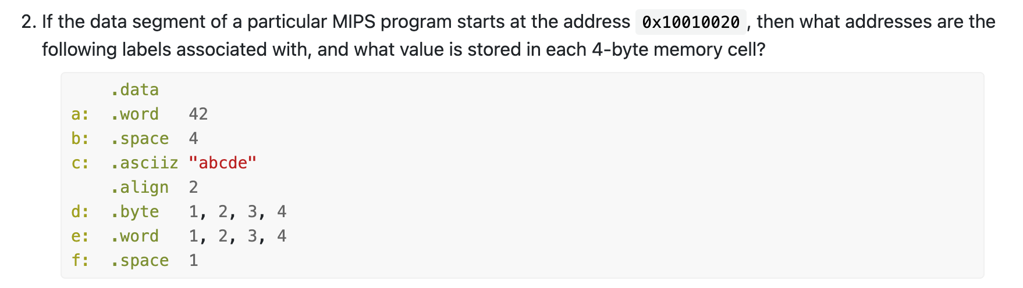
Tutorial question 2
Like C, MIPS has types too!
.word = 4 bytes (int)
.byte = 1 byte (char)
.space 7 = 7 bytes of uninitialized space.

Slide 4
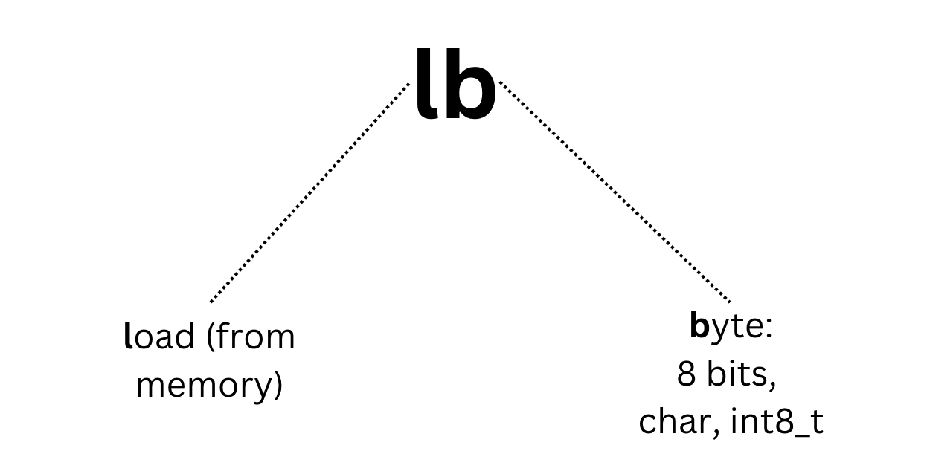

Slide 5
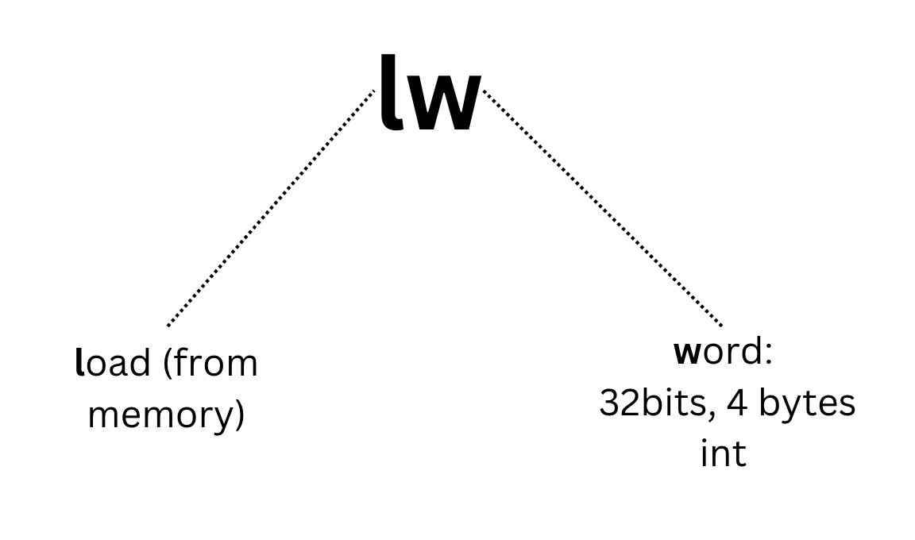

Slide 6
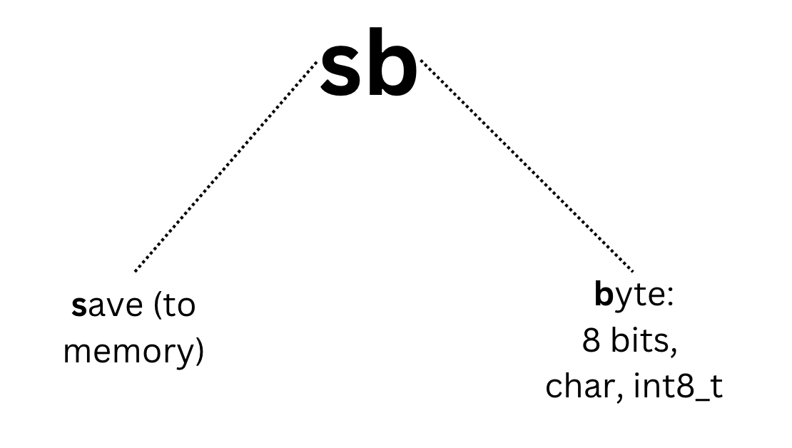

Slide 7
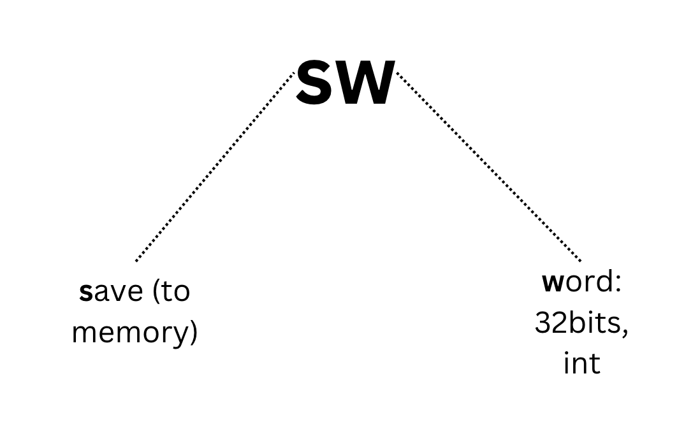

Slide 8
Difference between sb/lb
Store is difference!!
memory address = offset + reference addr
sb $t0, addr
lb $t1, addr

Slide 9
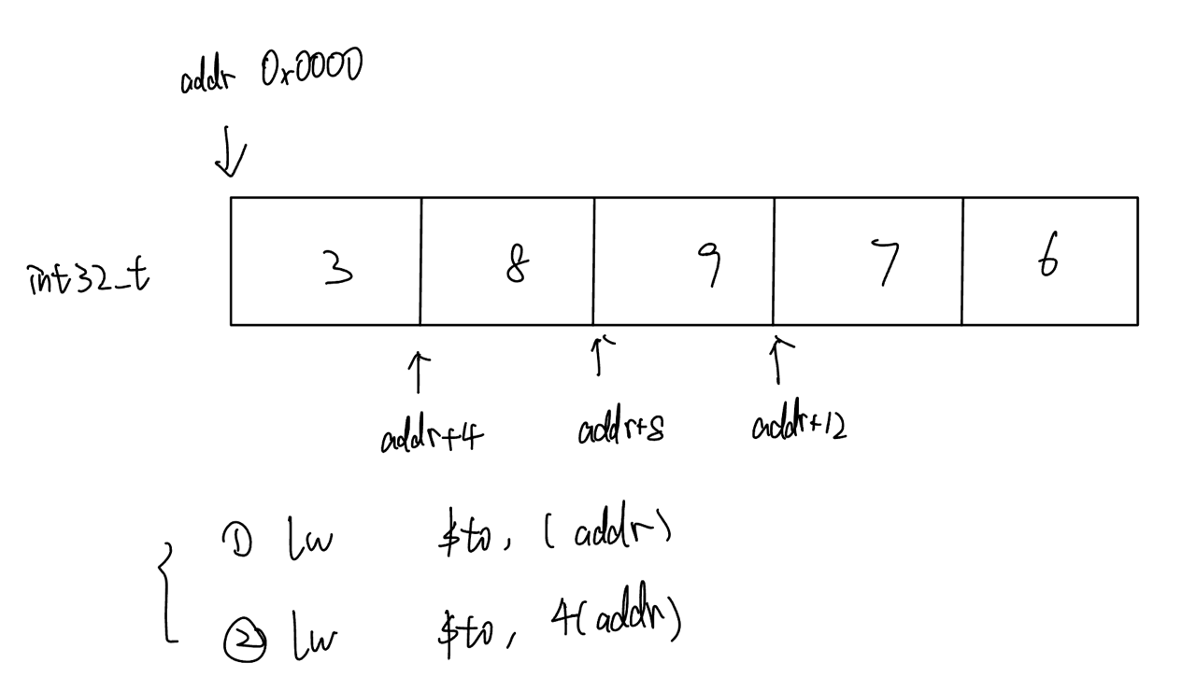
An example

Slide 10
Next step
Address number[i]
Tutorial question 4, 6, 7

Slide 11

Questions and Answers

