Slide 1
COMP1521 WEEK 4 – MIPS function
Siyu (Annie) Qiu

Slide 2
1. Mips 2D-array 2. Structs 3. Mips function 4. Style for ass!!!

Slide 3

Announcements
Lab start this week!
Lab4 has been released, due on Week 5 Monday 12:00:00 (midday)
weekly quiz will be due Week 5 Thursday 21:00:00
Assignment1 will due on Week 5 Friday 18:00:00
Notes:
(lab extantion)

Slide 4
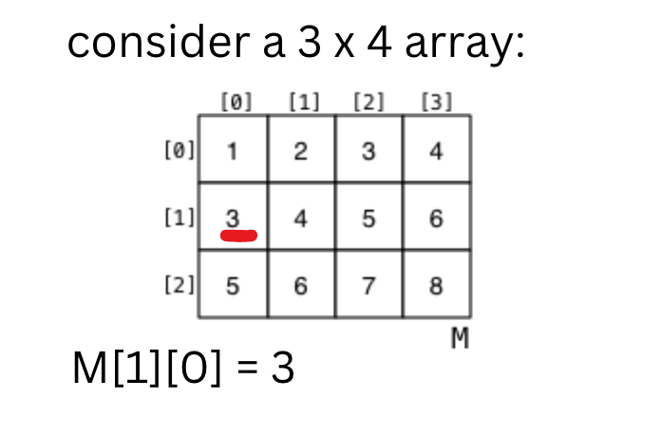
Multi-Dimentional Arrays

Slide 5
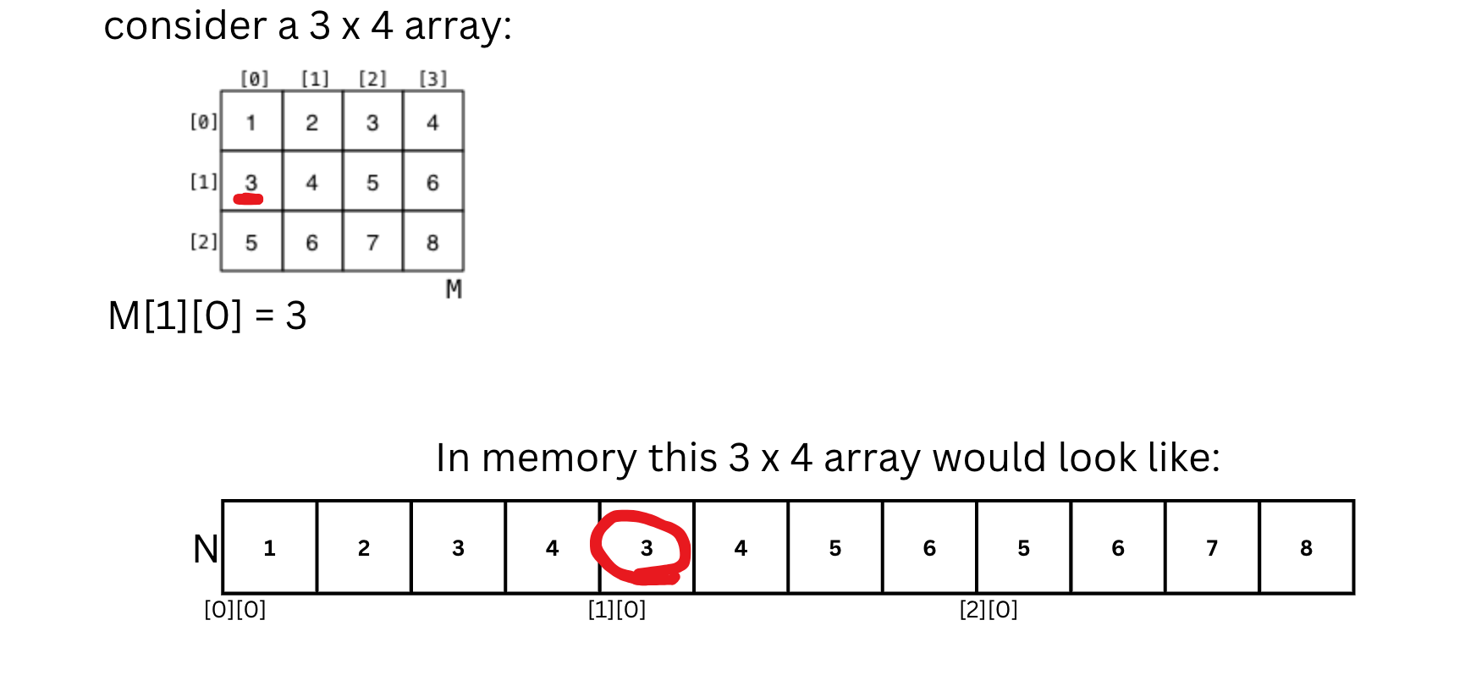

Slide 6
Summary
Total_offset = rows * num_cols + cols
multiply total_offset by a constant to adjust for element size
Int / char
Tutorial question 2

Slide 7
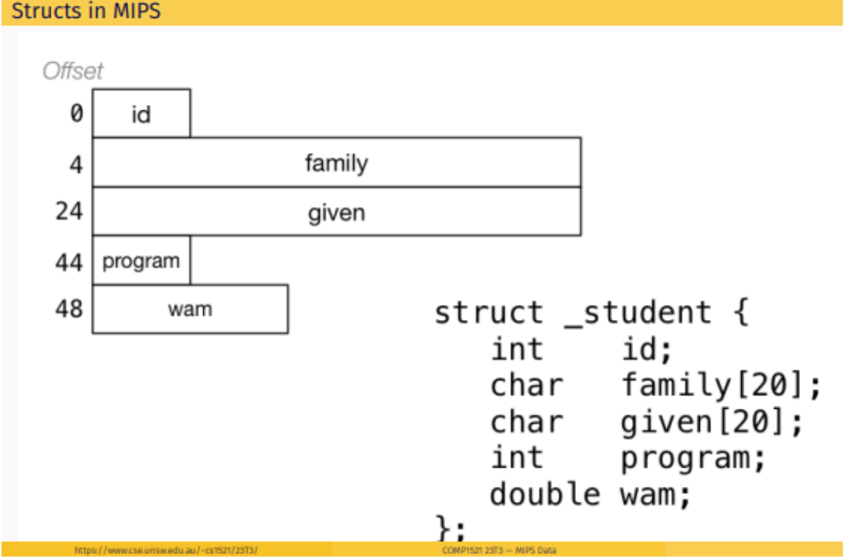
Structs

Slide 8
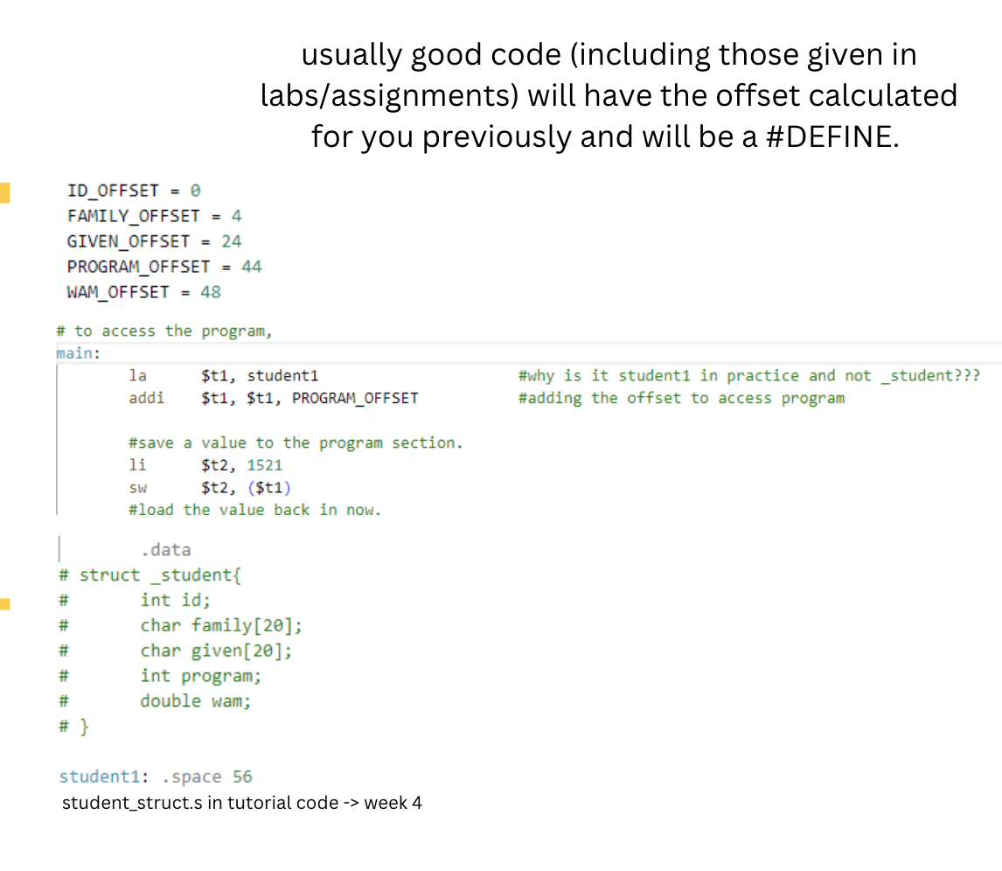

Slide 9
MIPS functions
Some key points:
All registers you use except S registers are “clobbered” or uninitialised upon using JAL
this means don’t use t-registers “across” JALs!
All functions must push and pop $ra
if function X uses any S registers, X must push and pop every register it uses
returning a value from a function is done through $v0

Slide 10
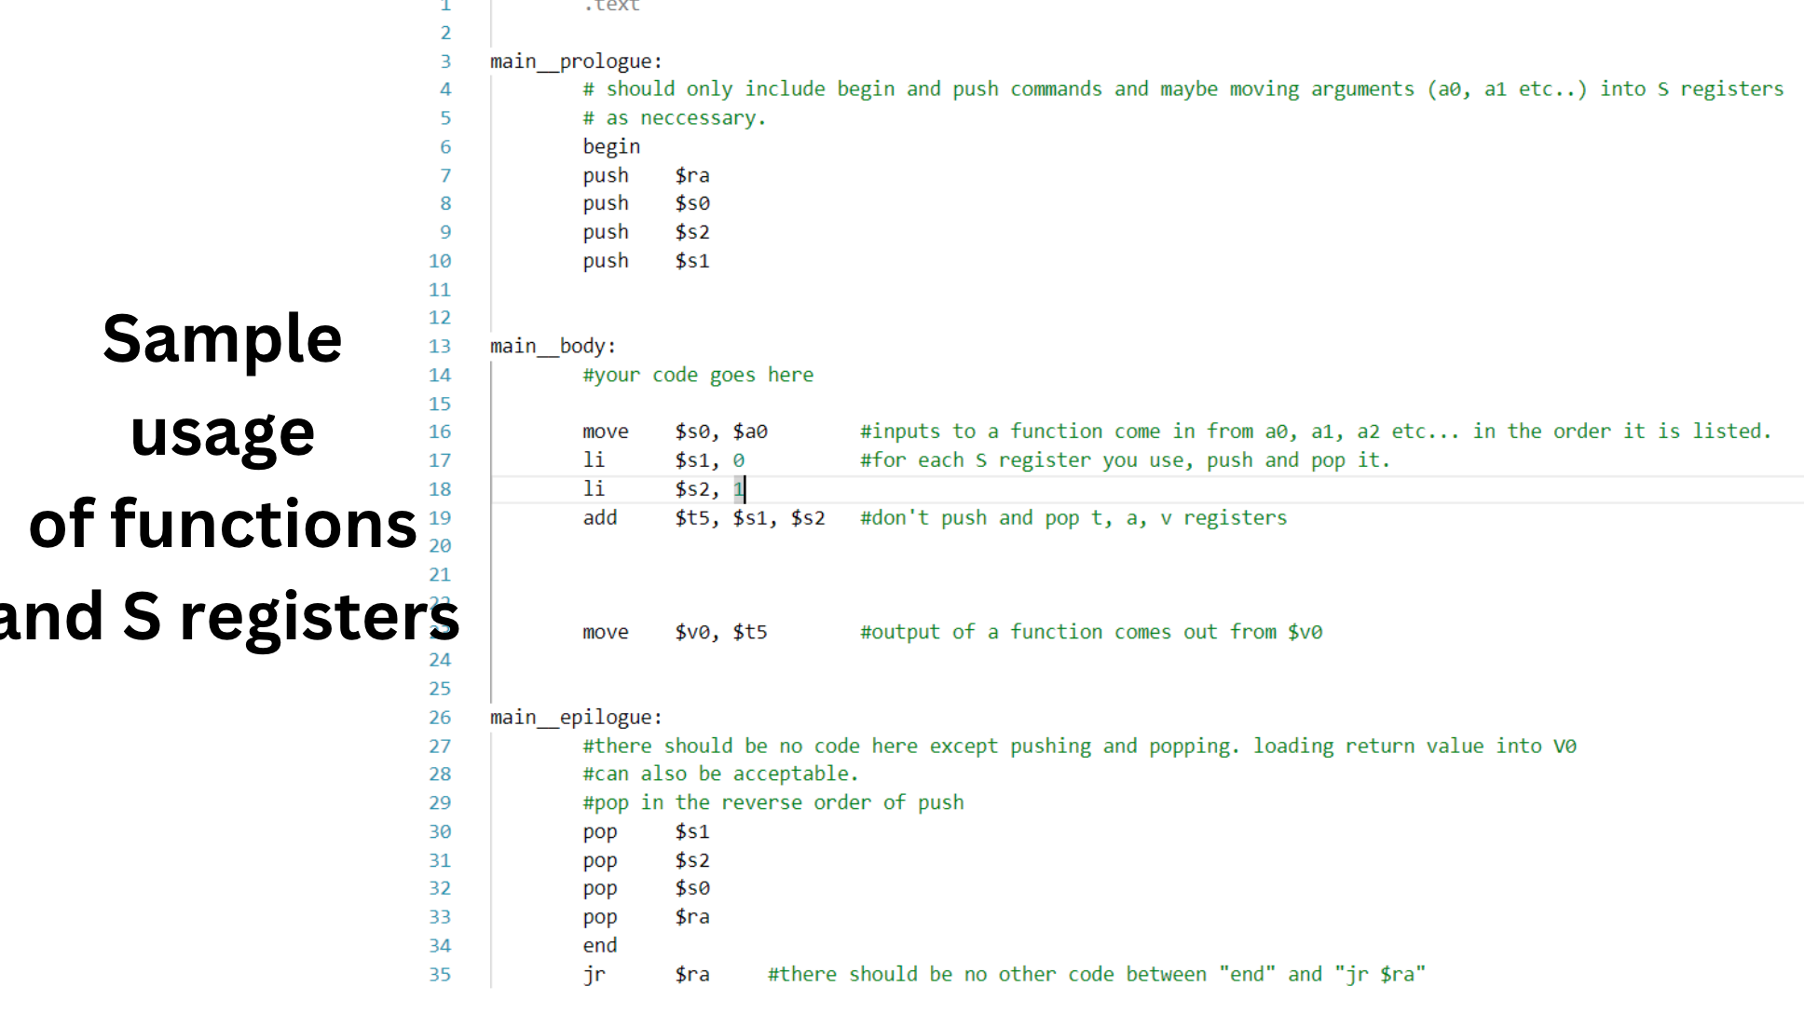

Slide 11
MIPS STYLE!
Tutrial question 6

Slide 12

Questions and Answers

