Slide 1
COMP1521 WEEK 1 intro to the course!
Siyu (Annie) Qiu

Slide 2
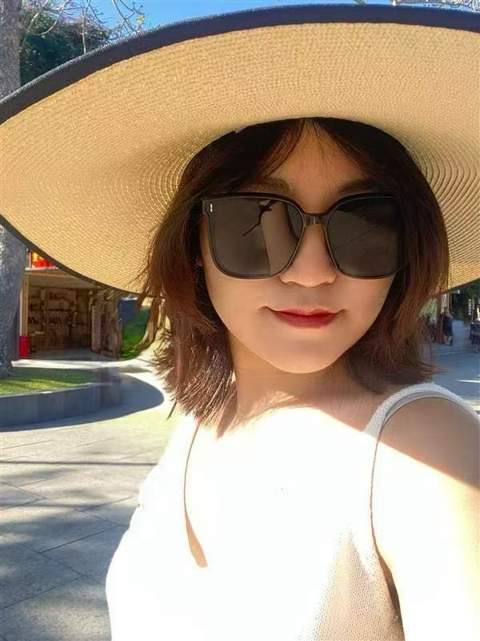
Introductions
4th year Comp Eng.
3 term year teaching COMP1521

Slide 3
Introductions
Let’s get to know each other!
Name (preferred name)
Degree
Year
Share something about yourself!

Slide 4
Admin
Tutor contact: siyu.qiu1@student.unsw.edu.au
Course contact: cs1521@cse.unsw.edu.au
Tute/lab attendance is optional but highly recommended.
You can complete the lab in your own time
Please join EdForum!!
Help session!!!

Slide 5
Assessment
Weekly Tests (from wk3): 10%
Each test is worth 1.7 marks.
best 6/8 test marks
Labs (from wk1): 15%
DUE:12:00 (midday) Monday
each week are worth in total 2 marks.
Assignment 1
Assignment 2
Final Exam

Slide 6

Announcements
Lab start this week!
Lab1 has been released, due on Week2 Monday midday
No weekly quiz this week!
Feel free to email me!
Notes:
(lab extantion)

Slide 7
For this tutorial!!
15 - 20 minutes of content revision first
30 - 40 minutes of working through questions
Try to cover all relevant content, especially exam/ assignment relevant ones.
Lots of useful tips and tricks!

Slide 8
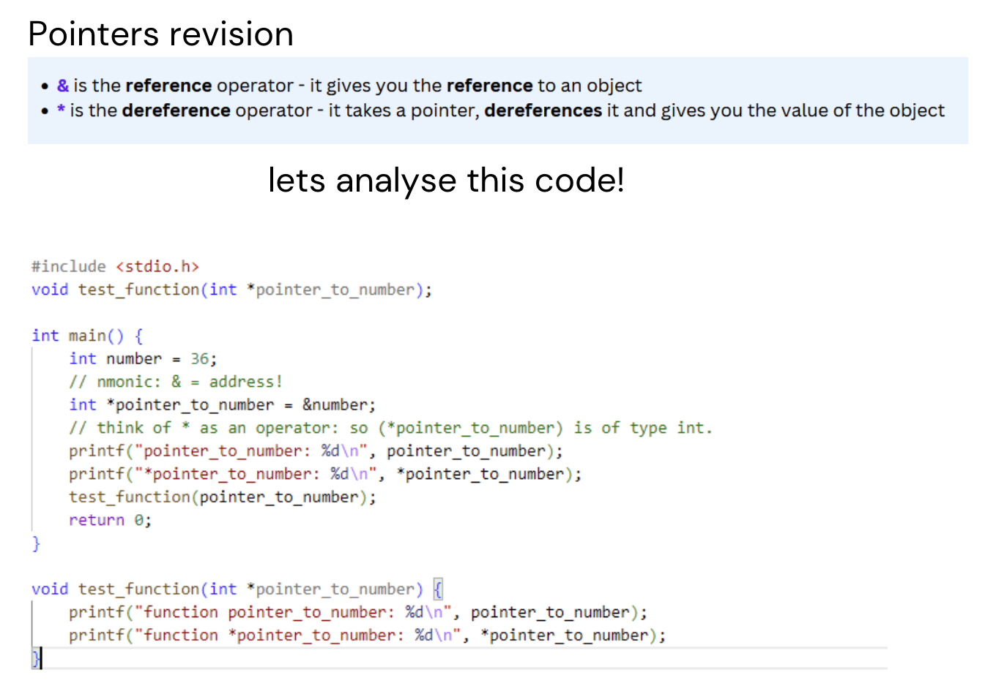
& -> value to pointer
Output:
pointer_to_number: -144215296
* pointer_to_number: 36
Function pointer_to_number: -144215296
Function * pointer_to_number: 36

Slide 9
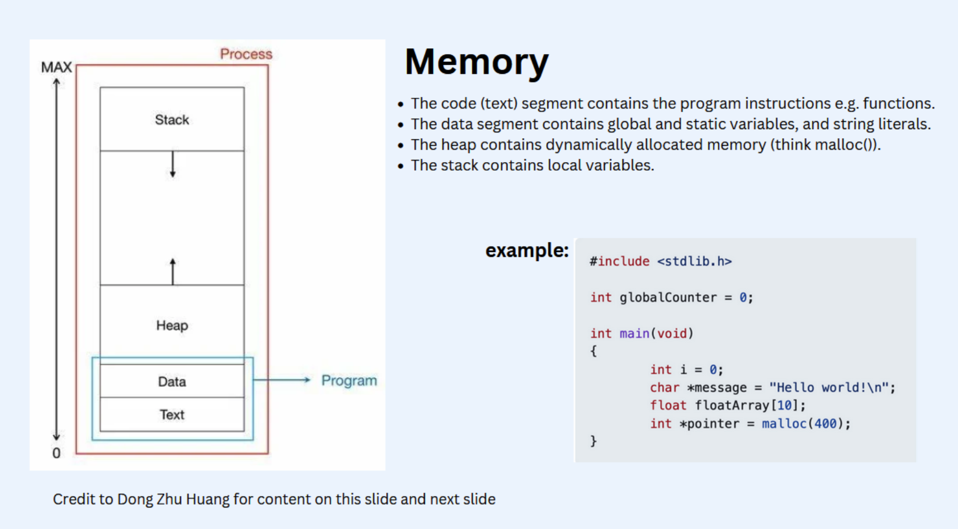

Slide 10
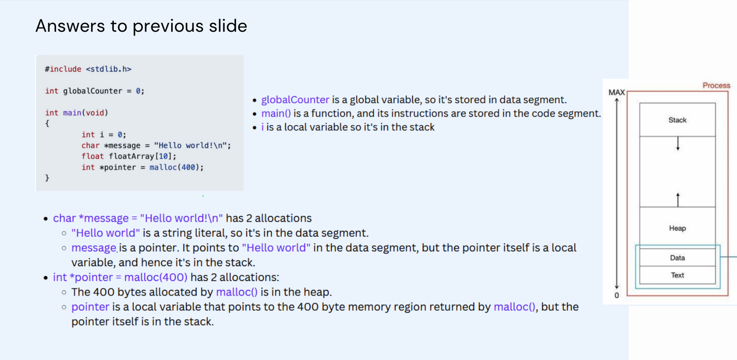

Slide 11
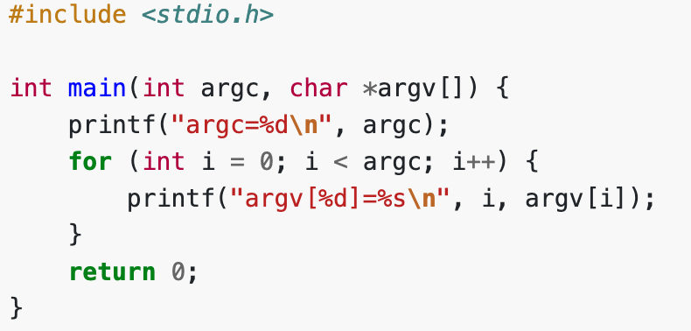
What Are argc and argv? (Q6)
argc: Number of command-line arguments, including the program's name.
argv: Array of pointers to the arguments.
argv[0]: Program name.
argv[1] to argv[argc-1]: Command-line arguments.
$ dcc -o print_arguments print_arguments.c
$ ./print_arguments I love MIPS
Output:
argc=4
argv[0]=./print_arguments
argv[1]=I
argv[2]=love
argv[3]=MIPS

Slide 12
Quick linux commands
compile: dcc -o hello hello.c
run: ./hello
make folder: mkdir week1
access folder: cd week1
access previous folder: cd .. / cd ~
make a file: code hello.c
open a folder: code .
remove a file: rm hello.c
remove a directory: rm -r week1
use tab to autofill file names!

Slide 13

Questions and Answers

