Slide 1

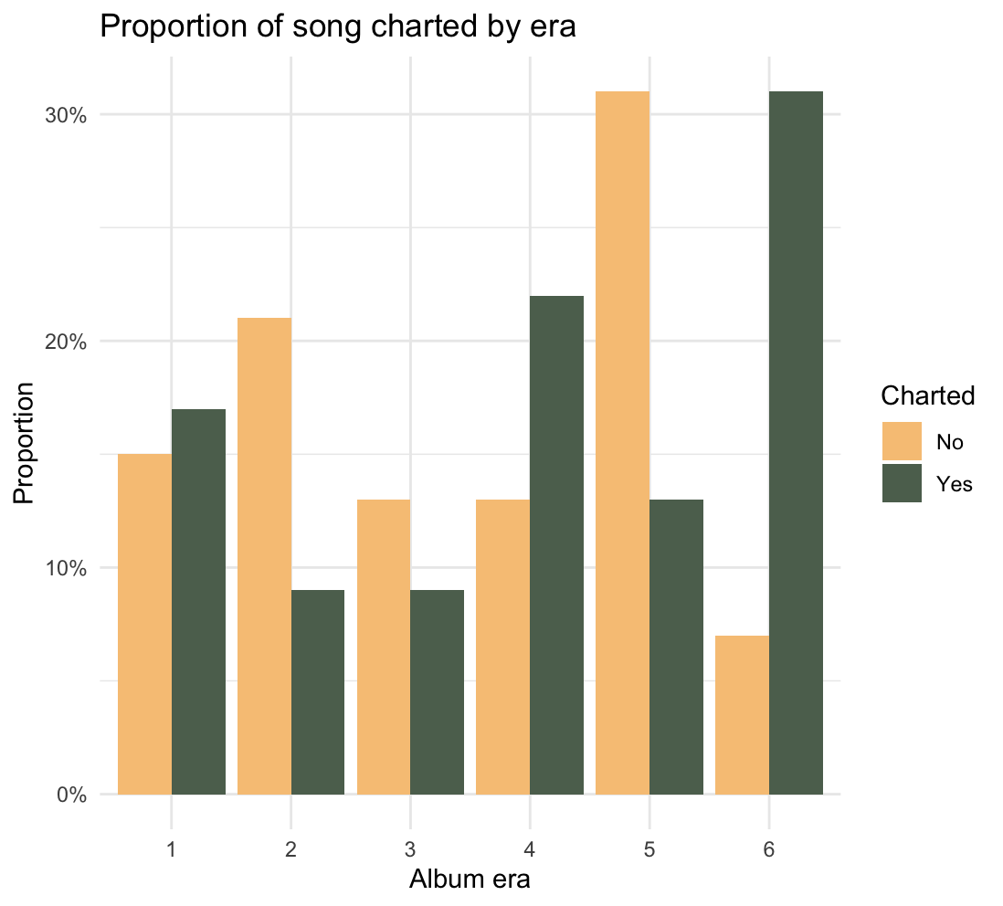
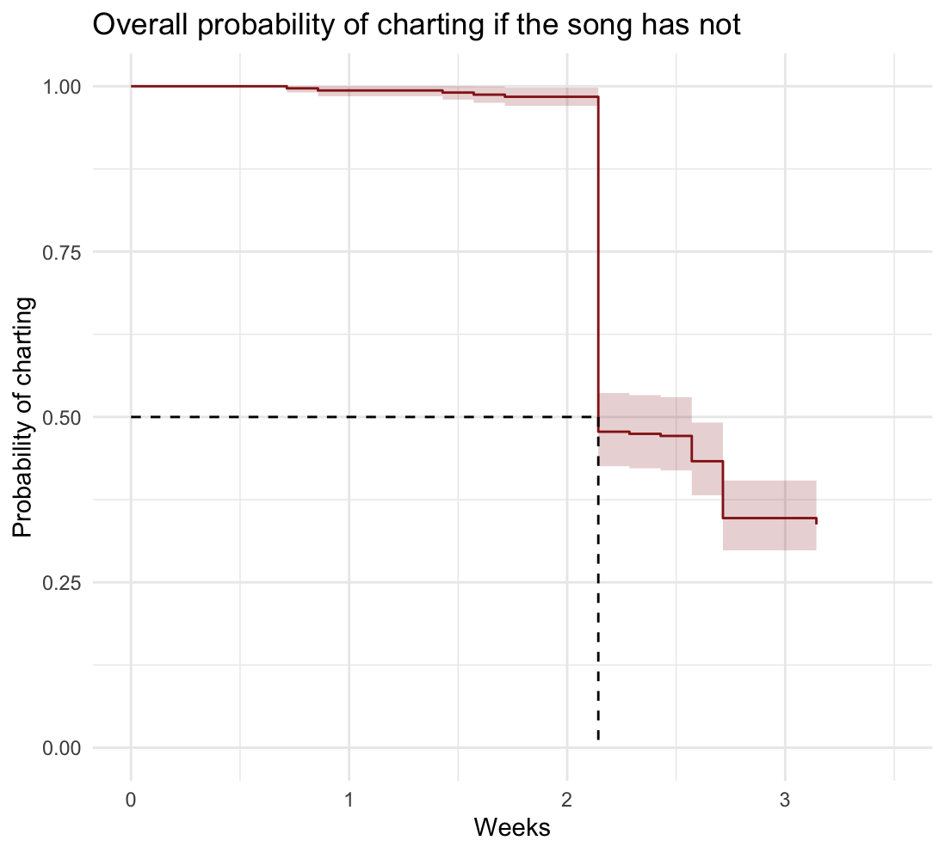
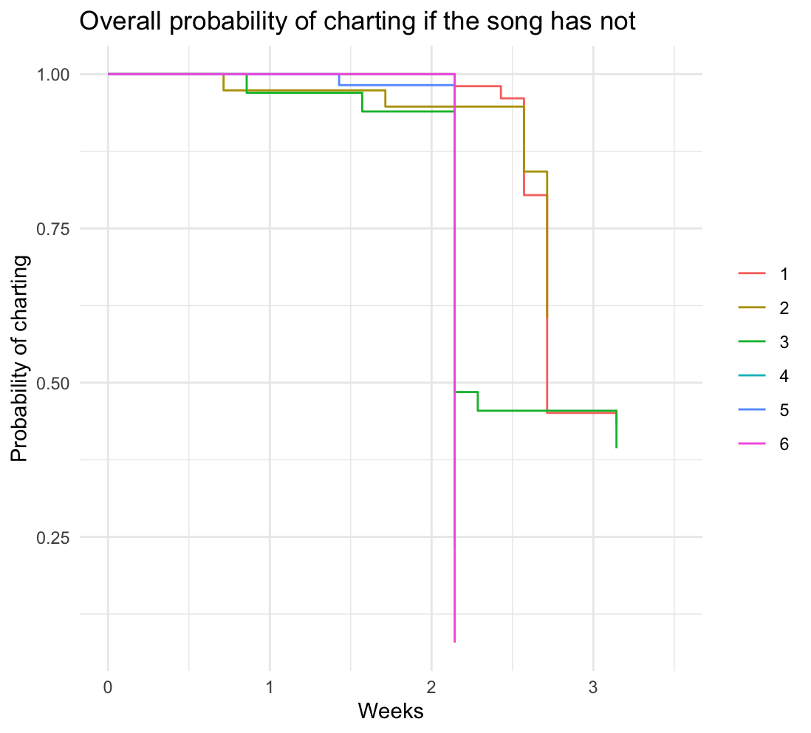

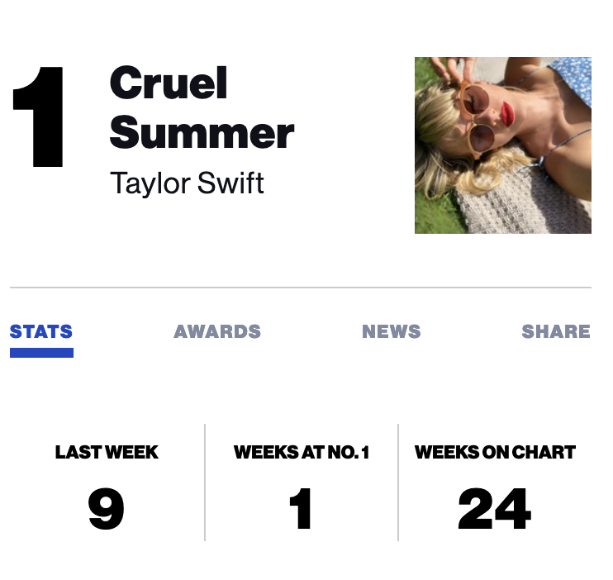
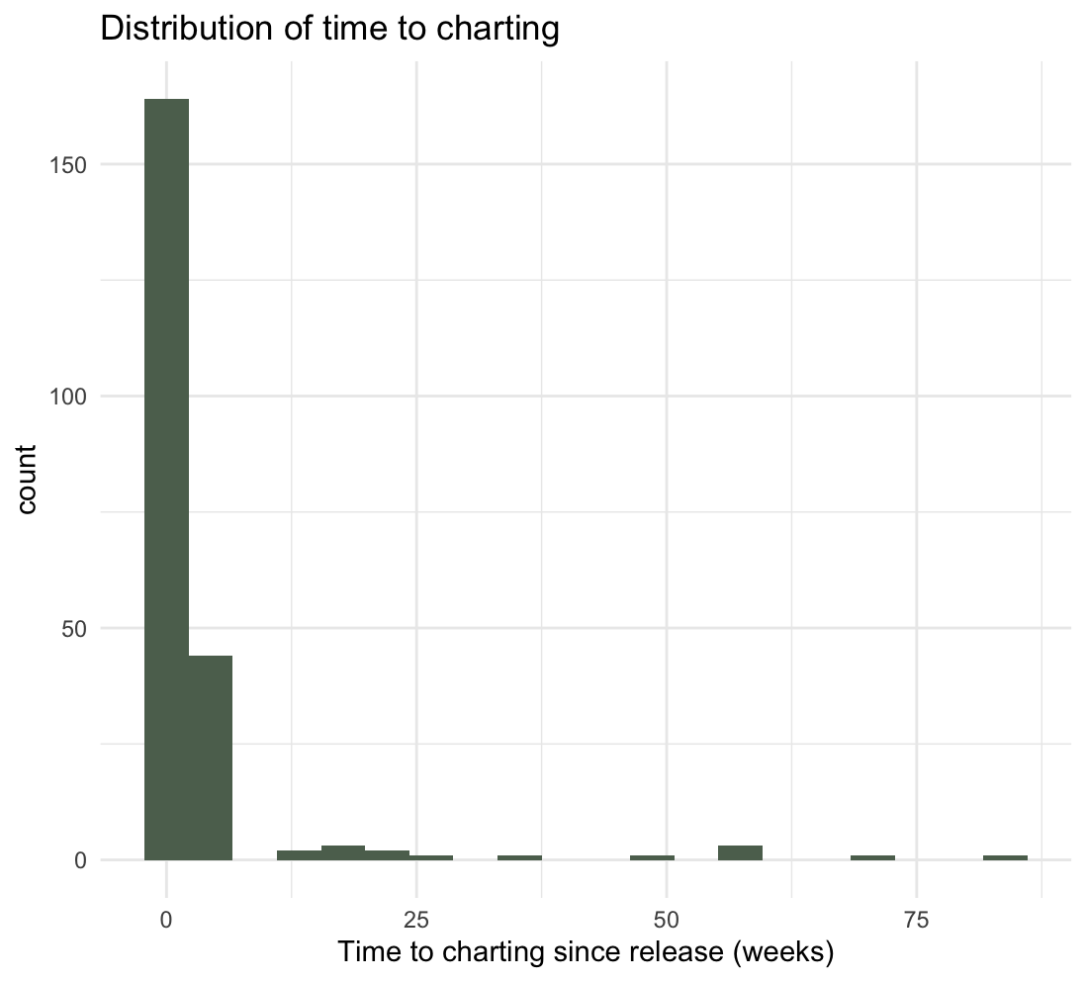

I don’t know about you, but I’m feeling an analysis on
Taylor Swift time to charting
Anh Nguyen
Wake Forest University,
Winston-Salem,
North Carolina
INTRODUCTION
RESULTS
Time from release to charting on the Billboard Hot 100 as an indicator of popularity. The chart counts sales and stream.
Taylor Swift is one of the most popular and pop-culture-defining artist in 2023 and 2024.
Eras | Probability of charting after 2.14 weeks (95% CI)
Era 1 | 98.0% (94.3%, 100%)
Era 2 | 94.7% (87.9%, 100%)
Era 3 | 48.5% (34.1%, 68.9%)
Era 4 | 23.3% (14.7%, 36.9%)
Era 5 | 50% (38.5%, 65.0%)
Era 6 | 8.0% (3.7%, 17.0%)
How long on average does it take for a song to reach the Billboard Hot 100?
How does charting time changes across eras?
METHODS
Time from release | Probability of charting after (95% CI)
1 week | 99.4% (98.5%, 100%)
2.14 week | 47.8% (42.6%, 53.6%)
3.13 week | 33.8%. (28.9%, 39.4%)
Billboard is updated every Sunday → interval censoring, no right censoring unless we stop the Billboard chart (which can happen one day).
DATA: Eras, divided albums into 6 groups; Taylor Swift song release date; Charted on Billboard Hot 100 date.
METHODS:
Kaplain-Meier Curve: empirical survival probability curve.
95% log confidence interval.
Use log-rank test for difference across eras
Use different ways to grouping eras to see if the results change drastically.
Log rank test:
$χ^{2}=61.5$ on 5 degrees of freedom
p – value ${=6 × 10}^{−12}$
CONCLUSION
REFERENCES
For Taylor Swift, more than 70% of her songs charted on the Billboard Hot 100.
The longest that a song take to chart is 84.6 weeks.
Charting rate is different for each eras: The eras with more charted songs are eras 1, 4 and 6. The eras with more songs that did not charted are eras 2, 3, and 4.
It takes a Taylor Swift song on average (median) 2.14 weeks (~ 15 days) to reach the Billboard Hot 100 chart.
However, if we consider each era, the time to charting very different from each other. The more recent the era the shorter it takes on average for a song to reach the Billboard Hot 100.
Using log rank test, we found the different in the probability to charting after a time point is statistically significant.
Using a different grouping of eras, we still see that the more recent songs will reach the chart quicker.
However, we might want to consider the fact that a song is well promoted as a single or not, and the favorability of a song among the fans and the general publich. Furthermore, eras is a time dependent covariates that might need other methods.
Thompson W (2024). taylor: Lyrics and Song Data for Taylor Swift's Discography. R package version 3.1.0, https://github.com/wjakethompson/taylor, https://taylor.wjakethompson.com.
UT Data, UT-Austin School of Journalism and Media, data and coding classes (2024). rwd-billboard-data: Billboards chart data. Github repository. https://github.com/utdata/rwd-billboard-data
1
2
3
Step 1:
Gather data
Step 2:
Exploratory data analysis
Step 3:
Fit Kaplain-Meier curve
THANKS
Thanks to Dr. Sarah Lotspeich (Wake Forest University), Ashley Mullan (Vanderbilt University), and the Wake Forest Statistics Department.

