Slide 1

Project Title-seasonal agriculture performance
AICTE STU ID : STU68305739807b61747998521
Name-Anu Bharti
College name-Dronacharya government college gurugram

Slide 2

PROBLEM STATEMENT
Agricultural performance is not the same throughout the year. Changes in seasons can affect weather conditions, farming practices, water availability, crop growth, production, and profitability. However, the raw agricultural data contains a large amount of information that is difficult to understand without proper analysis.
Therefore, this project aims to analyze the given agricultural dataset to understand how crop performance varies across different seasons. The analysis focuses on identifying meaningful patterns and relationships between factors such as rainfall, temperature, irrigation, soil conditions, water usage, yield, production, revenue, cost, and profit. The goal is to use data analysis and visualization to gain a clearer understanding of seasonal agricultural performance and identify factors that may be associated with better productivity and profitability.

Slide 3
Project Description
The Seasonal Agriculture Performance Analysis project focuses on understanding how agricultural performance varies across different crops, states, and seasons. The project uses a dataset containing information about crop yield, production, rainfall, temperature, soil conditions, irrigation methods, fertilizer and pesticide usage, water consumption, revenue, cost, profit, and disease or pest risk.
Using Python in Google Colab, the dataset was explored, cleaned, and analyzed through statistical methods and data visualizations. Different factors were compared to identify patterns and relationships affecting agricultural productivity and profitability. The analysis also examines crop-wise, state-wise, and seasonal performance to identify the best-performing crops, regions, and seasons.
The project aims to turn raw agricultural data into meaningful insights that can help in understanding productivity, resource efficiency, and economic performance, while demonstrating how data analysis can support better agricultural decision-making.

Slide 4

WHO ARE THE END USERS?
The key end users of this project are:
Farmers – To understand crop performance, seasonal trends, water usage, and profitability and make better farming decisions.
Agricultural Researchers – To study relationships between environmental conditions, farming practices, crop yield, and agricultural productivity.
Government Agricultural Departments – To support agricultural planning, resource allocation, and development of policies based on data-driven insights.
Agricultural Consultants – To provide farmers with recommendations regarding crop selection, irrigation, resource utilization, and profitability.
Agribusinesses and Agro-Companies – To understand crop production trends, market conditions, and profitability for better business planning.
Students and Data Analysts – To study agricultural datasets and use data analysis and visualization techniques to understand real-world agricultural problems.

Slide 5

Technology Used
Python – Used for data analysis, calculations, and generating insights from the dataset.
Google Colab – Used as the development environment for writing and executing Python code.
Pandas – Used for data loading, cleaning, manipulation, and statistical analysis.
NumPy – Used for numerical operations and data processing.
Matplotlib – Used to create graphs and visualizations for the analysis.
Seaborn – Used for advanced statistical visualizations and correlation heatmaps.
CSV Dataset – Used as the primary data source for analyzing seasonal agricultural performance.

Slide 6
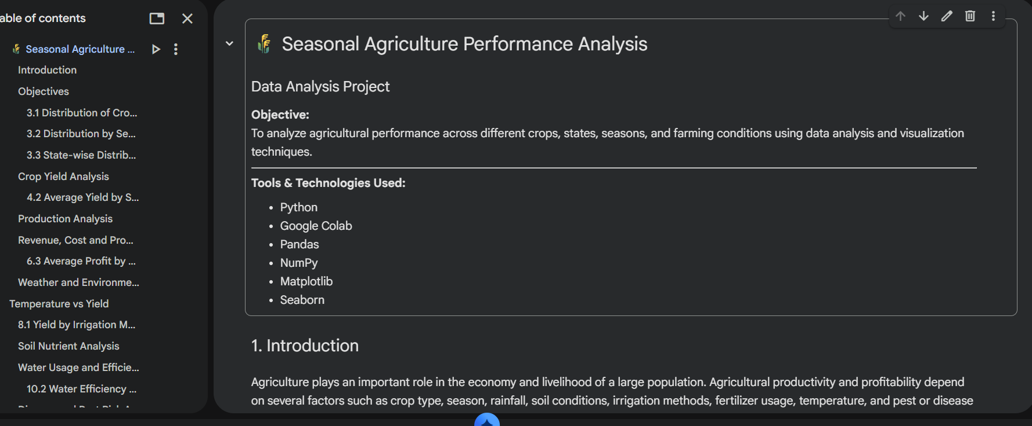
RESULTS

Slide 7
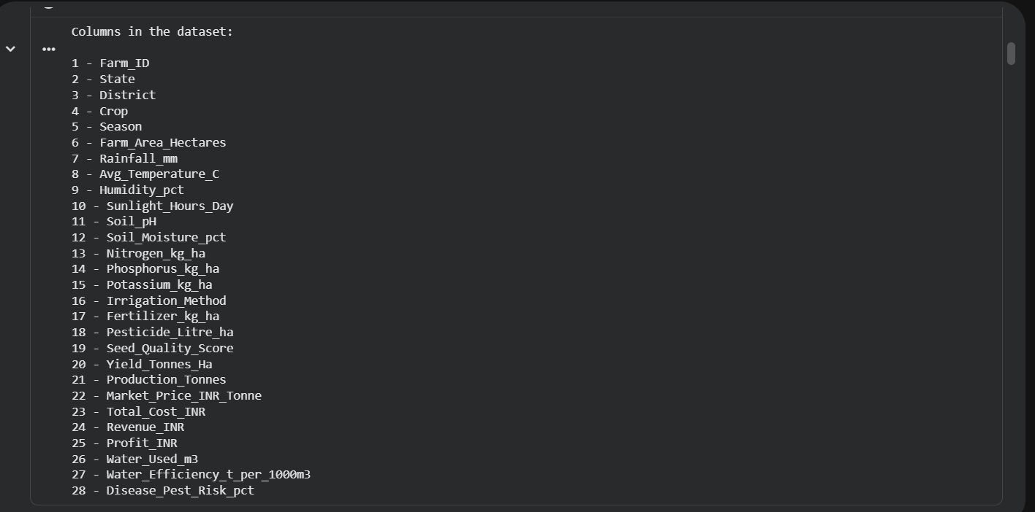
RESULTS
[Add screen shots of your code ]

Slide 8
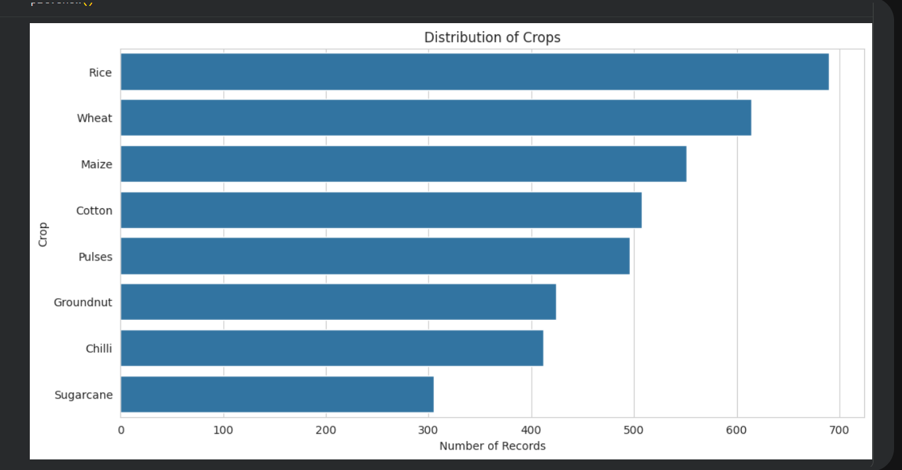
RESULTS
[Add screen shots of your code ]

Slide 9
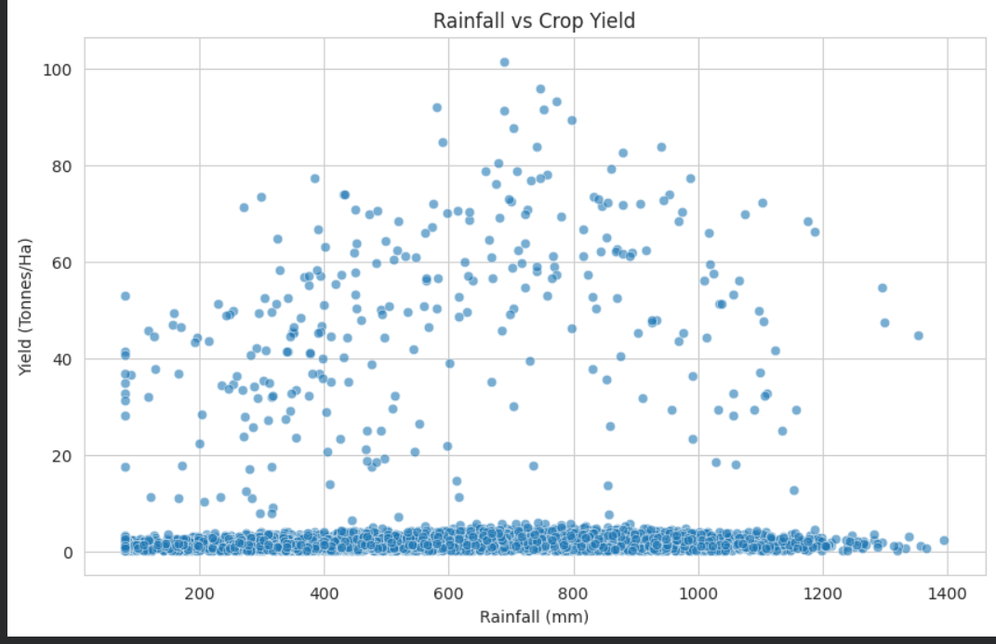
RESULTS
[Add screen shots of your code ]

Slide 10
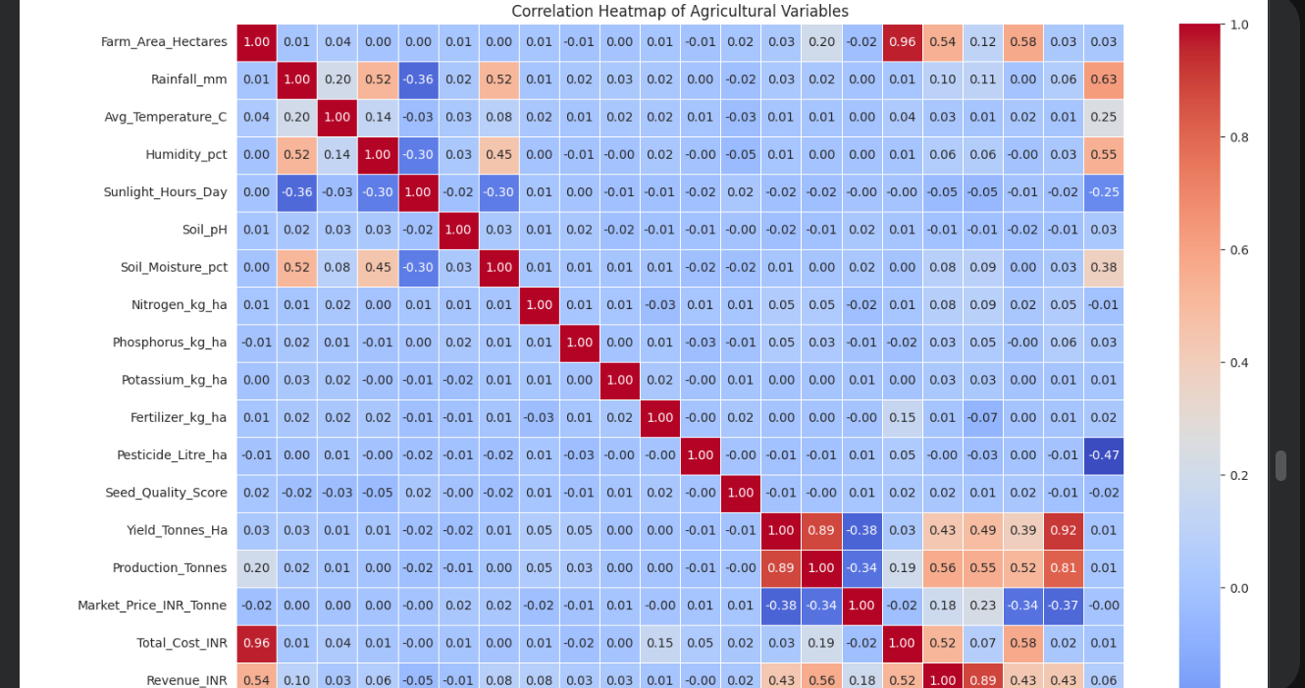
RESULTS
[Add screen shots of your code ]

Slide 11
Future scope
The project can be further improved and expanded in the following ways:
Predictive Analysis: Machine learning models can be used to predict crop yield, production, and profit based on environmental and farming conditions.
Weather Forecast Integration: Real-time weather data and forecasts can be included to improve seasonal crop planning.
Crop Recommendation: A recommendation system can be developed to suggest suitable crops based on soil, rainfall, temperature, and water availability.
Real-Time Data: Live data from farms, weather stations, and agricultural sensors can be integrated for more accurate analysis.
Advanced Visualization: An interactive dashboard using Power BI or Tableau can be developed to help users explore the data easily.
Risk Prediction: Future models can predict disease and pest risks and provide early warnings to farmers.
Resource Optimization: Further analysis can help optimize water, fertilizer, and pesticide usage while maintaining good crop productivity.
Market Analysis: Market price trends can be incorporated to help farmers identify more profitable crops and improve decision-making.

Slide 12
GitHub Link
https://github.com/annnuu01/Seasonal-Agriculture-Performance-Analysis-.git

Slide 13
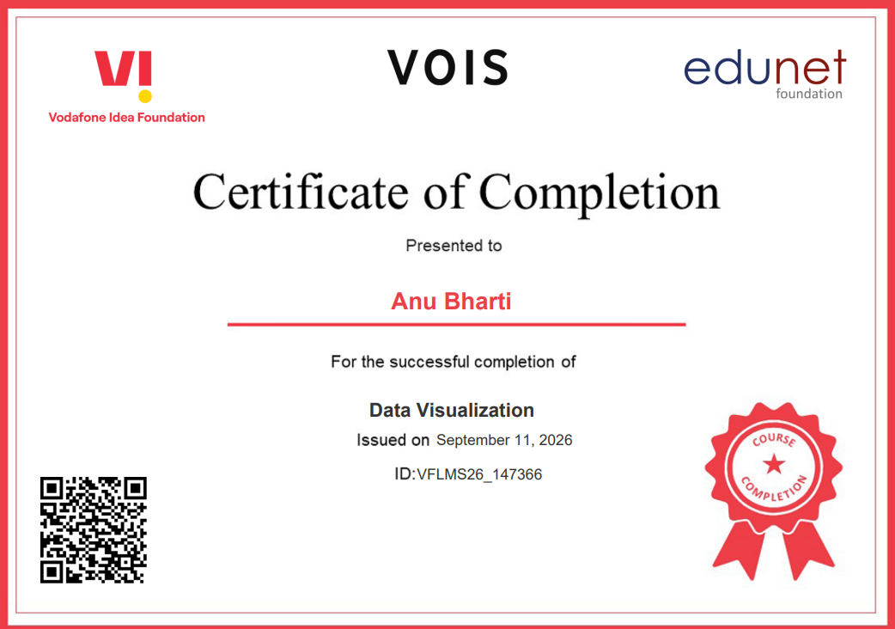
VOIS Course completion certificate -
Course name- Data Visualization

Slide 14
Thank you
I sincerely thank my mentor and the teams at VOIS, Vodafone India, and AICTE for their valuable guidance, support, and encouragement throughout this learning journey.
Thank you for your guidance and support.
.
.

