Slide 1

Embedding using Convolutional Layers with Sigmoid activation function – Report for week 6
Authors:
- Anna Beketova
- Shatu Ahmed

Slide 2
Introduction
Previous weeks:
Sigmoid activation function
High metrics → precise model
Updated training data more agreeable
Adam optimizer delivers precise results, despite minor overfitting
This week:
implement cross validation
Sum up results of experiments

Slide 3
Methods
Further work with Adam optimizer due to precise results
Implementation of dropout layers to reduce overfitting:
Dropout layers after 1st, 2nd, 3rd and 4th convolutional layers: 0.2
Dropout layer before the fully connected layer: 0.5
Cross validation

Slide 4
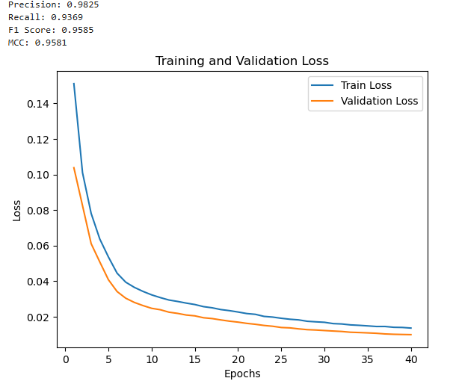
Results – Dropout layers

Slide 5
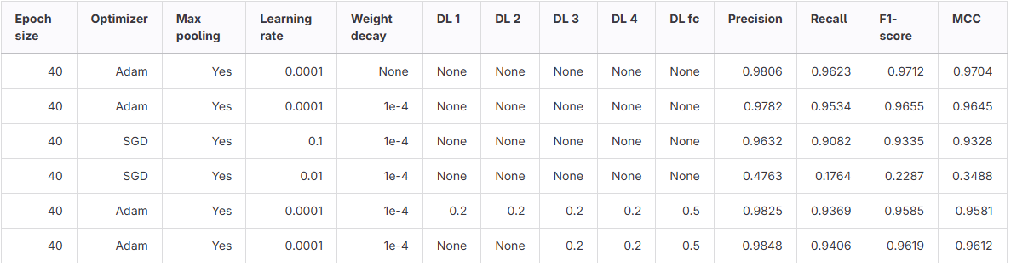
Results – Summarized metrics
Sequence length 1500:

Slide 6
Results – Summarized metrics
Sequence length 1500:

Slide 7
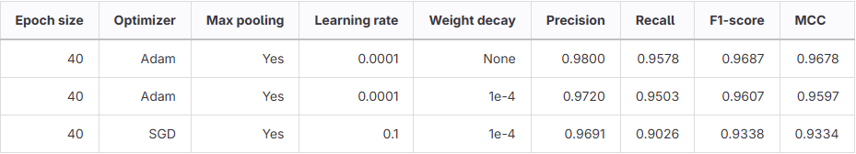
Results – Summarized metrics
Sequence length 2500:

Slide 8
Results – Summarized metrics
Sequence length 2500:

Slide 9
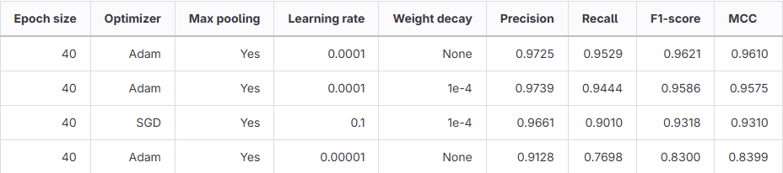
Results – Summarized metrics
Sequence length 3500:

Slide 10
Results – Summarized metrics
Sequence length 3500:

Slide 11
Results – Summarized metrics
Sequence length 4500:

Slide 12
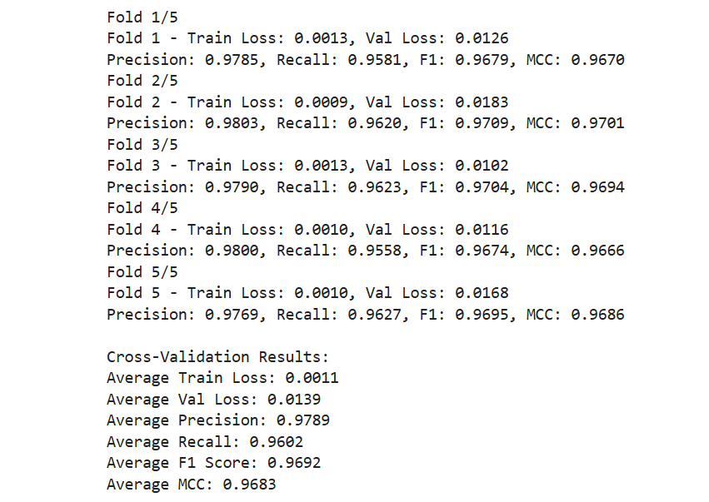
Results – Cross-Validation

Slide 13
Discussion
Shorter sequences deliver best metrics
Dropout layers reduce overfitting, but don't change results a lot
Good balance between precision and recall, meaning the model is robust in its predictions.
MCC = (0.9683) → strong agreement between predictions and the true labels
model generalizes well and avoids overfitting

Slide 14
Thank you for your attention!

