Slide 1
CSE7302 - INTERNSHIP Review-4 Presentation Elevator Maintenance and Asset Tracking App
Student Details
Name | Ann Olivia M
Roll No | 20221COM0208
Section | 8-COM-01
Under the Supervision of,
Dr./Mr./Ms./Prof. Mohamed Shakir
Professor / Associate Professor / Assistant Professor
Presidency School of CSE
Presidency University
Name of the Program: B.Tech
Name of the HoD: Dr. Gopal Krishna Shyam
Name of the Program Internship Coordinator: Mr. Sreehari T M
Name of the School Internship Coordinator: Dr. Md Ziaur Rahman

Slide 2
Content
About Company or Organization
Working domain or the technology
About your team and reporting Manager
Challenges Faced in Internship
Objectives of the work
Literature Review
Proposed System
Problem Statement
System Requirements
Advantages of Proposed System/Work
System Design
System Implementation
System Testing
Conclusion
References
Github Link

Slide 3
About Company or Organization
Axxonet Technologies - is a Bangalore-based technology and research-driven company founded in the year 2000. The company focuses on delivering innovative IT solutions, analytics, and digital transformation services.
Axxonet combines strong research capabilities with real-world business applications. It offers services in business intelligence, data analytics, DevOps, cloud solutions, and software development.
The organization is also well known for its work in healthcare and neuroscience technologies.
Axxonet develops advanced medical and laboratory systems for research and clinical use. The company follows global quality standards and is ISO certified. It serves clients across India and international markets. Axxonet emphasizes innovation, problem-solving, and technology excellence. Overall, it bridges research, technology, and business to deliver impactful solutions.

Slide 4
Working domain or the technology
Axxonet operates in IT consulting, analytics, and digital transformation services.
It specializes in business intelligence and data analytics for informed decision-making.
The company works with AI, machine learning, and predictive analytics technologies.
It delivers cloud computing and DevOps solutions for scalable digital platforms.
Axxonet develops custom web, mobile, and enterprise software applications.
The organization uses modern data platforms and visualization tools for insights.
It also focuses on healthcare and neuroscience technologies, including EEG and research systems.

Slide 5
About your team and reporting Manager
For the initial phase of my internship, I am currently working under the guidance of an internship guide – Mr. Akash KJ, Mr. Mukesh, Mr. Akash Gupta who acts as my reporting mentors and oversees my learning and progress.
The first week was focused on training, where I was introduced to Python basics and Django fundamentals to build a strong technical foundation. In past one month, I have worked on a demoproject under my mentor’s supervision to apply the concepts learned.
Later on I was put into the core project team to work on ERP systems.

Slide 6
Challenges Faced in Internship
Adapting to a new work environment and professional culture
Understanding requirements and expectations initially
Learning new technologies and tools within a limited time
Applying theoretical knowledge to practical tasks
Managing time between learning and assigned tasks
Gaining confidence while asking questions and seeking guidance

Slide 7
Objectives of the work
To understand how real-world software development works
To improve my skills in both Front-end and Back-end.
To apply classroom concepts to practical tasks and mini projects
To follow proper coding standards and development practices
To gain confidence in working on assigned tasks independently
To prepare myself for contributing to major projects in later stages of the internship

Slide 8
Literature Review
Before starting the development process, I explored backend development using Django, Django REST Framework, and GraphQL. I learned core concepts such as API design, layered architecture, data validation, and exception handling.
Based on this, I implemented the backend using Django, built APIs with Django REST Framework, and designed GraphQL queries and mutations using the Graphene package. The frontend was developed using HTML, CSS, and MUI to interact with the backend services. This preparation helped me effectively complete my assigned tasks and understand how my modules fit into the overall project.

Slide 9
Proposed System / Work
The proposed work for the internship period involves the development of both backend and integration components of a web-based enterprise application. Initially, I am working on a demo project to gain practical exposure to full-stack development concepts, including designing RESTful APIs, implementing authentication mechanisms, managing databases, and integrating frontend interfaces with backend services.
The core focus of my work at Avia Enterprises is to develop an ERP Integration Adapter Module that enables seamless switching between multiple ERP platforms and facilitates efficient data retrieval. This module acts as an intermediate layer between different ERP systems and the company’s central application, ensuring standardized data flow across platforms.

Slide 10
Problem Statement
Large enterprises often build customized ERP systems to manage their operations, but small and mid-sized businesses cannot afford such infrastructure. Many of them still rely on books, physical records, or manual entries to maintain customer data, invoices, and warranty details. When records are lost or damaged, there is no reliable proof or backup of the stored data.
Avia Enterprises was created to overcome these challenges by providing a centralized digital platform for managing business data and workflows.
However, since different clients use different ERP systems with varying data structures, integration becomes complex and inconsistent. Therefore, there is a need for a flexible ERP Integration Adapter that can standardize data and ensure seamless synchronization across multiple platforms.

Slide 11
System Requirements
1. Hardware Requirements
Processor: Intel i5 or higher
RAM: Minimum 8 GB (16 GB recommended for development)
Storage: Minimum 256 GB SSD
Stable Internet connection
2. Software Requirements
Operating System: Windows / Linux / macOS
Backend Framework: Django / Django REST Framework
Database: GraphQL / MySQL
API Testing Tool: Postman/Thunderclient
Version Control: Git
Code Editor: VS Code
Web Browser: Chrome / Edge

Slide 12
Advantages of Proposed System/Work
Centralized Data Management
Improved Data Security & Backup
Seamless ERP Integration
Standardized Data Format
Scalability
Reduced Manual Errors

Slide 13
System Design
Follows a Layered Architecture: Presentation Layer, API Layer,
Service Layer, ERP Adapter Layer, and Database Layer.
The ERP Adapter connects to multiple ERP systems, fetches data,
and converts it into a standardized format.
A Switching Mechanism selects the appropriate ERP based on
client configuration.
Processed data is stored securely and displayed through the
frontend interface.
Security is ensured using authentication, role-based access,
and encrypted API communication.

Slide 14
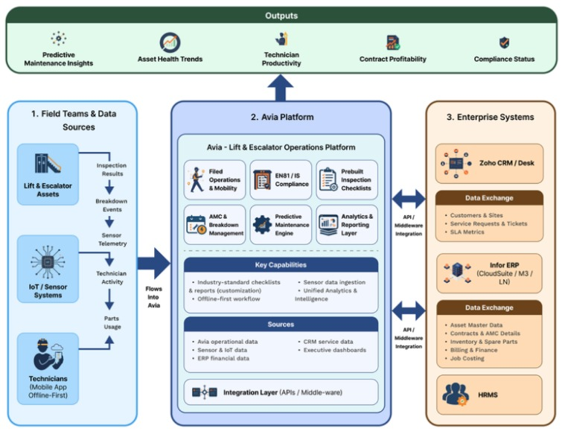
Architecture Diagram

Slide 15
System Implementation
Set up and configured Frappe environment using Docker.
Created and tested REST APIs for data access and integration.
Studied and analyzed existing internal APIs provided by the company
for ERP communication.
Implemented integration logic to connect with ERP systems using
the provided APIs.
Integrated GraphQL to fetch and query structured data dynamically
from ERP platforms.
Successfully retrieved and validated ERP data flow from Frappe
into the application database.

Slide 16
System Testing
Functional Testing: Verified that all modules such as API endpoints, ERP integration, and data retrieval processes work as expected.
API Testing: Tools like Postman/Thunder Client were used to test REST APIs and GraphQL queries for correct responses and data accuracy.
Integration Testing: Ensured smooth communication between frontend, backend, and ERP systems through the adapter module.
Data Validation Testing: Checked whether the data fetched from different ERP systems is properly standardized and stored.
Performance Testing: Observed system behavior under normal usage to ensure stable performance and response time.
Error Handling Testing: Verified that appropriate error messages are displayed for invalid inputs and system failures.

Slide 17
Conclusion
The internship project provided valuable hands-on experience in real-world software development. Through this project, I gained practical knowledge in backend development using Django, API creation using Django REST Framework, and data querying using GraphQL.
The development of the ERP Integration Adapter Module helped in understanding how different systems can be connected and standardized efficiently. The project successfully addressed the problem of inconsistent ERP systems by introducing a flexible and scalable integration solution.
Overall, this internship enhanced my technical skills, problem-solving ability, and understanding of industry-level development practices. It also prepared me to contribute effectively to larger projects in the future.

Slide 18
References
Django Documentation – https://docs.djangoproject.com/
Django REST Framework Documentation – https://www.django-rest-framework.org/
GraphQL Official Documentation – https://graphql.org/
Graphene (Python GraphQL Library) – https://graphene-python.org/
Frappe Framework Documentation – https://frappeframework.com/docs
Postman API Testing Tool – https://www.postman.com/
MDN Web Docs (HTML, CSS, JavaScript) – https://developer.mozilla.org/
GitHub (Version Control & Code Repository) – https://github.com/

Slide 19
Q&A

Slide 20
Thank you !!

