Slide 1
Test Document
This is a test document, with multiple slides, images, text, notes and comments
Notes:
Test Notes

Slide 2
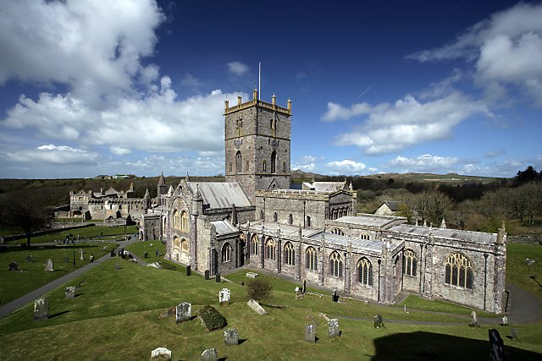
St David’s Cathedral and Bishop’s Palace
Alan Thomas / St David’s Cathedral and Bishop’s Palace /

