Slide 1

Brand the Persona
A Rhetorical Analysis of Kunal Shah

Slide 2


Executive Summary: The Core Idea
The Analysis
The Proposal
Kunal Shah's "Unconventional Philosopher" persona is a masterclass in rhetoric. He uses *Logos* (unconventional logic) on professional platforms like LinkedIn and *Pathos* (niche community memes) on personal platforms like Instagram.
This "exclusive" brand, while effective, creates a gap. We propose a rebrand to *"The Societal Architect,"* shifting his core message from the aspirational "Status" to the foundational, inclusive value of "Trust."

Slide 3






Our Objectives
Analyze
Identify
Propose
Deconstruct his current persona and the rhetorical tools (Ethos, Pathos, Logos) he uses to build it.
Pinpoint the "Exclusive Gap" created by his "not for everyone" messaging and its long-term limitations.
Outline a strategic pivot to the "Societal Architect" persona, shifting his message to be more inclusive and visionary.

Slide 4
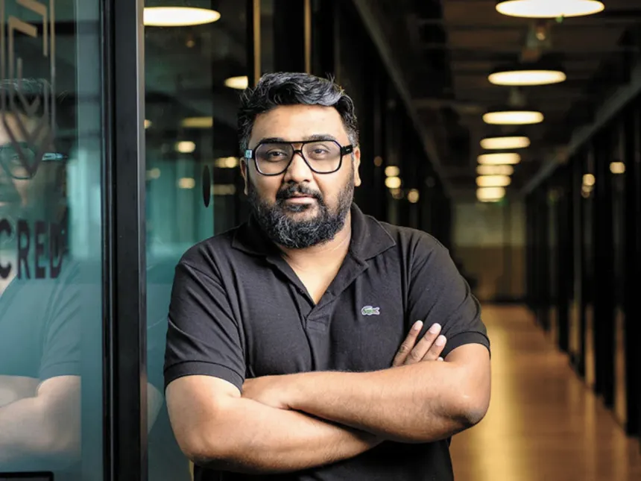
Rationale: Why Kunal Shah?
•
A deliberate, "hyper-rhetorical" persona built on his Philosophy background.
•
His personal brand and CRED's brand are one and the same.
•
Manages a multi-platform strategy (LinkedIn, Instagram, Podcasts) with different goals.
•
He is at the center of the critical "Aspirational vs. Mass-Market" debate in modern India.

Slide 5
Part 1: The Analysis
Analyzing the Current Rhetorical Situation

Slide 6






The Rhetorical Triangle
Ethos (Speaker)
Pathos (Audience)
Logos (Message)
The "Proven Builder," The "Xennial Philosopher," and The "Rebellious Founder."
The core logical framework: His challenging "Status > Wealth" argument for the Indian market.
Dual-pronged: "Insider" humor for his community and "Mass-Market" nostalgia (CRED ads) for all.

Slide 7
Ethos: How He Builds Credibility
The Proven Builder: Founded and sold Freecharge; built CRED into a unicorn. His track record is his primary authority.
The "Outsider" Philosopher: His B.A. in Philosophy isn't a footnote; it's his brand. It positions him as a "systems thinker" who sees the world differently.
The "Xennial": His "young at heart" persona allows him to authentically use memes and show "faith in the newer generations."
The Rebellious "Builder": He creates a strong community with other founders by being aggressively pro-builder.

Slide 8
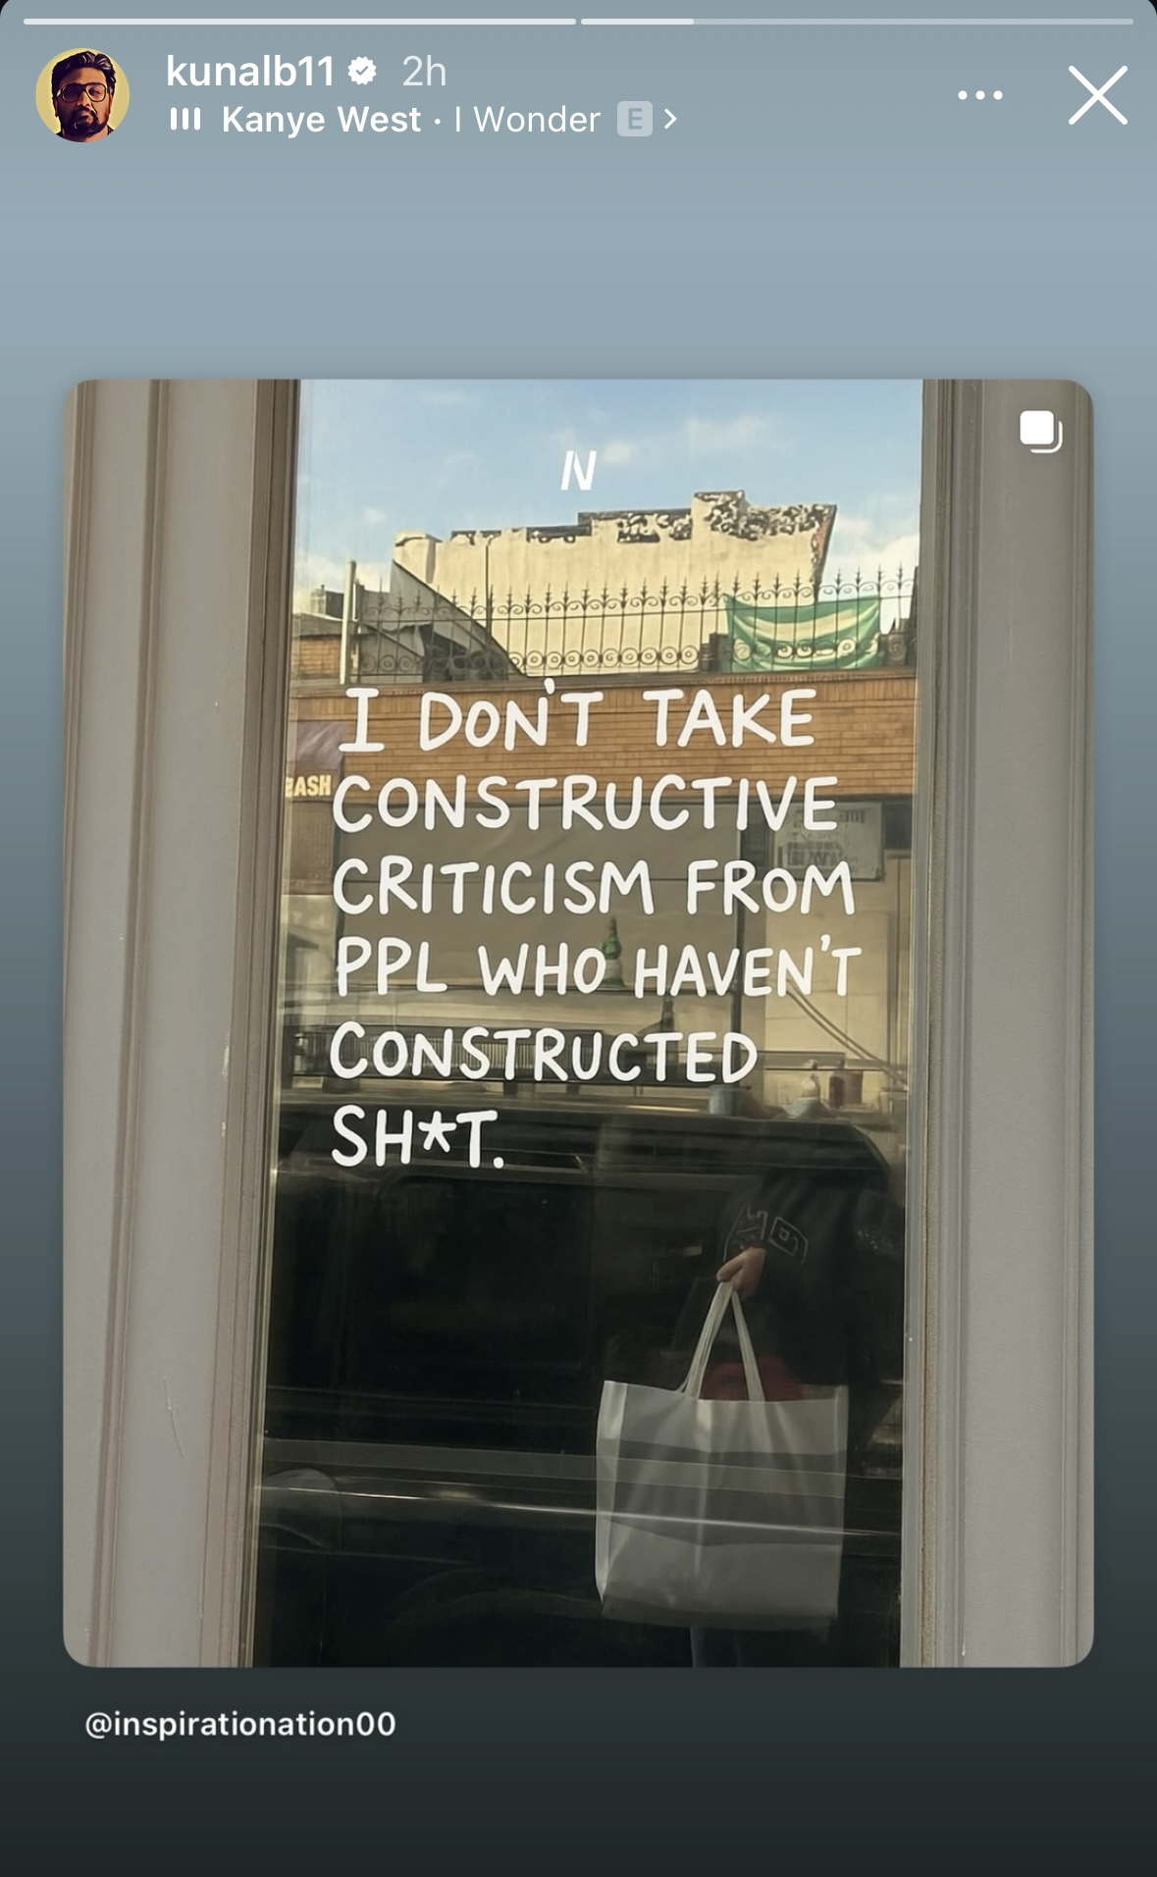
Ethos: In His Own Words
The "Builder" Ethos
"I DON'T TAKE CONSTRUCTIVE CRITICISM FROM PPL WHO HAVEN'T CONSTRUCTED SH\*T."
- via Instagram Stories
This builds a rebellious "builder" persona, creating a strong bond with other founders and entrepreneurs.

Slide 9


Logos: The Unconventional "Kunal-isms"
"Schadenfreude is easy to understand if we treat world as one big zero sum game."
"Highly reliable people are rarely interesting. Very interesting people are rarely reliable."
- via LinkedIn
Non-Obvious Frameworks
- via LinkedIn
Challenging "Truths"
He presents challenging, logical frameworks for human motivation, solidifying his "philosopher" brand.
Builds his brand as a thinker who presents unconventional ideas that make his audience stop and think.

Slide 10
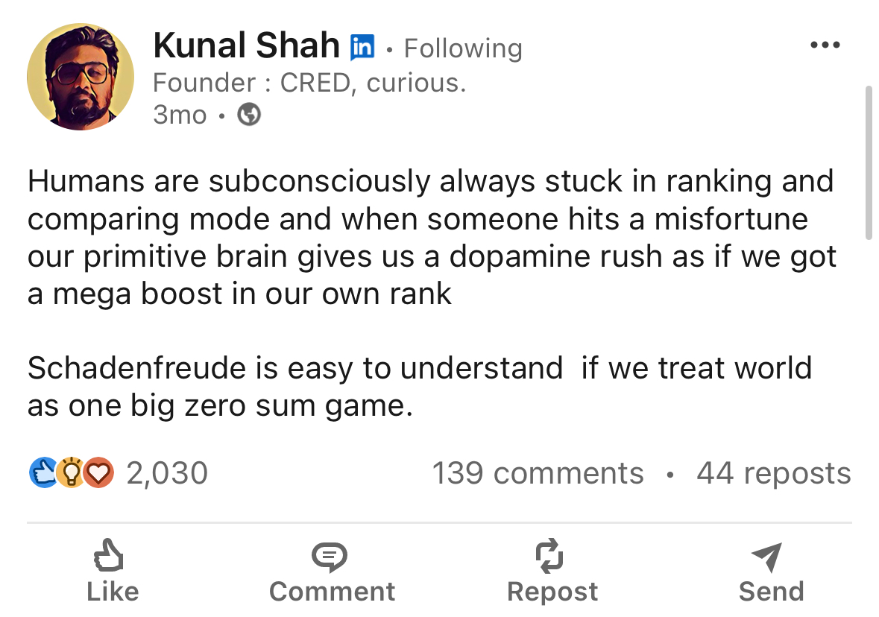
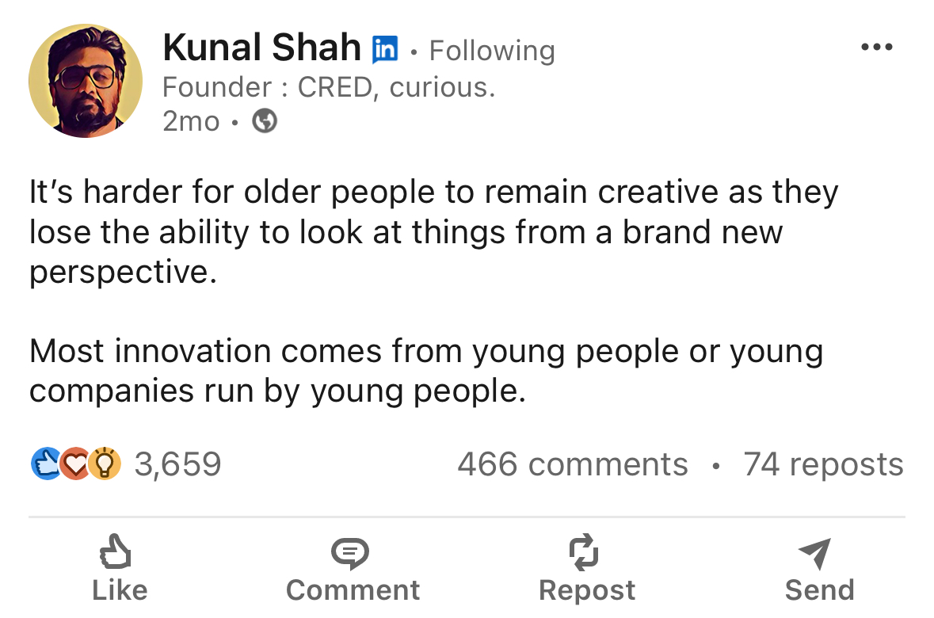
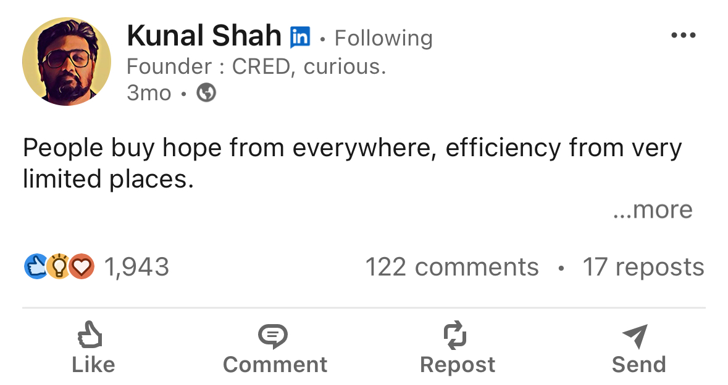
More Examples

Slide 11
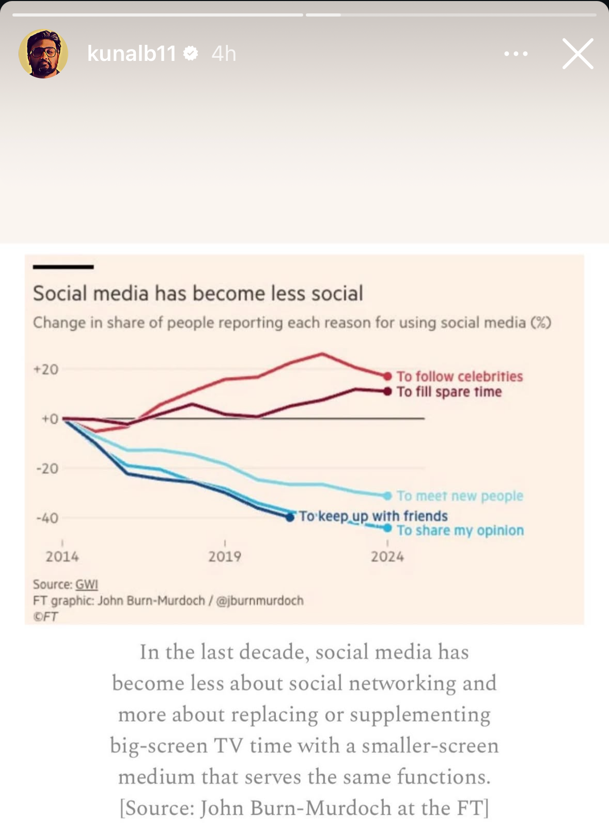
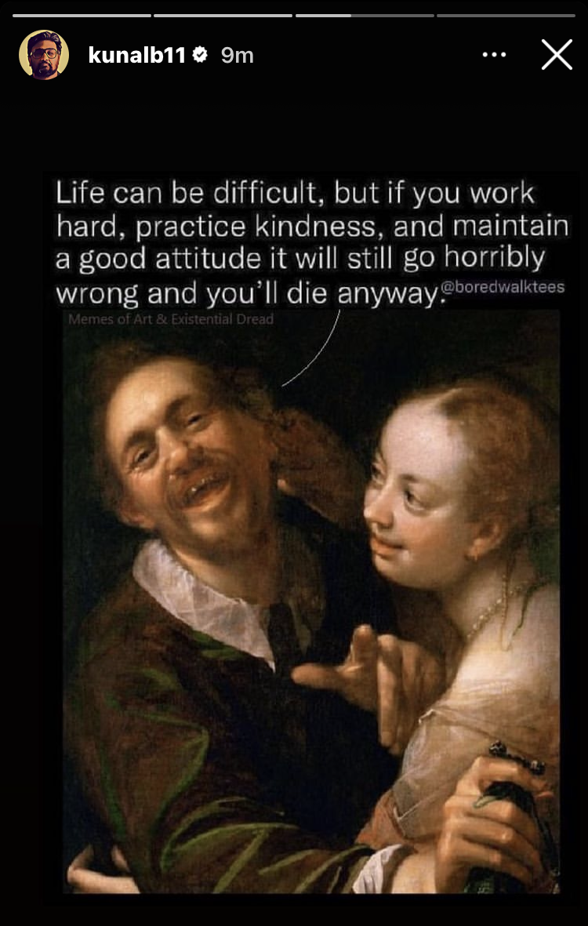
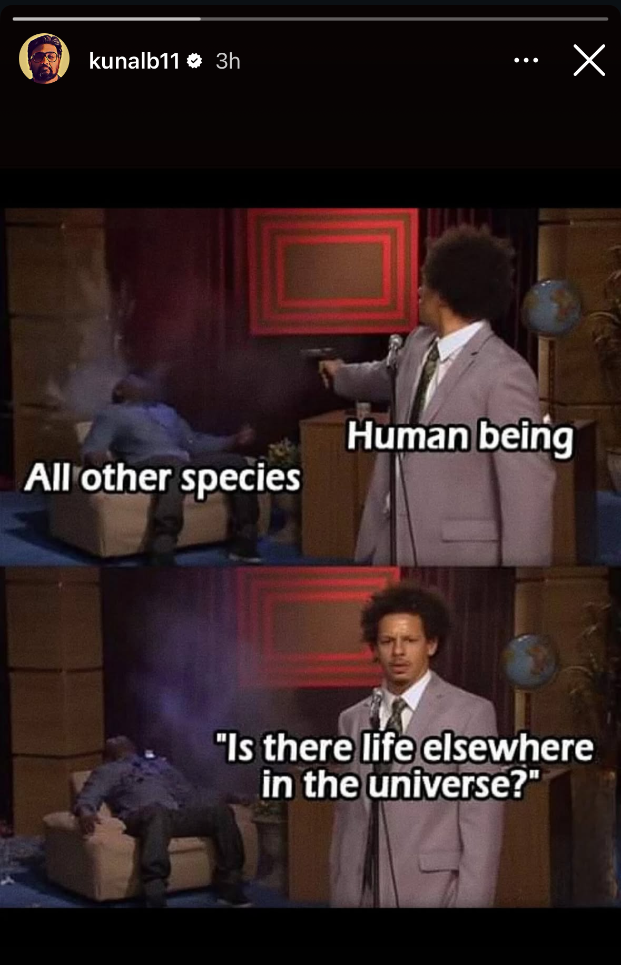
Pathos: The "Insider" Cues (Instagram)
Philosophical Jokes
Shares "smart humor" (like the Trolley Problem) that appeals to a niche, educated audience.
Shared Curiosity
Builds community not just with humor, but with shared intellectual curiosity about tech and economics.
Data-Driven Insights
Reinforces his "researcher" persona by sharing interesting data, bonding with other "nerds."

Slide 12
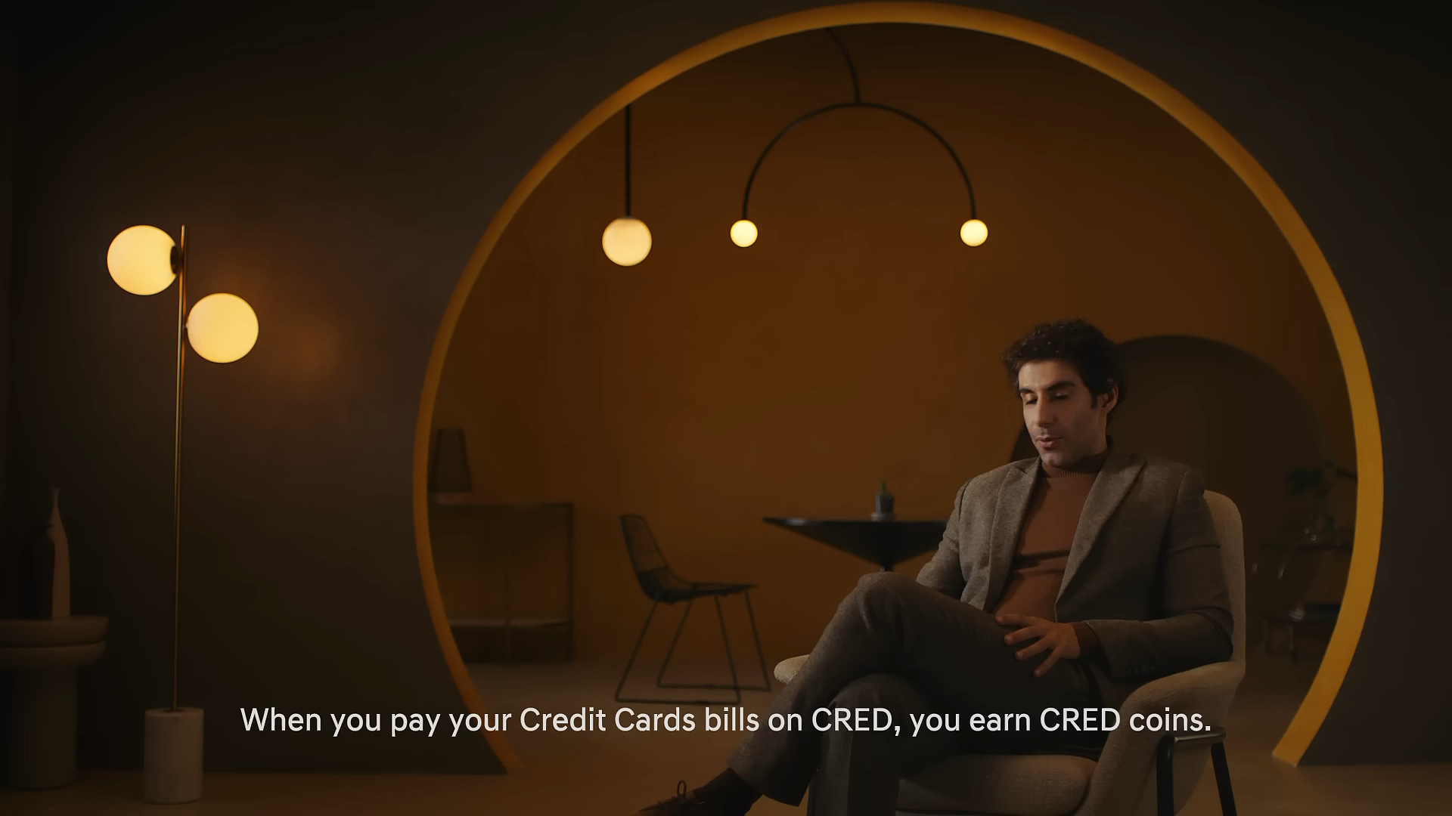
Pathos: Mass-Market Nostalgia
The "CRED Ad" Strategy
This is the second part of his "two types of ads" strategy. He targets his "Xennial" and "Millennial" base by using 90s icons (like Rahul Dravid) in absurd, "meme-able" situations.
This creates a warm, nostalgic feeling and a mainstream "buzz" event, even if the ad's "logic" is confusing. The humor *is* the message.

Slide 13
Part 2: The Proposal
The Rebranding Strategy

Slide 14
The Communication Gap
1%
The "Not Everyone Gets It" Problem
His strategy is brilliant for building an exclusive, aspirational brand for the Top 1%. But it creates a gap.
The "Exclusive" Brand
A brand that is *proud* that "not everyone gets it" cannot easily become a trusted, foundational tool for the *entire nation*.

Slide 15
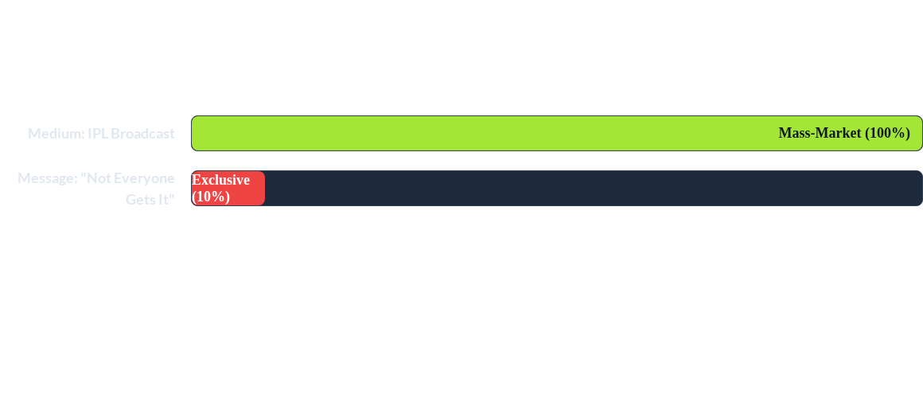
The Misalignment
He uses India's *most mass-market* medium (the IPL) to deliver his *most exclusive* message. This clash is intentional, but it reinforces the "exclusive" gap.

Slide 16
The Rebranding: The Goal
From... "The Unconventional Philosopher"
(Exclusive, Challenging, "Status")
To... "The Societal Architect"
(Inclusive, Foundational, "Trust")

Slide 17


Objective 1: Shift His Core Logic
FROM: "Status"
TO: "Trust"
His current *Logos* in podcasts and on social media is about the "zero-sum game" of status. This sounds exclusive and positions him as a thinker for the "winners" only.
He will shift his *personal narrative* to focus on "Trust" as the cornerstone of any strong economy. This reframes his mission as building a *foundational* system, which is inclusive and patriotic.

Slide 18




Objectives 2 & 3: Shift the Persona
From "Challenging" to "Connecting"
From "Exclusive" to "Ecosystem"
His LinkedIn "Kunal-isms" will evolve. Instead of just posting challenging "truths," he will focus on "connecting the dots" for his audience—showing *how* philosophy, tech, and economics create value for society.
In his interviews, *he* will introduce a new narrative that links the "high-trust core" (the 1%) to a "cascade effect" of new opportunities for the 99%, framing *his personal work* as nation-building

Slide 19
Thank You
Questions?
"The quality of your questions determines the quality of your life"
-Kunal Shah
Source: Knowledge Project podcast

